Slide 1
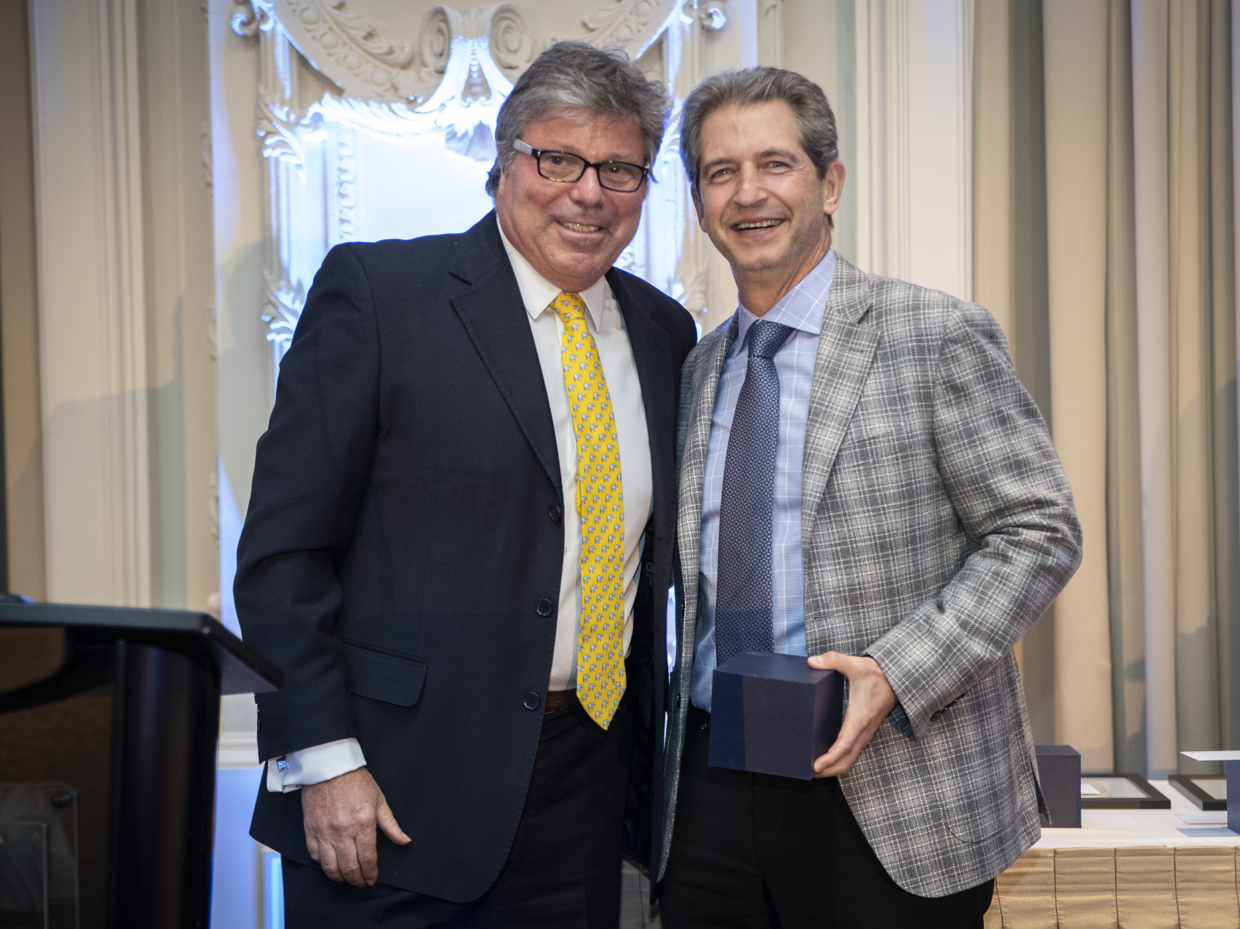
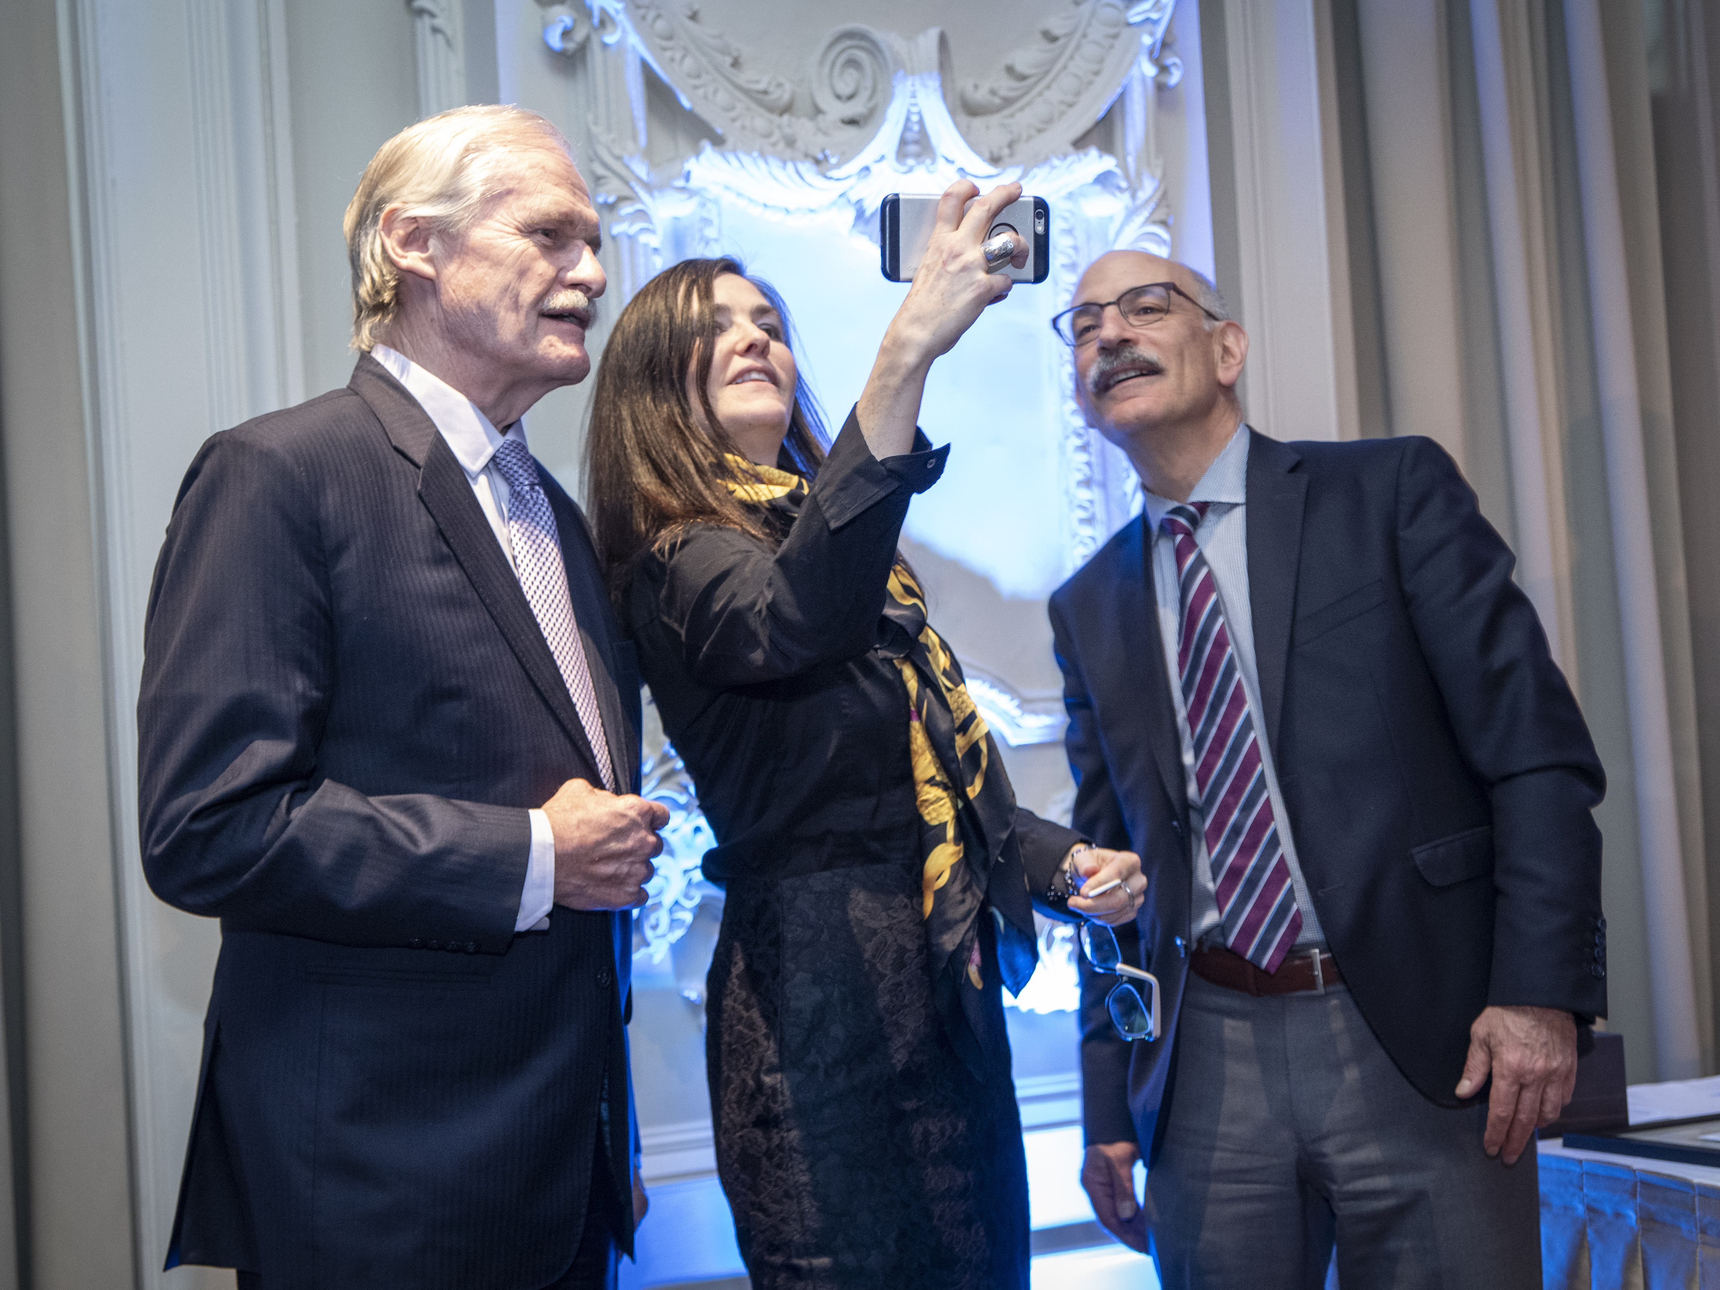
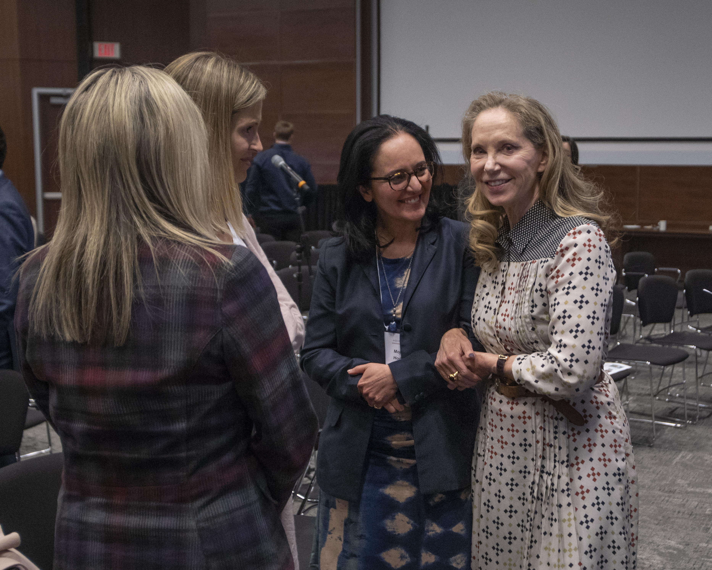
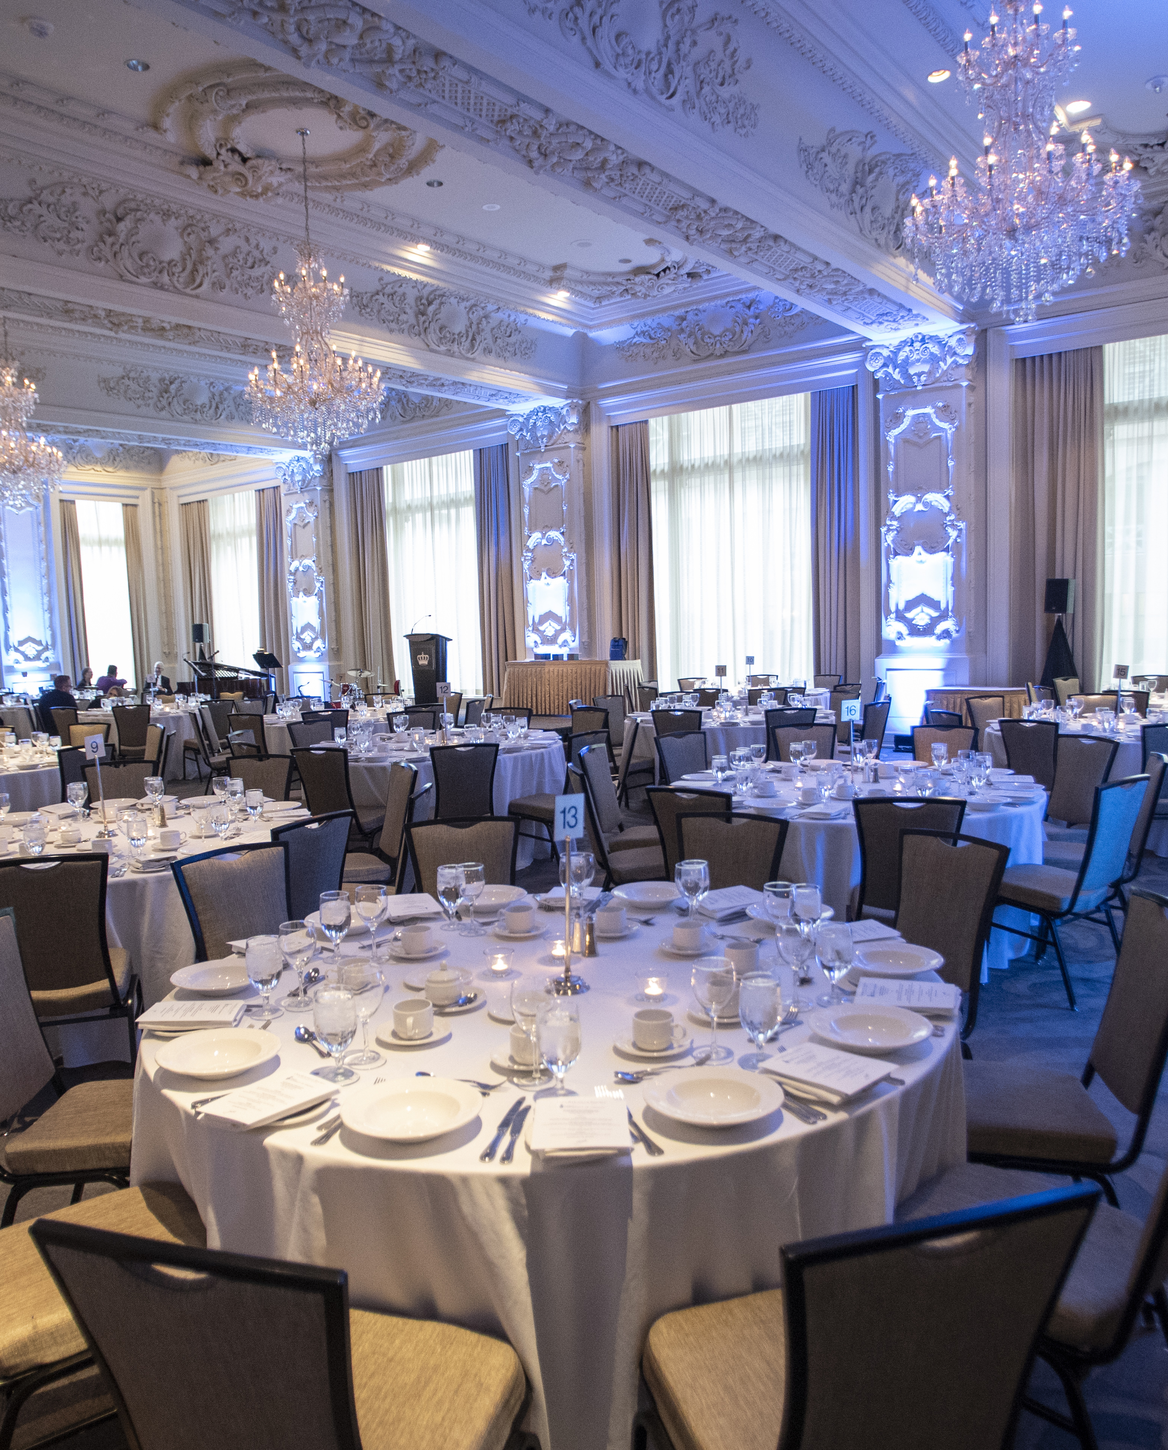
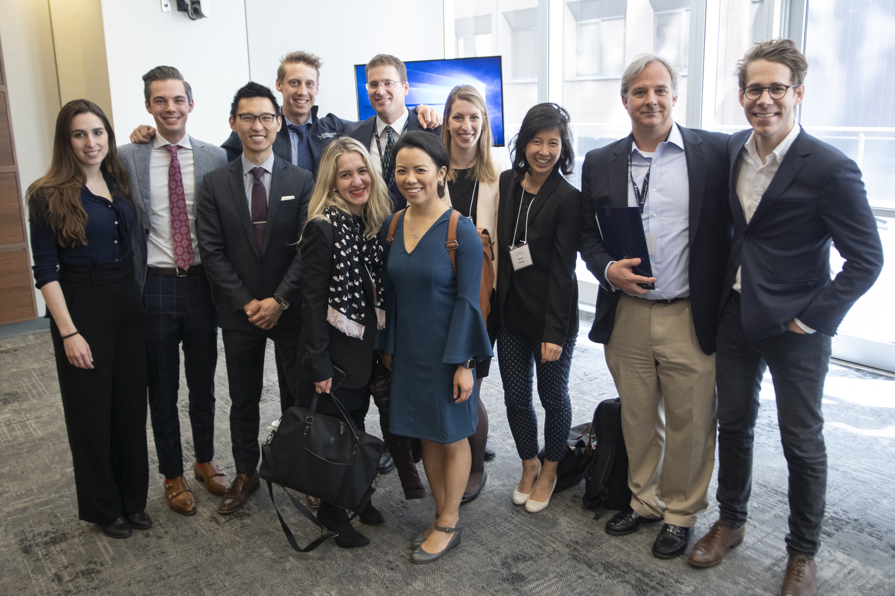
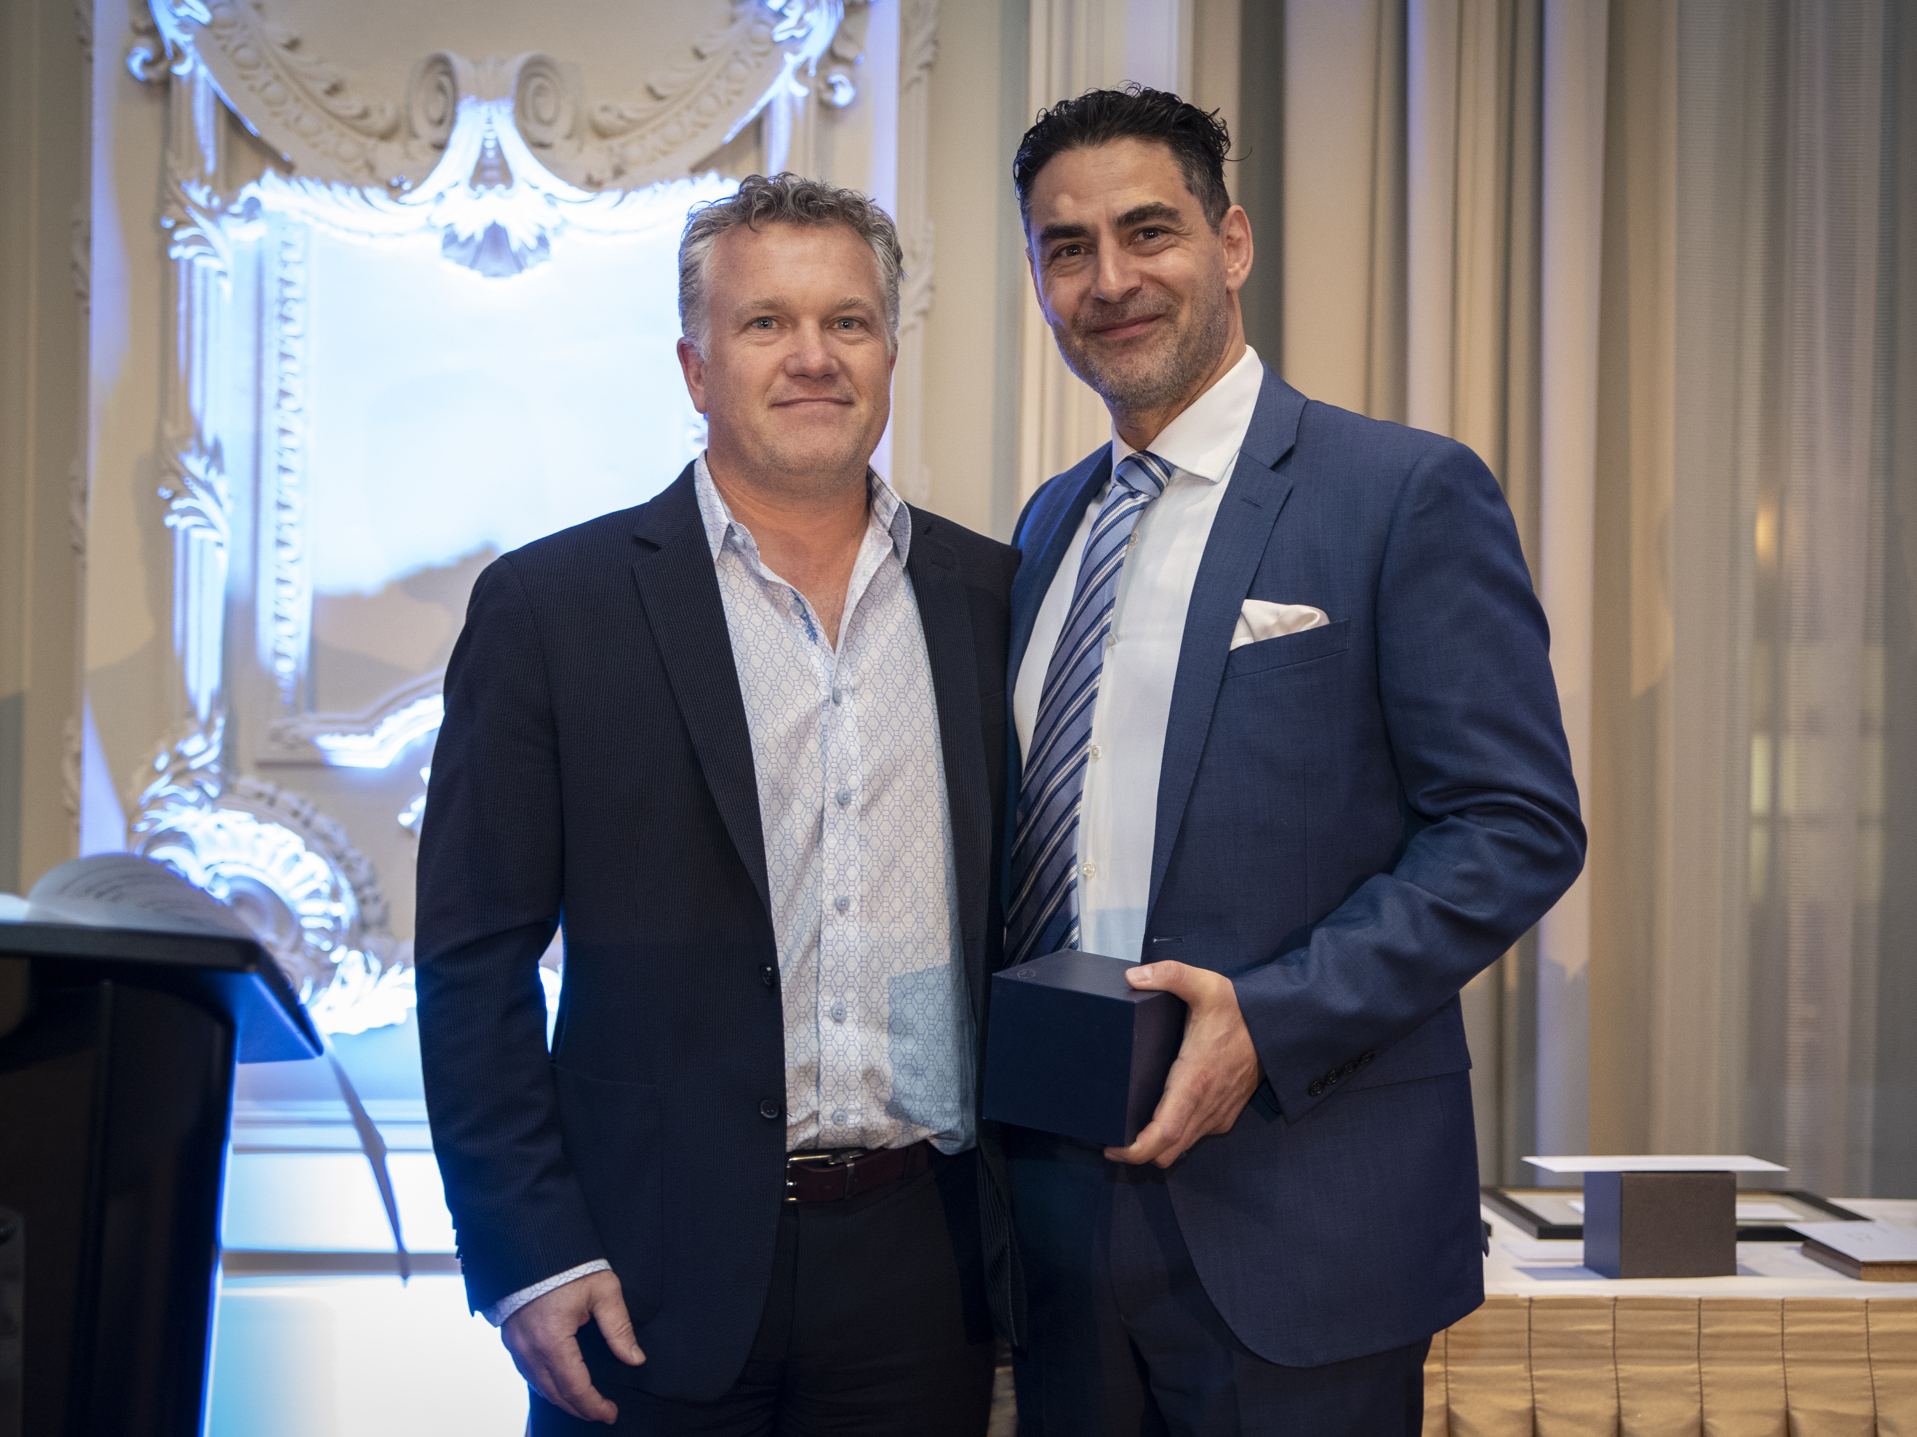
2018 GALLIE DAY celebration
Nancy Baxter Bryce Taylor Mentorship Award
Mitch Brown Tovee Postgraduate Prize
Fuad Moussa Tovee Undergraduate Prize

Slide 2
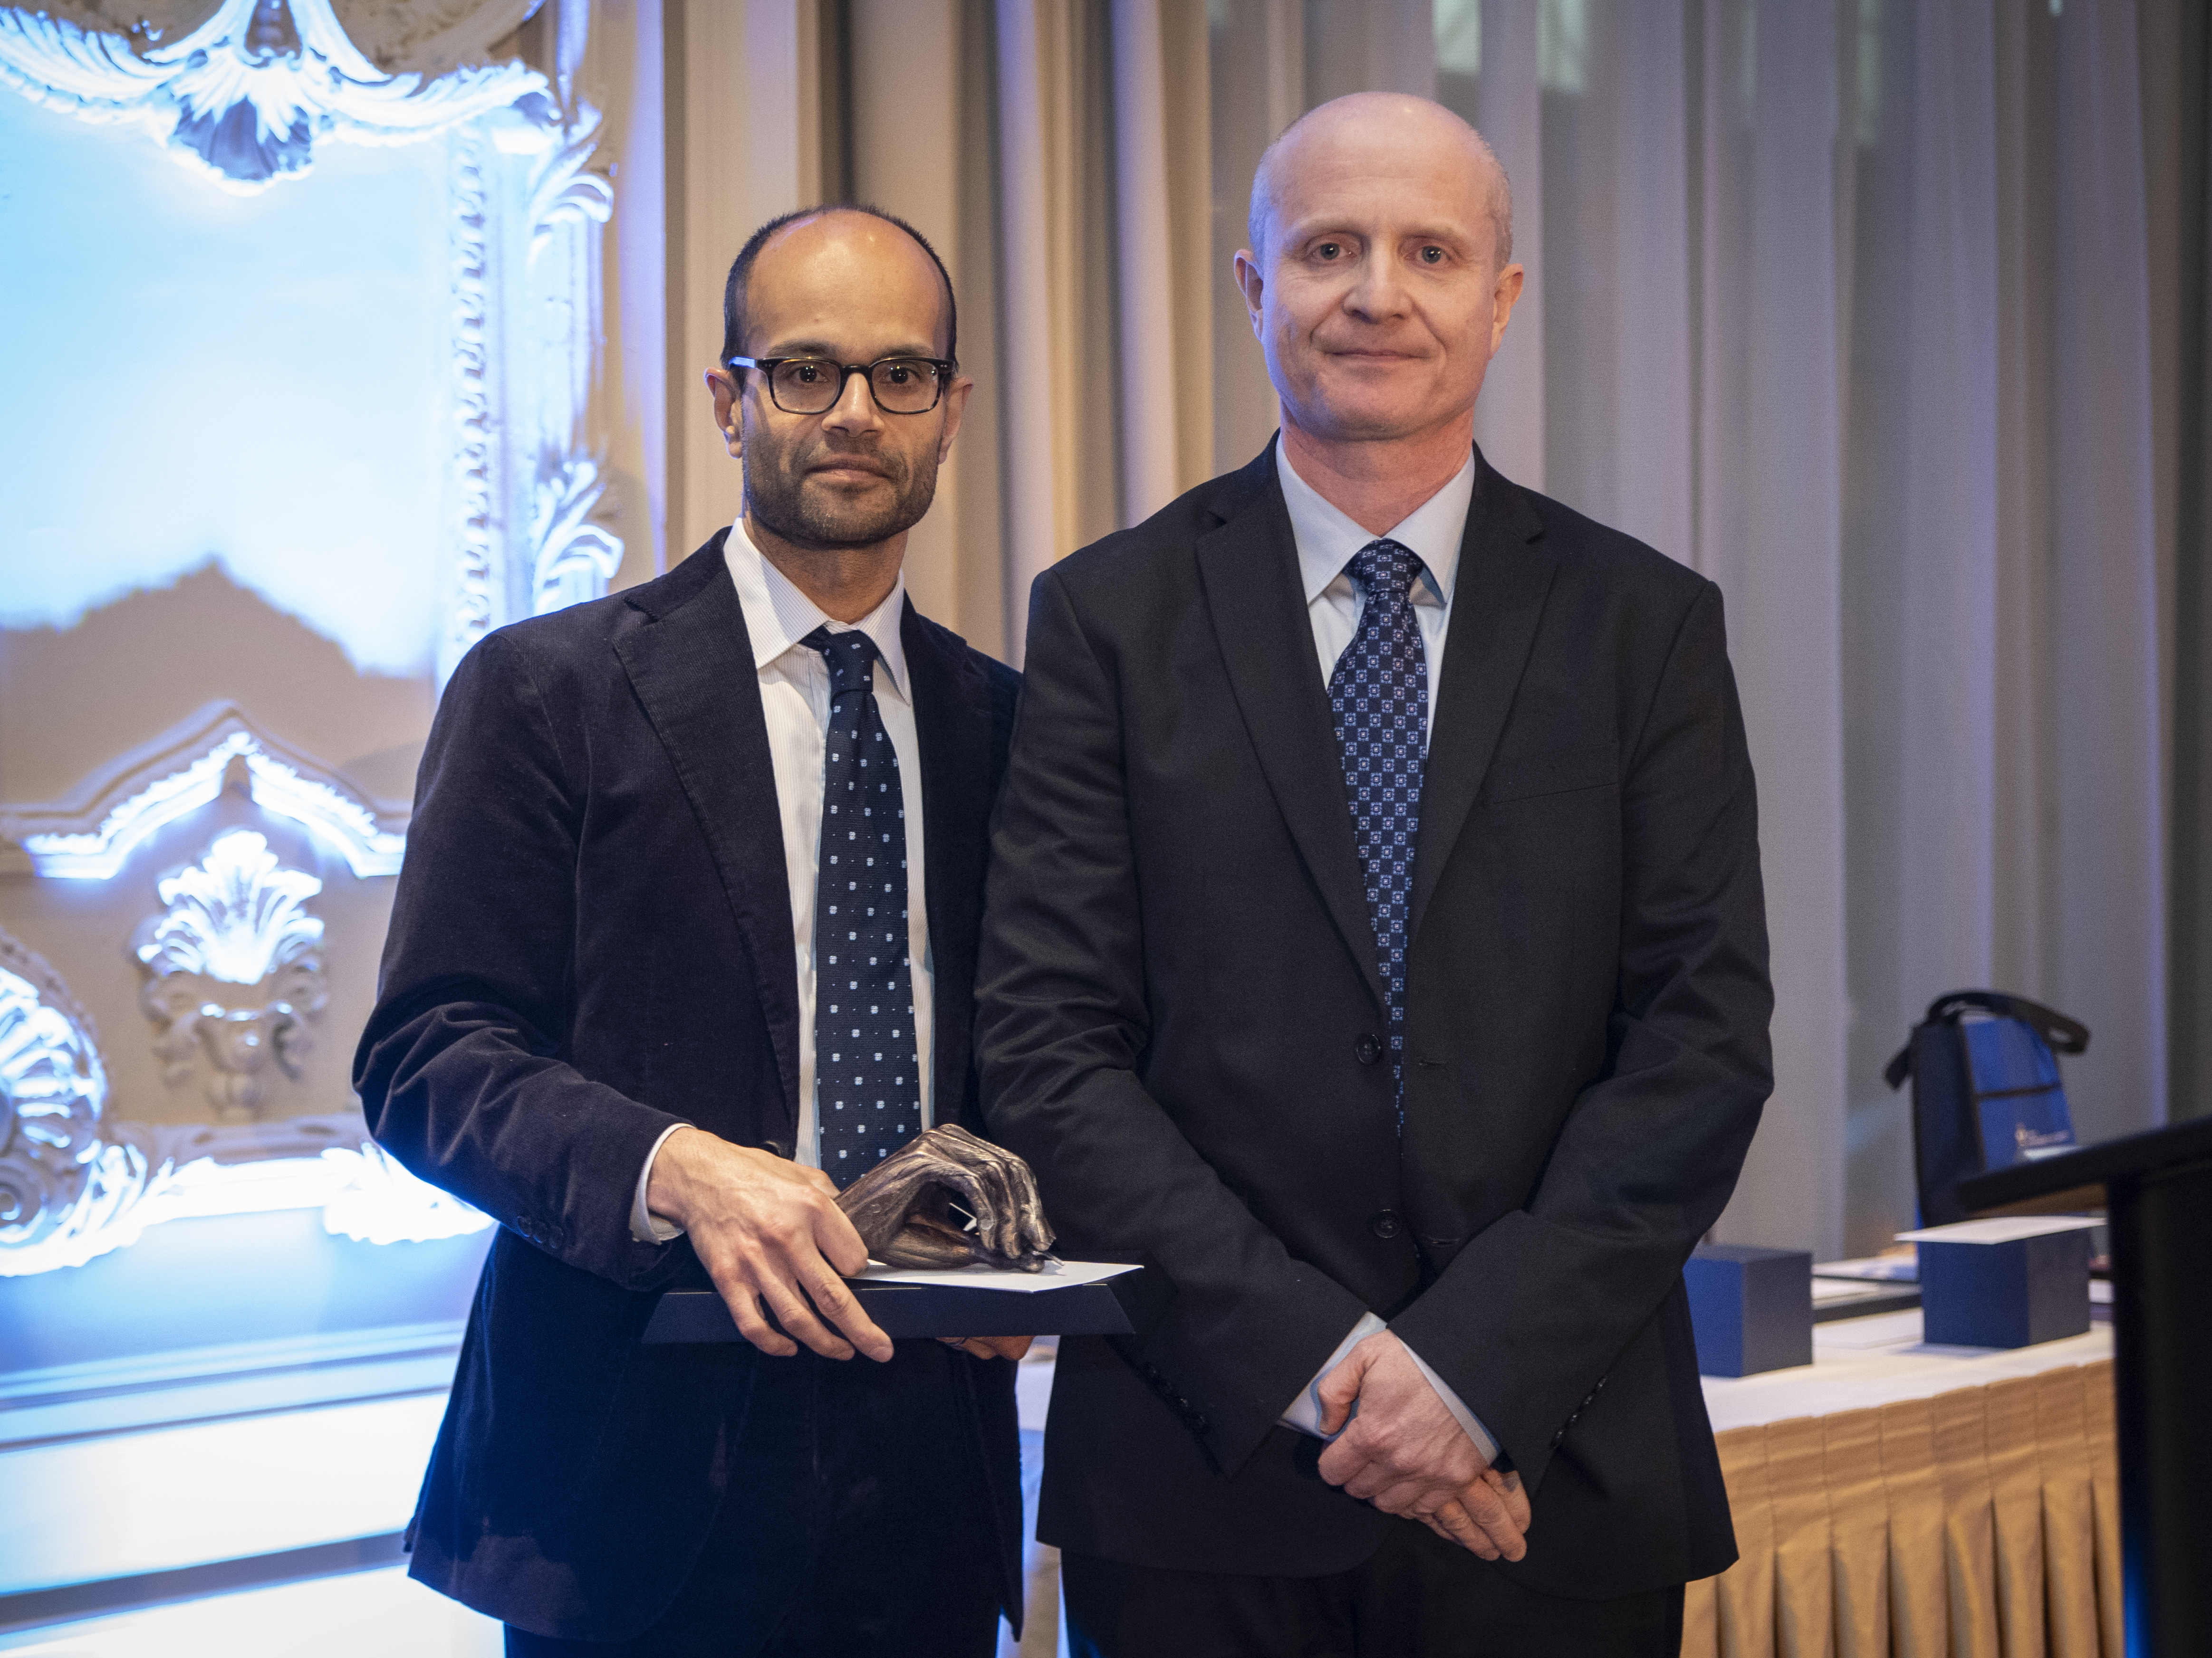
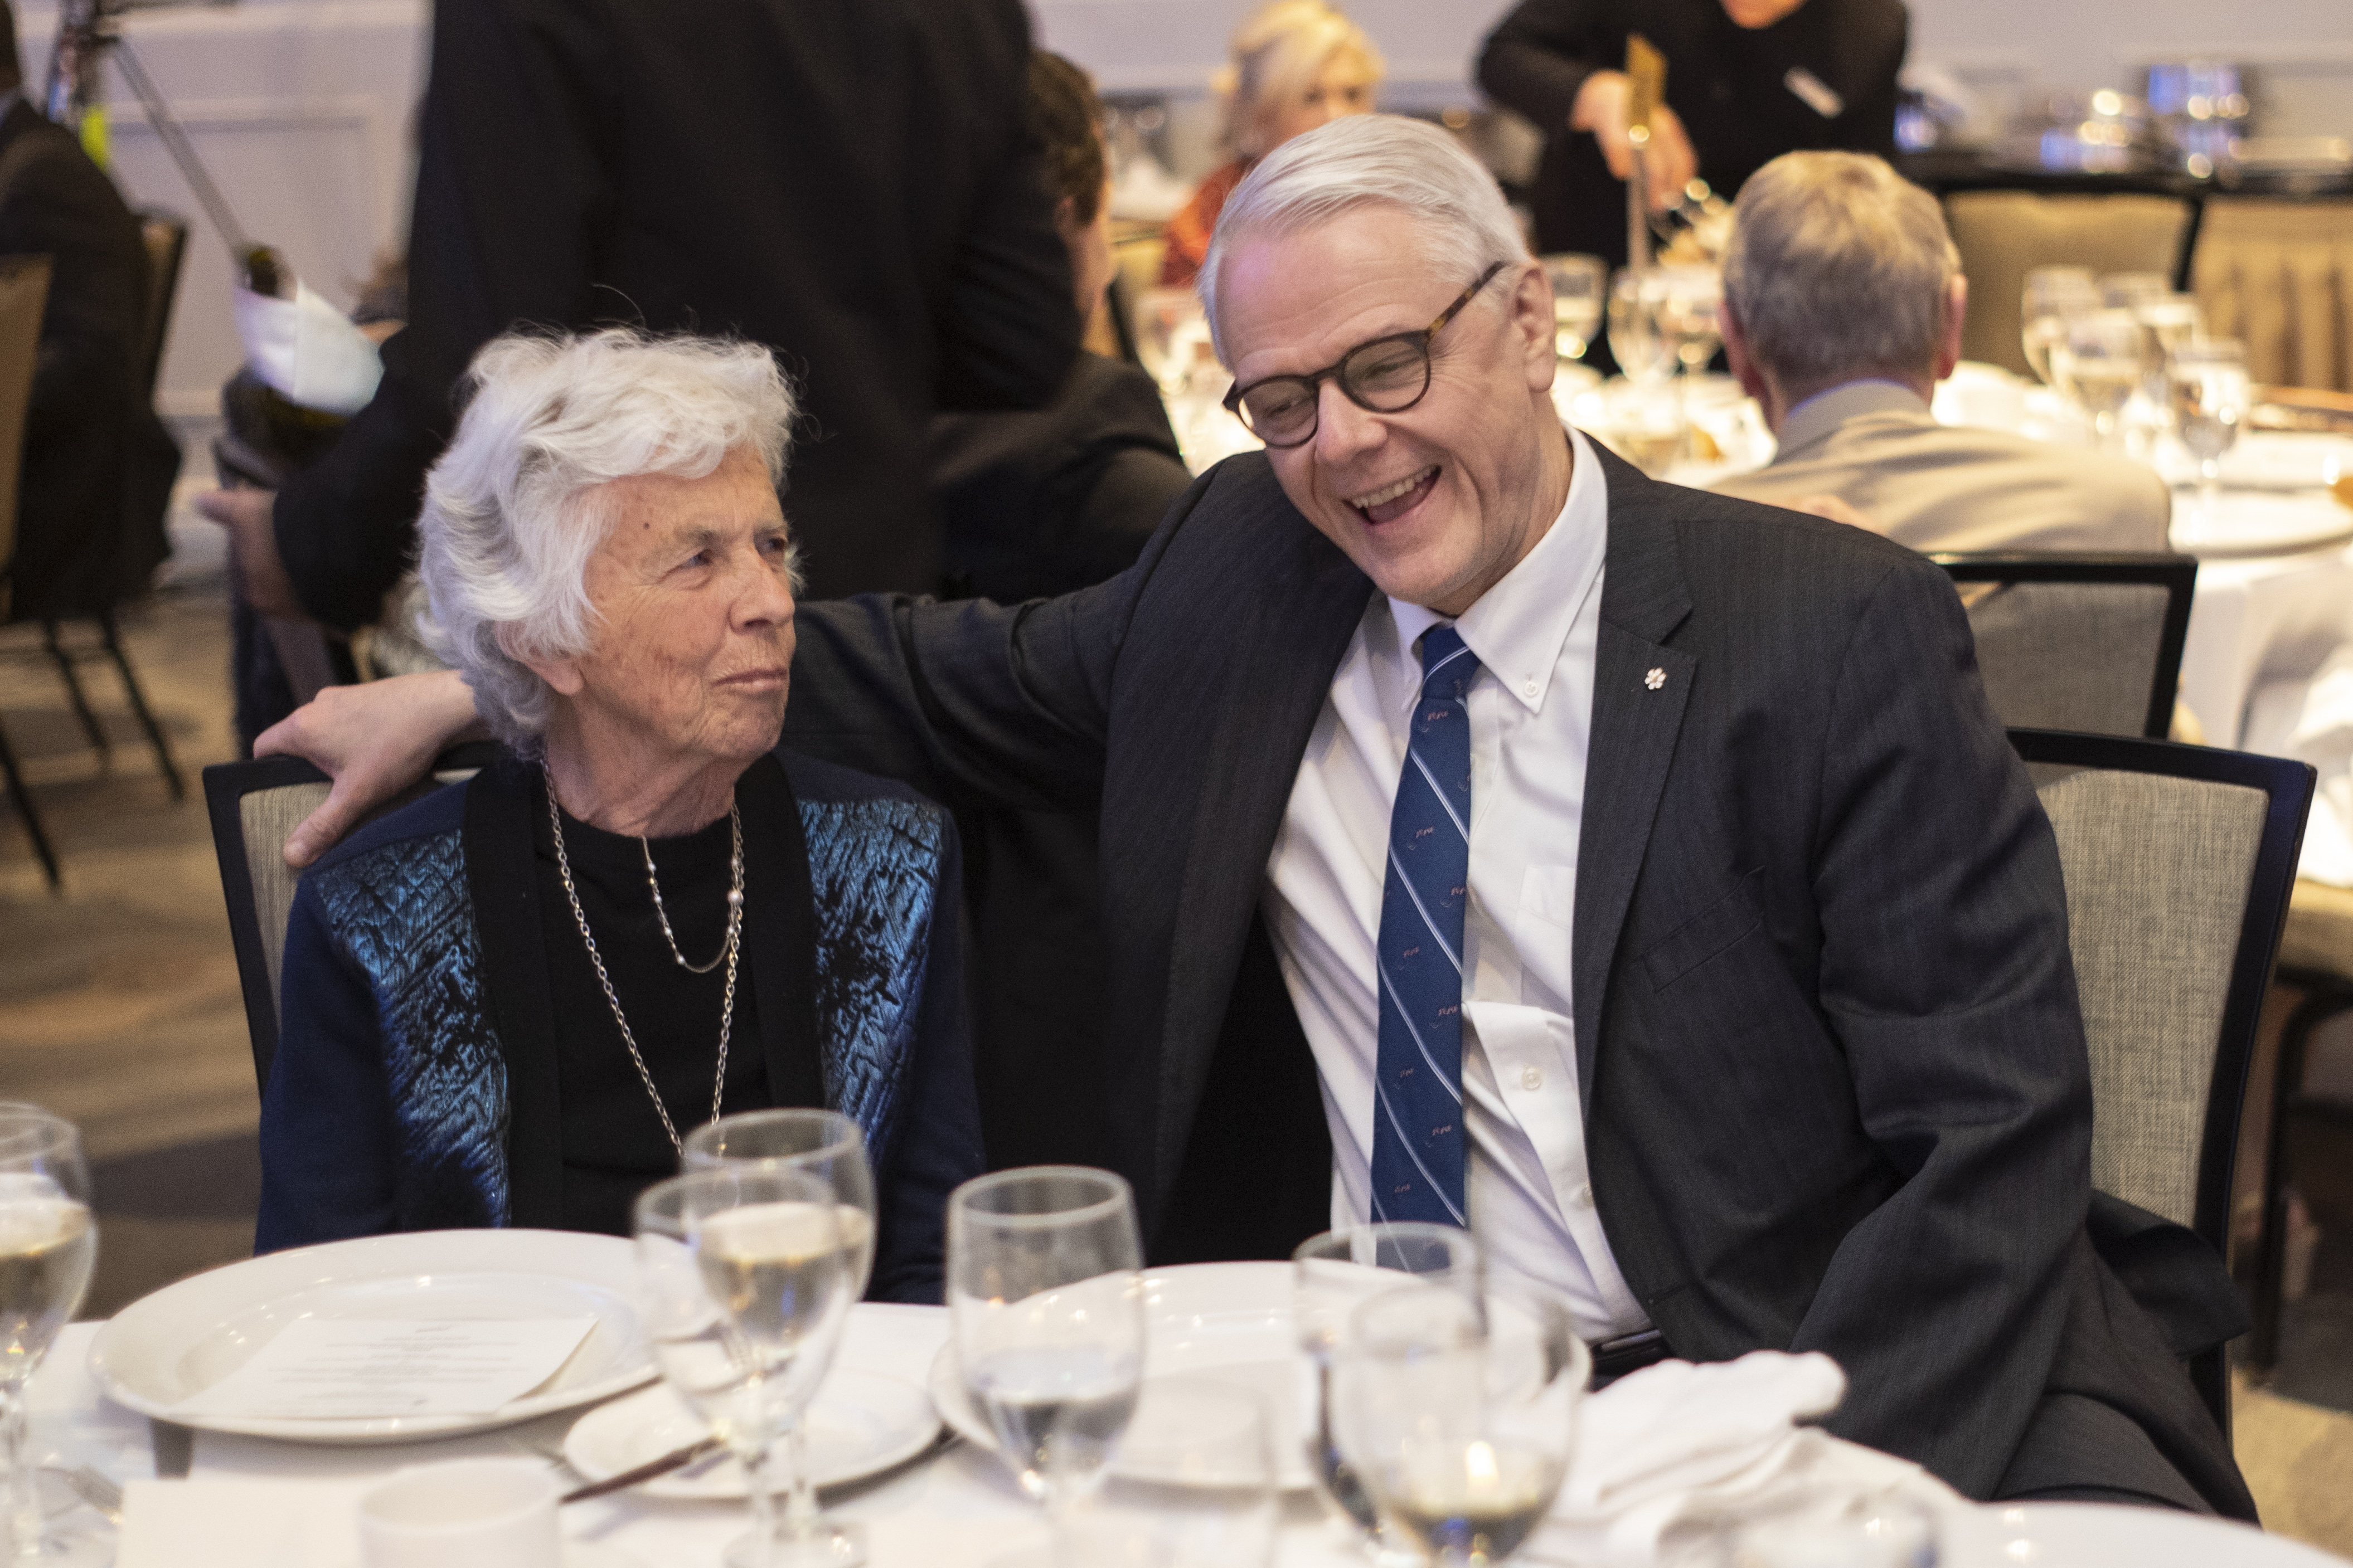
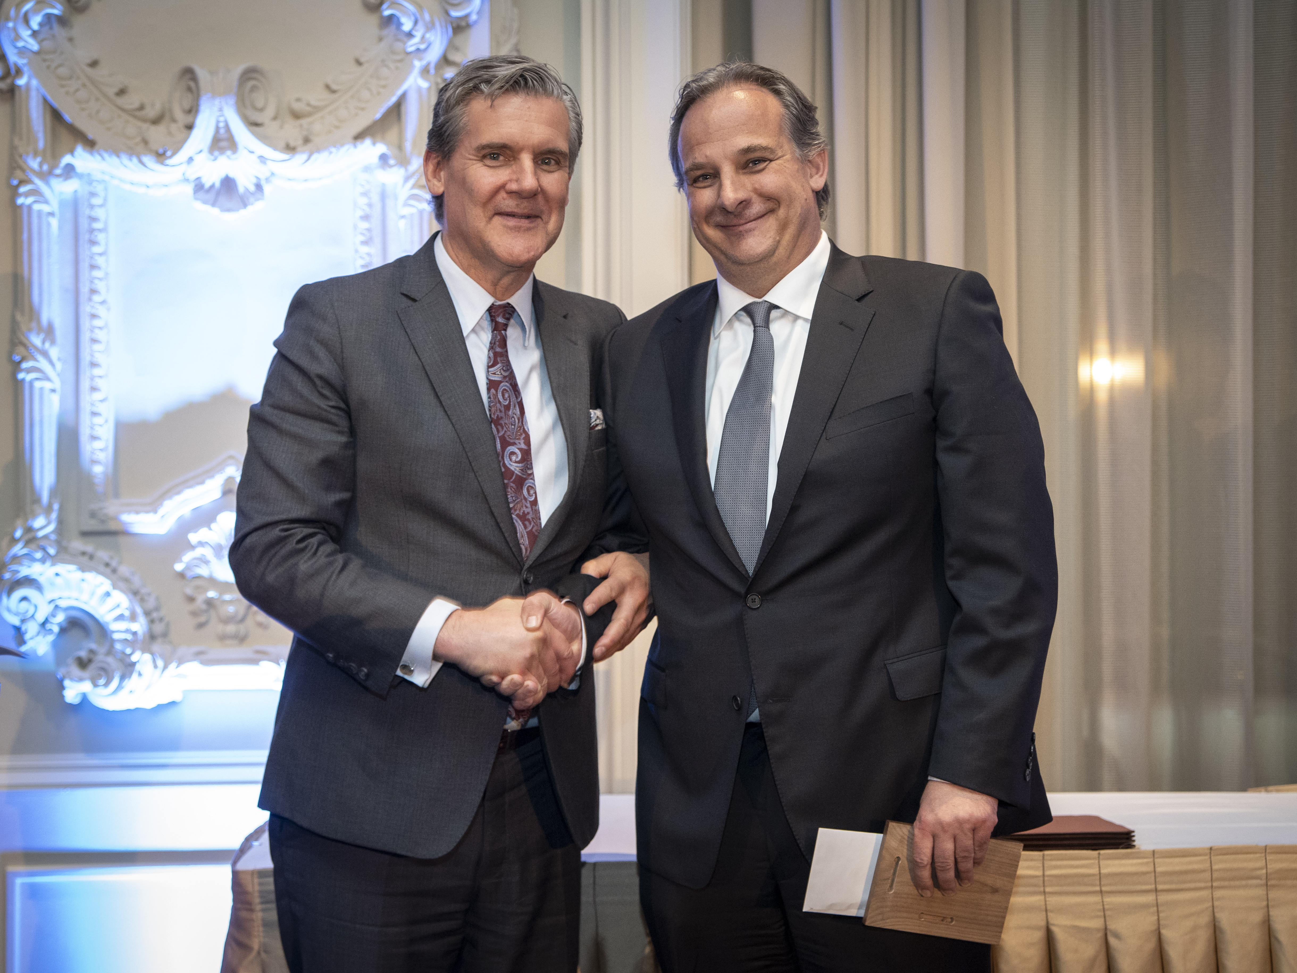
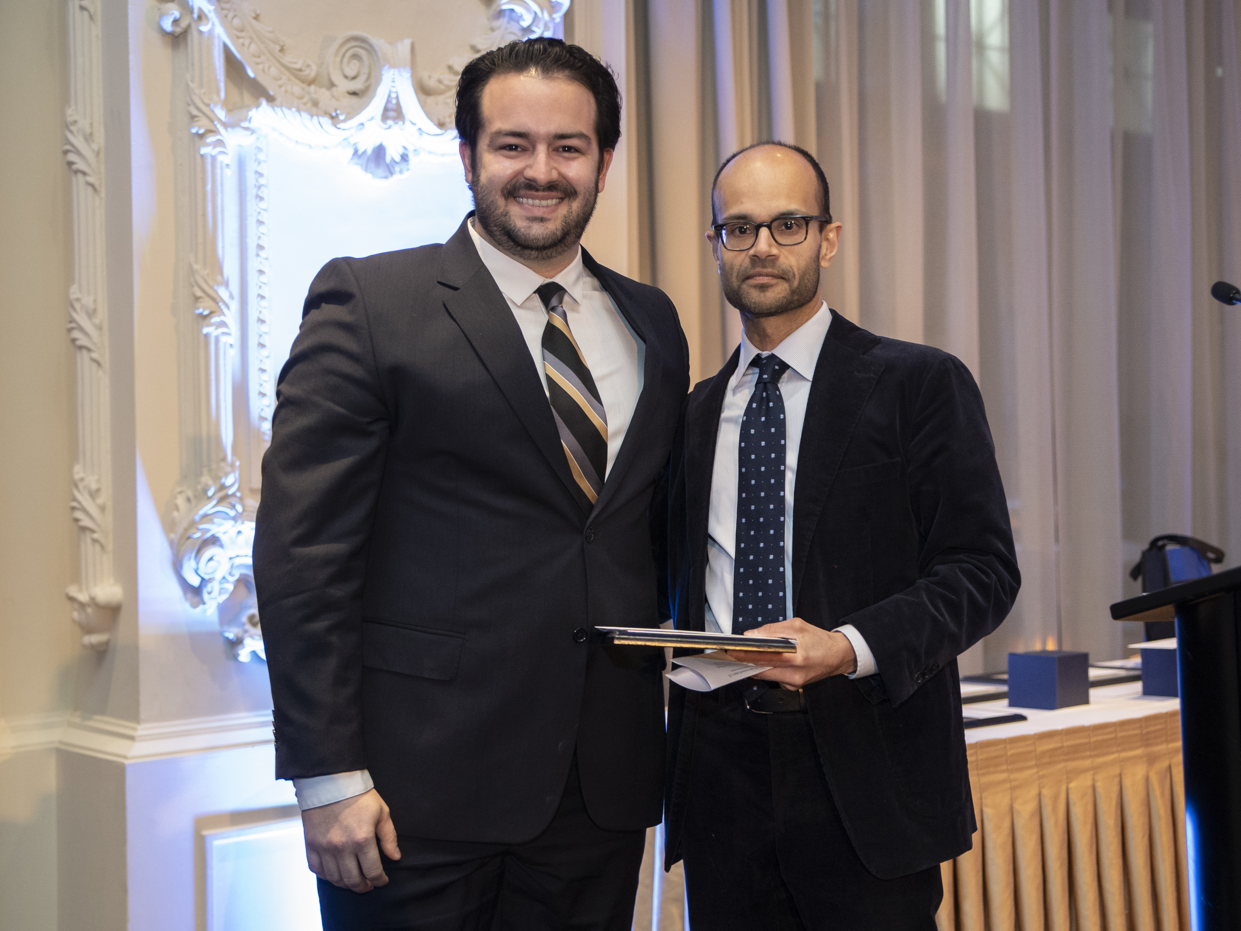
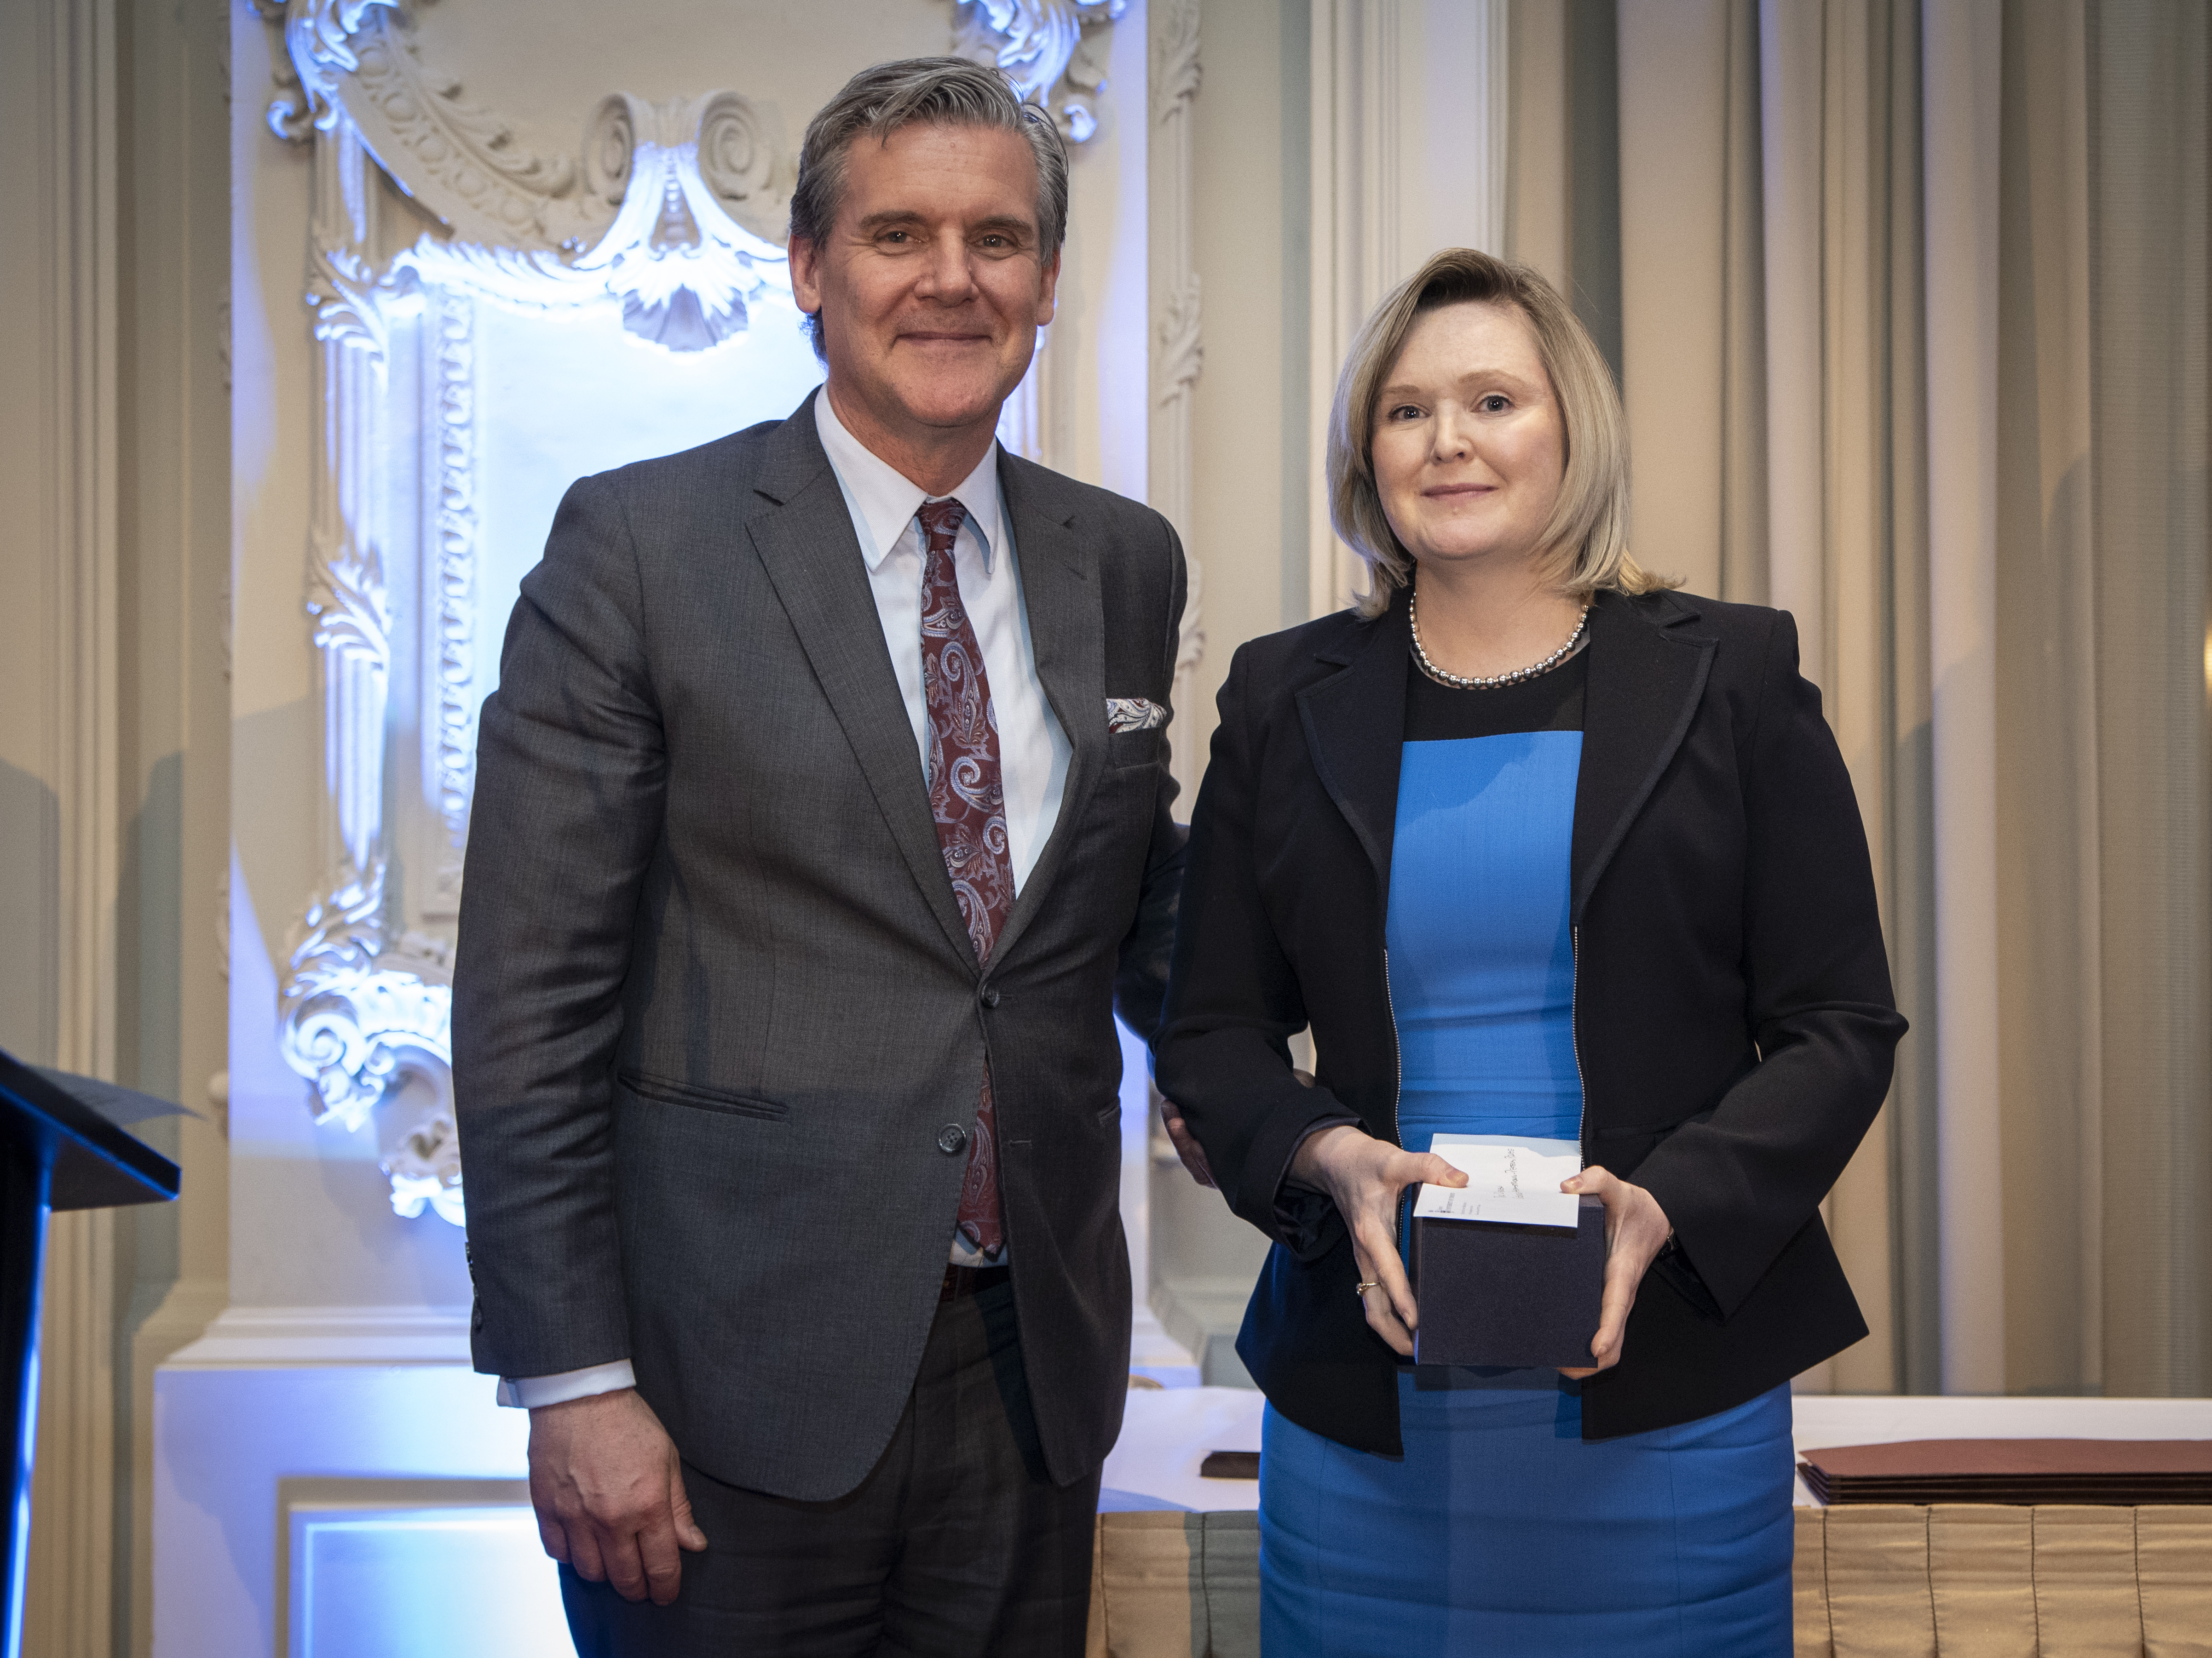
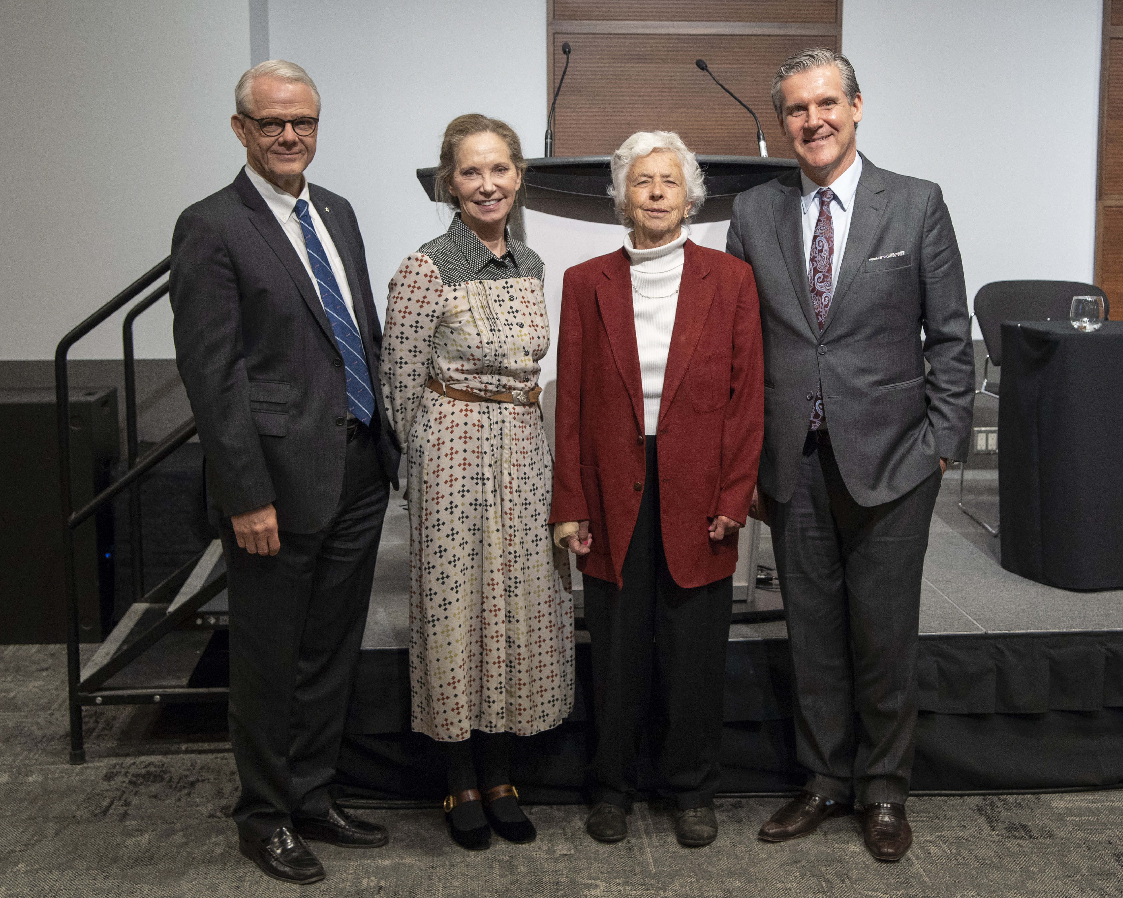
2018 GALLIE DAY celebration
Abhaya Kulkarni SSC D H Gales Outstanding Educator Award
Marc Jeschke Lister Prize
Joao Paulo de Almeida Zane Cohen Clinical Fellowship Award
Catherine O’Brien George Armstrong-Peters Prize

