Slide 1
DEPT Surgery in the news
This is Najma Ahmed. You’ve probably never heard her name before, but you should.
She’s a hero.

Slide 2
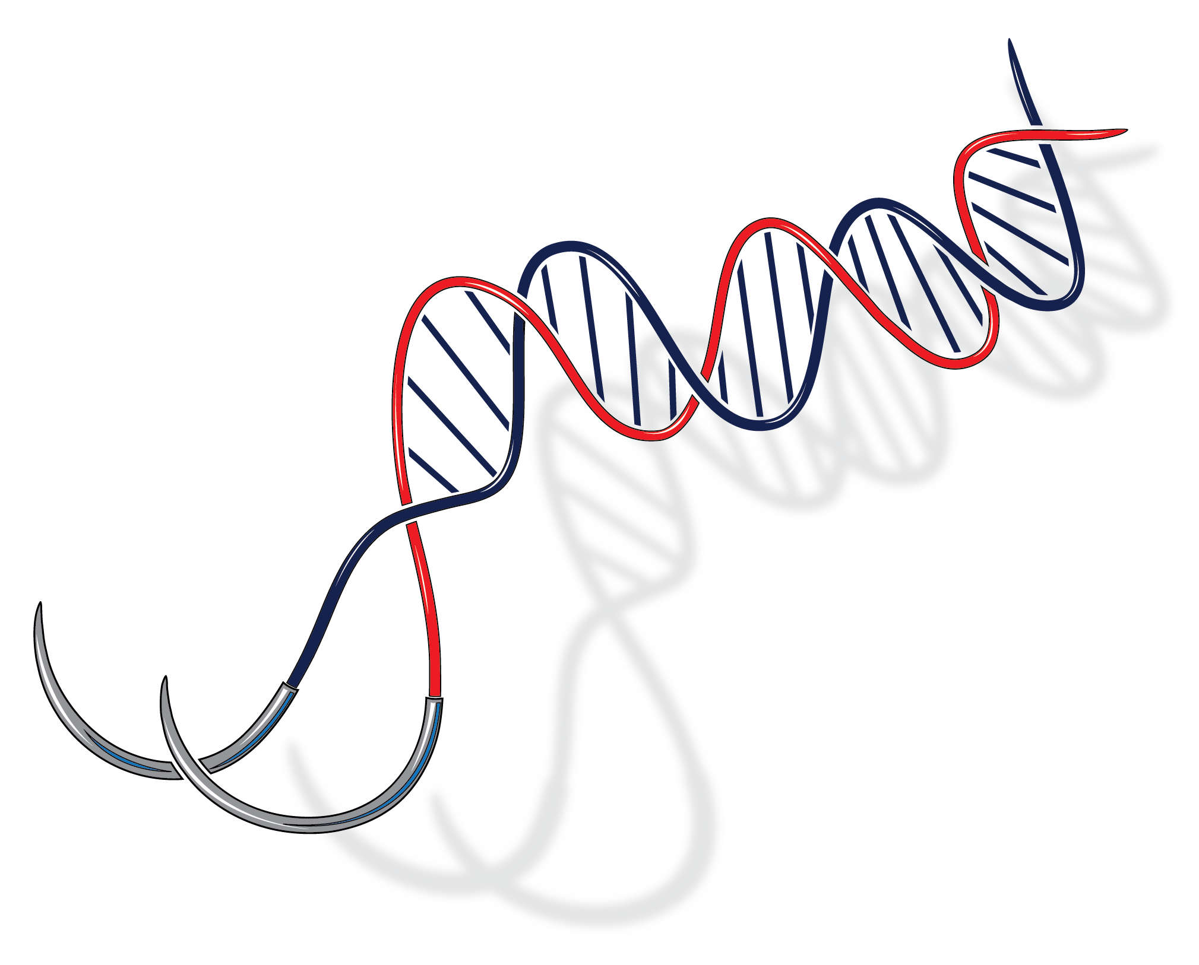
University of Toronto Department of Surgery
Annual Address 2018
COMING YOUR WAY in 2018-19!

Slide 3
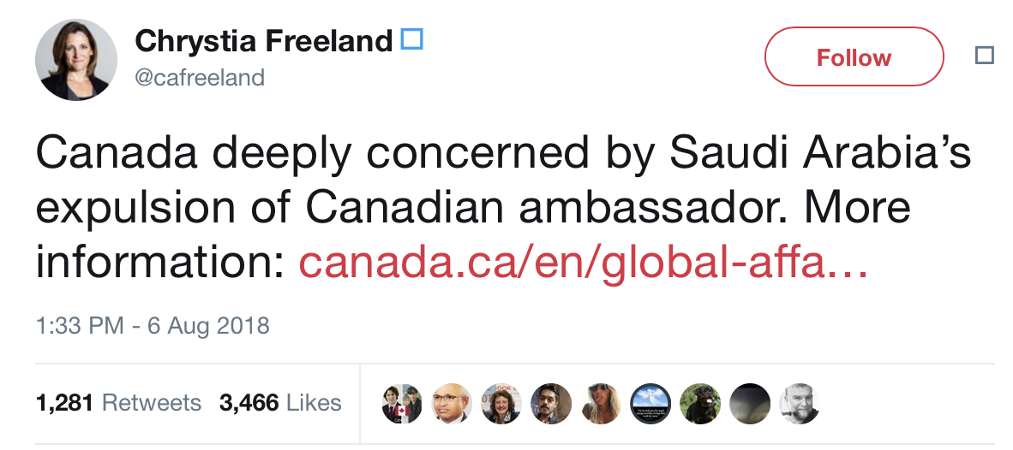
University of Toronto Department of Surgery
Annual Address 2018
IMPACT OF A TWEET!
potential loss of trainees from saudi arabia

Slide 4
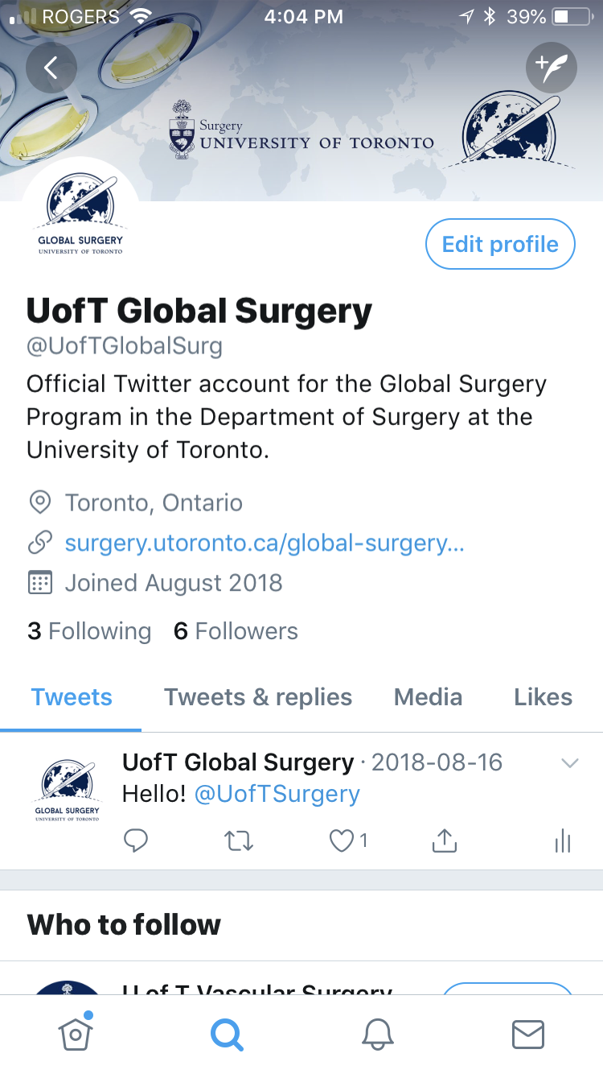
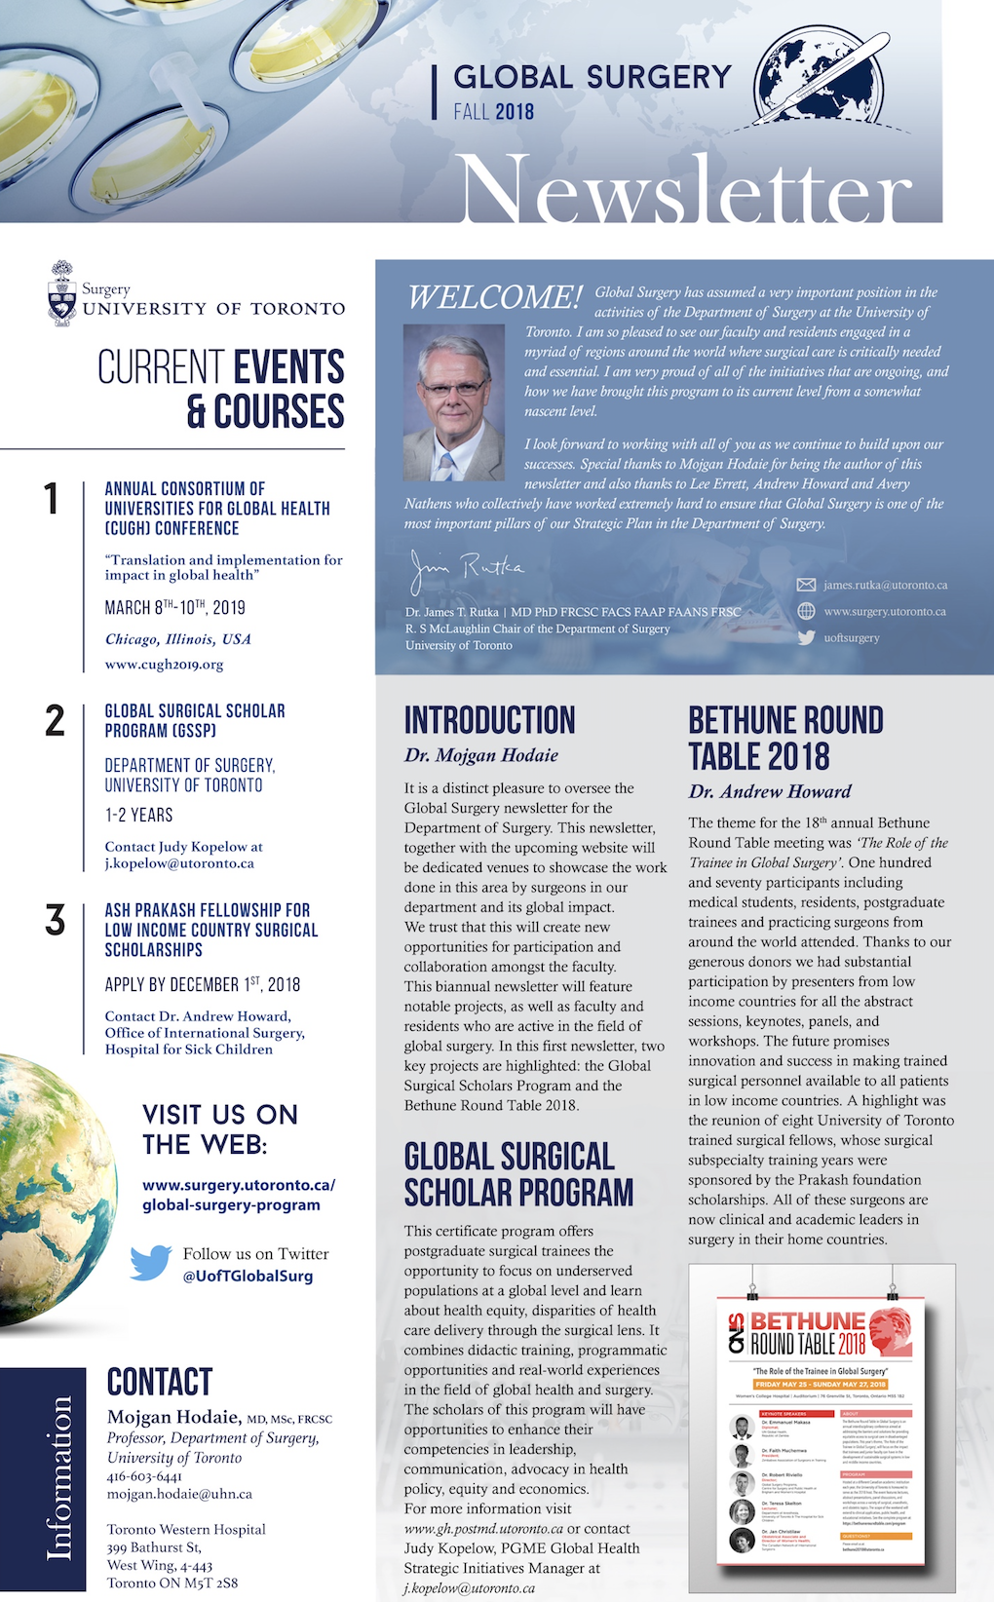
Global Surgery IS NOW on Twitter

Slide 5
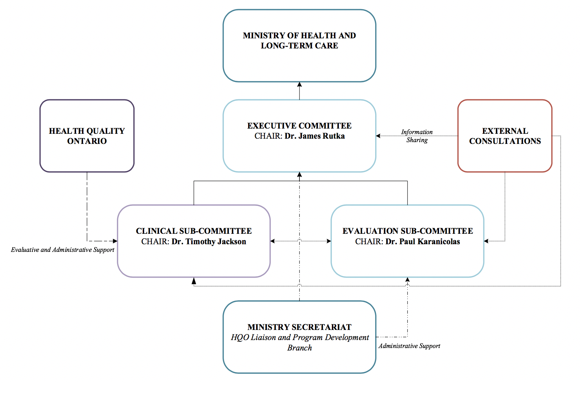
University of Toronto Department of Surgery
Annual Address 2018
SURGICAL INNOVATION PROGRAM - MOHLTC

Slide 6
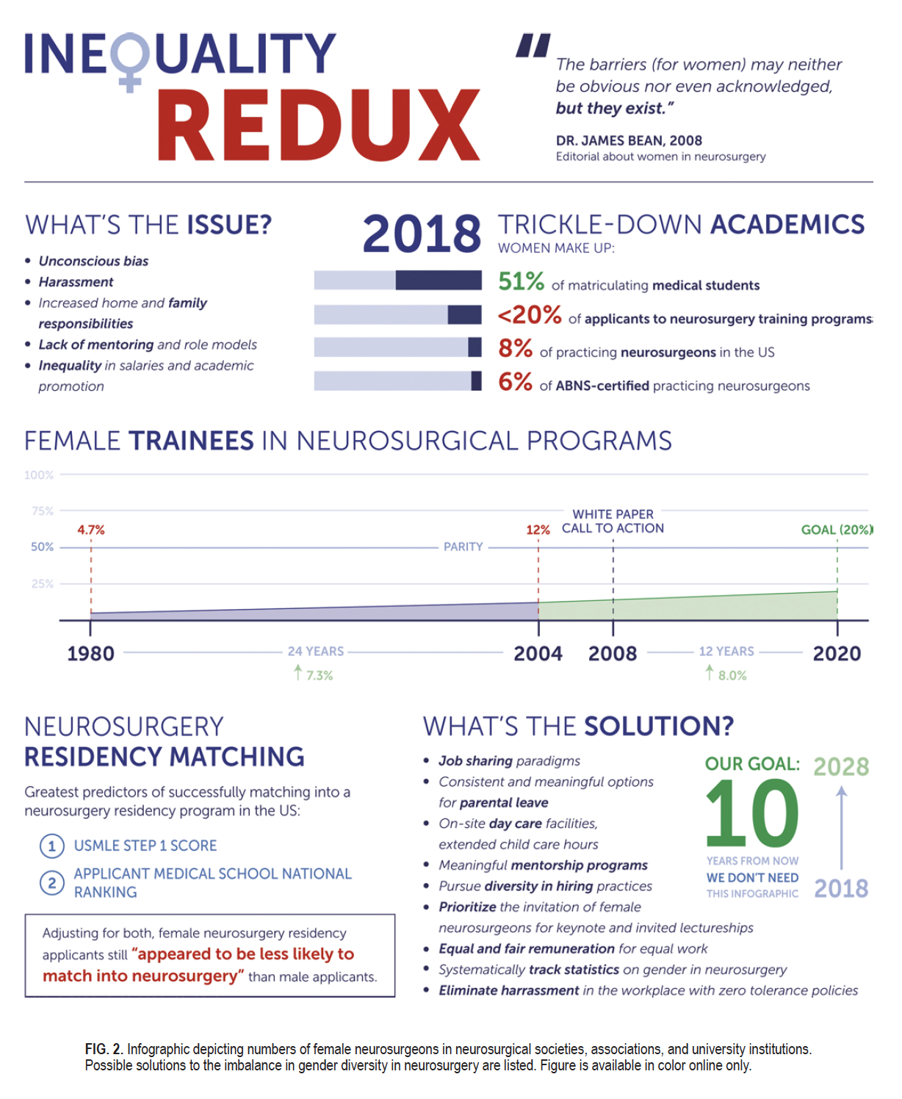
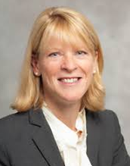
University of Toronto Department of Surgery
Annual Address 2018
COMING YOUR WAY…
Career Advancement in Surgery:
Focus on Issues of Gender
Thursday October 4, 2018
Li Ka Shing Knowledge Institute, St. Michael’s Hospital
Featuring an Address by:
Dr. Gillian Hawker
Sir John & Lady Eaton professor & Chair of the Department if Medicine, University of Toronto

Slide 7
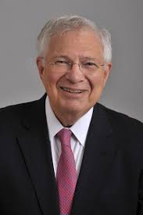
University of Toronto Department of Surgery
Annual Address 2018
COMING YOUR WAY…
Balfour Lecture
Monday October 15, 2018
Women’s College Hospital
Featuring an Address by:
Dr. Mark Siegler
Lindy Bergman Distinguished Service Professor of Medicine and Surgery
Executive Director, Bucksbaum Institute for Clinical Excellence
Director, MacLean Center for Clinical Medical Ethics

Slide 8
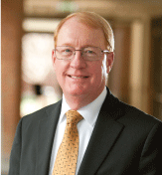
University of Toronto Department of Surgery
Annual Address 2018
COMING YOUR WAY…
Faculty Development Day
Theme: Patient Safety, Quality Improvement and Risk Prevention
Monday November 12, 2018
Hart House, Great Hall
Keynote Speaker:
Dr. Gerald B. Hickson
Senior Vice-President
Quality, Safety, and Risk PreventionVanderbilt University Medical Center

Slide 9
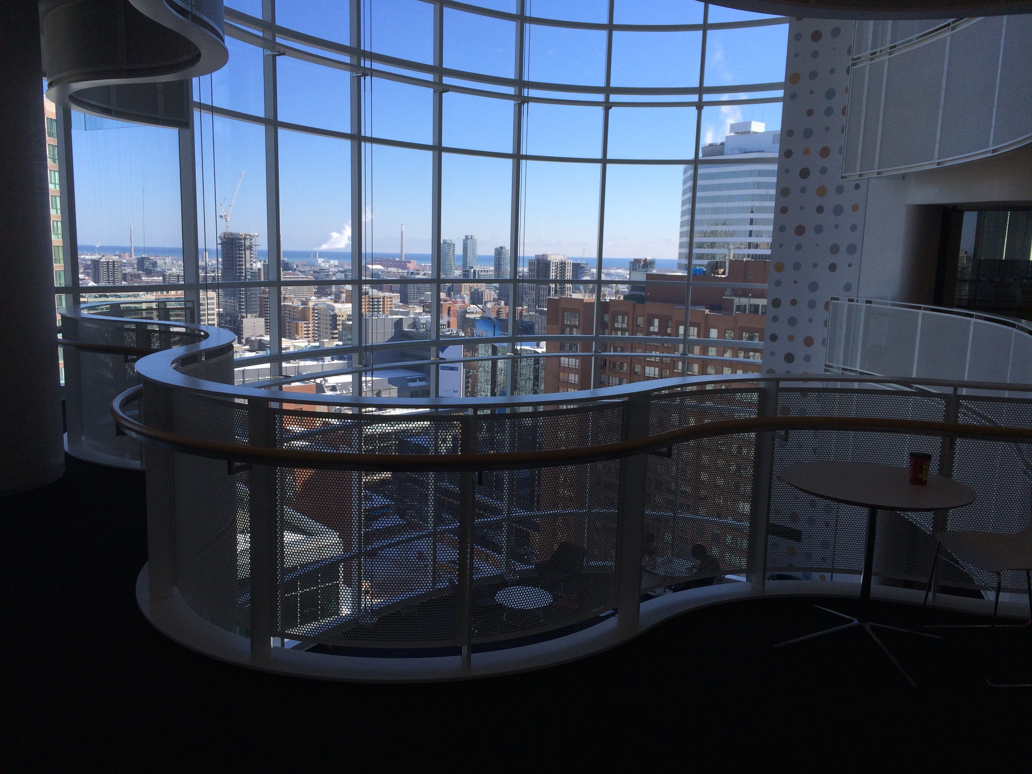
University of Toronto Department of Surgery
Annual Address 2018
COMING YOUR WAY…
HOLIDAY SEASON GATHERING
PGCRL SICK KIDS HOSPITAL - ATRIUM
THURSDAY DECEMBER 6, 2018
FAMILY, CHILDREN AND FRIENDS ALL WELCOME TO ATTEND!

Slide 10
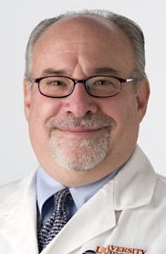
University of Toronto Department of Surgery
Annual Address 2018
COMING YOUR WAY…
Kergin Lecture
Thursday February 8, 2019
Li Ka Shing Knowledge Institute, St. Michael’s Hospital
Dr. Kenneth Brayman
Professor of Surgery, Medicine and Biomedical Engineering
University of Virginia
Director, Kidney, Pancreas and Islet Transplant Programs
Director, Center for Cellular Therapy and Biologic Therapeutics

Slide 11
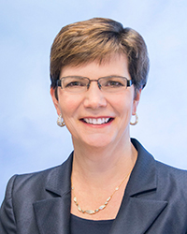
University of Toronto Department of Surgery
Annual Address 2018
COMING YOUR WAY…
2019 Gallie Day
Gordon Murray Lecturer
Dr. Diane M. Simeone
Laura and Isaac Perlmutter Professor of Surgery and Pathology
Director, Pancreatic Cancer Center
Associate Director of Translational Research
NYU Langone Health
Thursday February 8, 2019
Peter Gilgan Centre for Research in Education

Slide 12
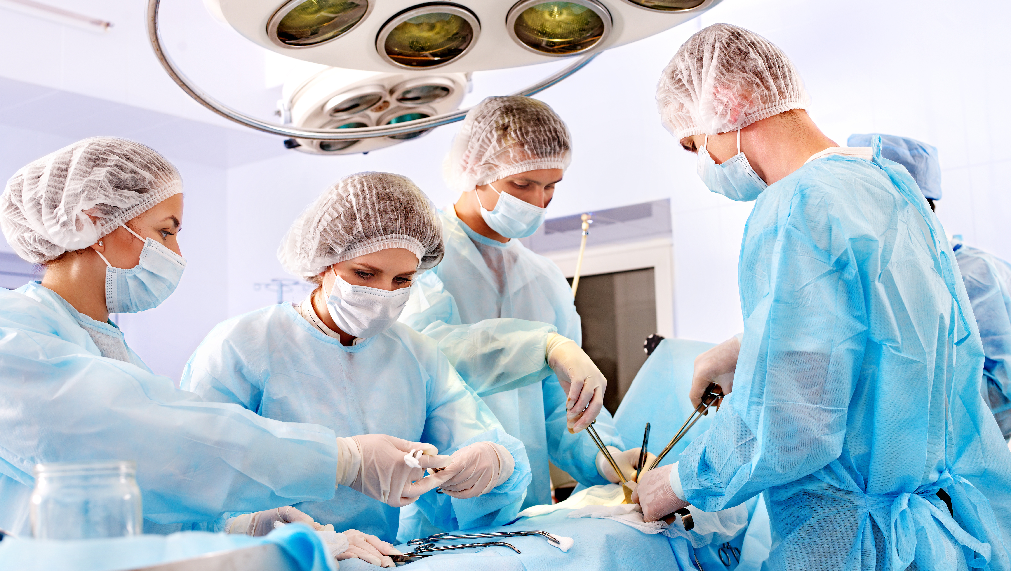
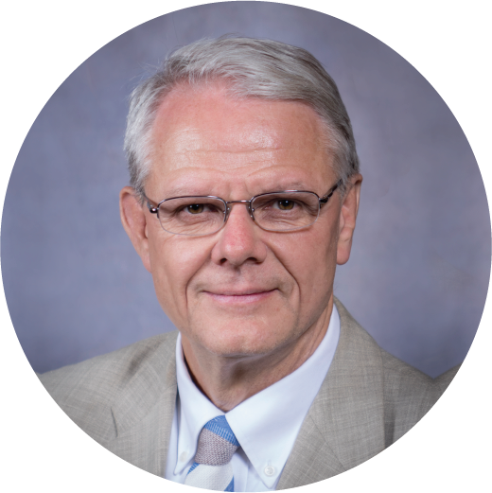
Thank you!
james.rutka@utoronto.ca
james.rutka@utoronto.ca
surgery.utoronto.ca
surgery.utoronto.ca
@
uoftsurgery
uoftsurgery

