Slide 1
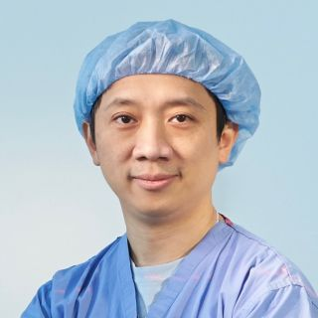
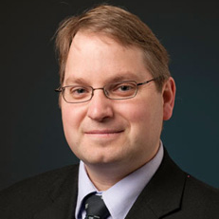
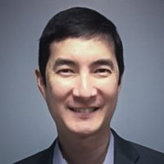
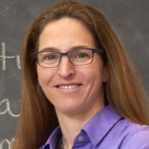
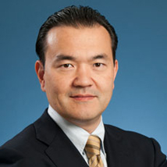
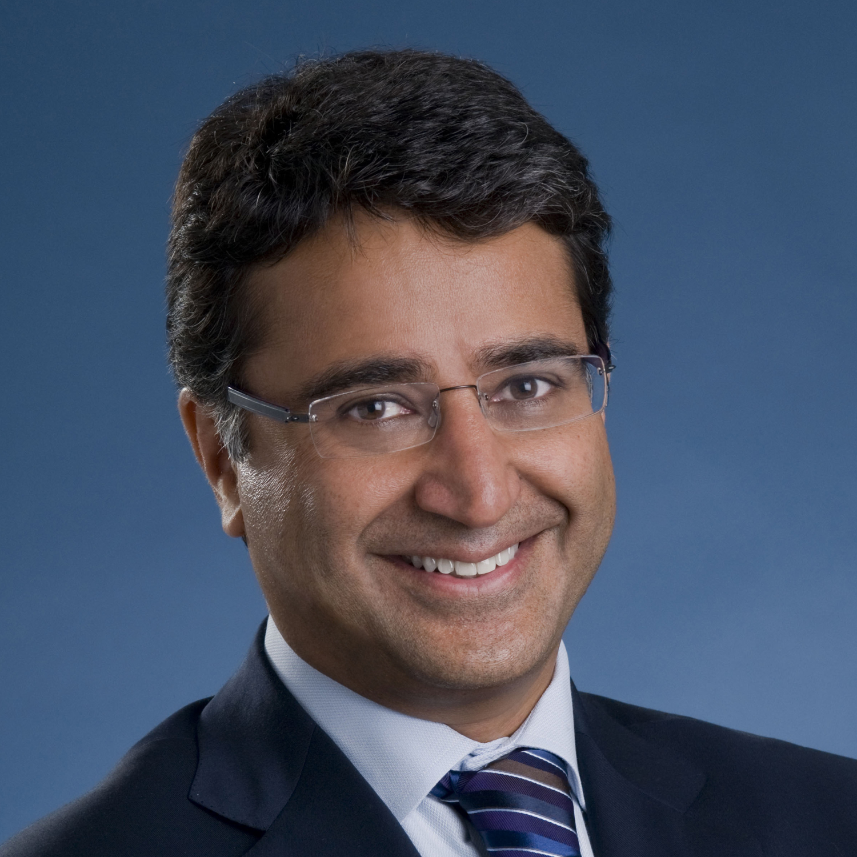
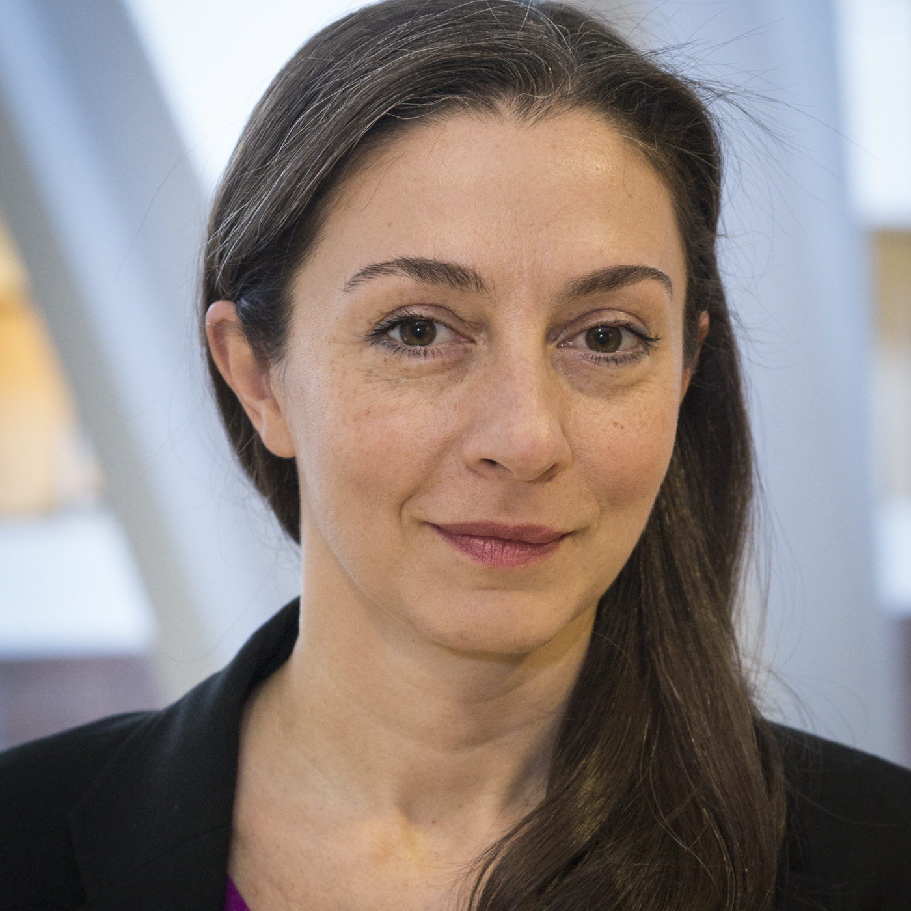
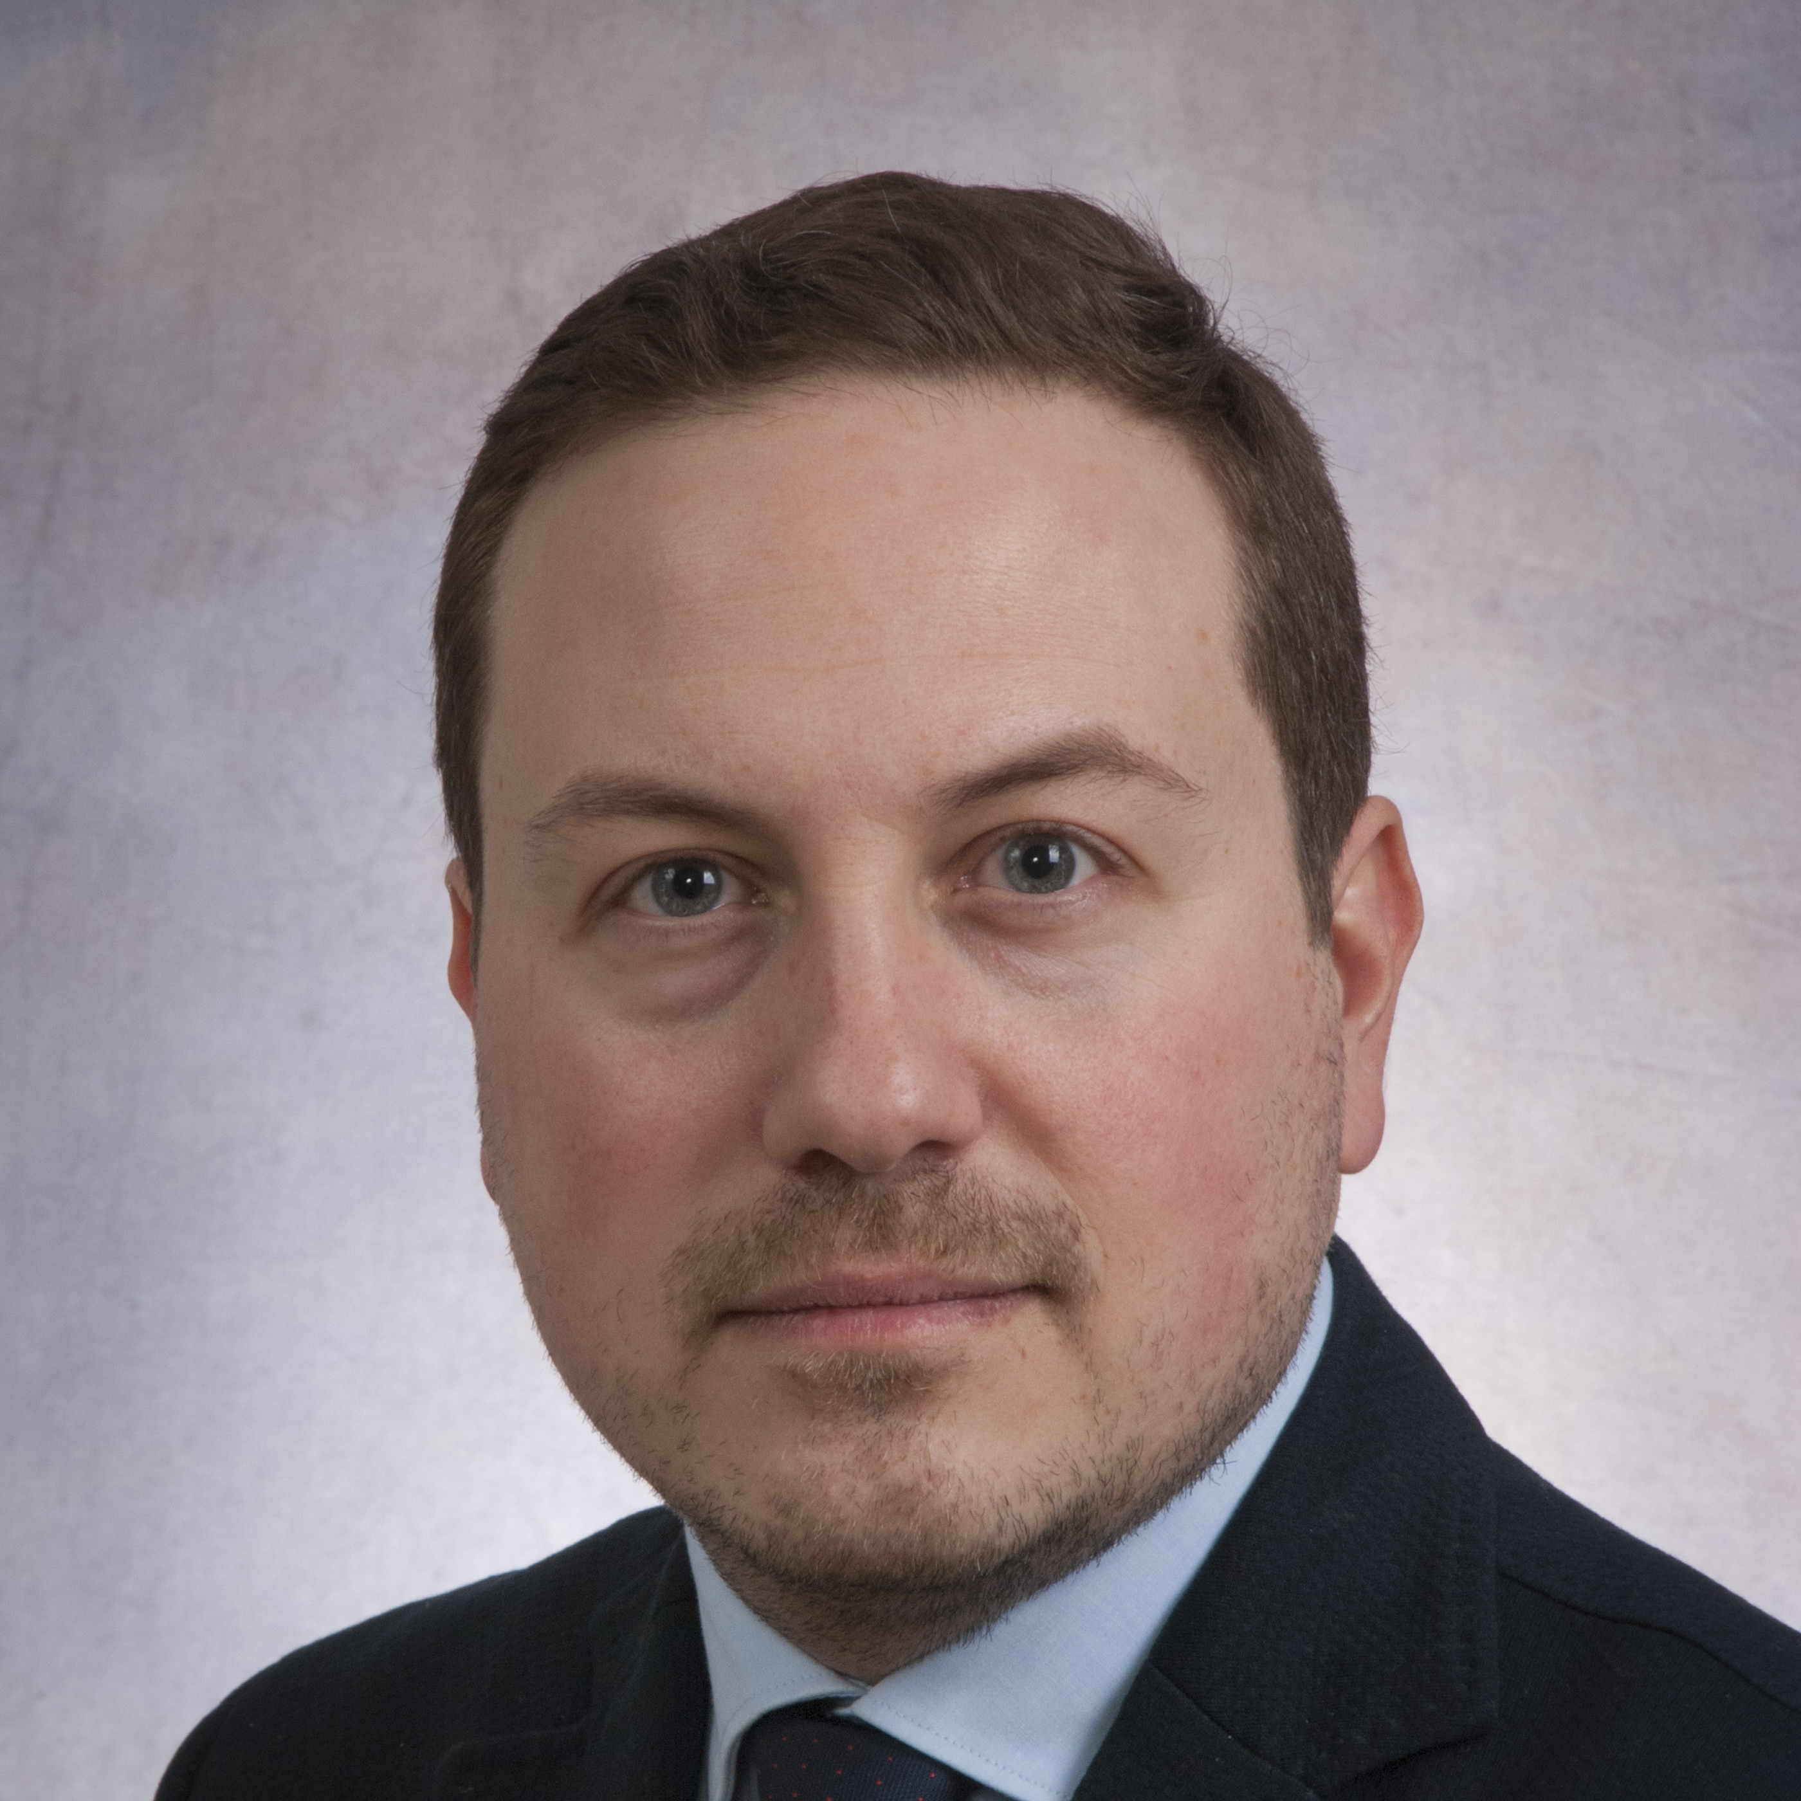
University of Toronto Department of Surgery
Annual Address 2018
GRANTS cont’d JULY 1, 2017 - JUNE 30, 2018
Cari Whyne
NSERC Discovery Grant
Victor Yang, Todd Mainprize, Albert Yee
Ontario Research Fund
Gelareh Zadeh
CIHR Project Grant #1
CIHR Project Grant #2
Canadian Cancer Society
Kazuhiro Yasufuku and Shaf Keshavjee
CIHR Project Grant
Augusto Zani
CIHR New Investigator Grant

Slide 2
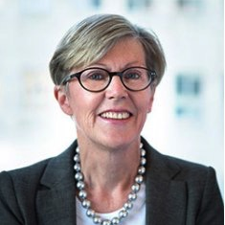
University of Toronto Department of Surgery
Annual Address 2018
HONOURS AND AWARDS July 1, 2017 - June 30, 2018
Robin McLeod named as
American surgical association (ASA)
president-Elect!
ASA is the oldest Surgical Association established in 1880
Robin will be only the second woman President of the ASA
Other Canadian Presidents include: William Gallie, LD McLean, Charles Drake
Other notable Presidents include: Roswell Park, William Mayo, Dallas Phemister, Allen Whipple, Alfred Blalock, Robert Zollinger, David Sabiston, Seymour Schwartz
Robin McLeod
Vice Chair, Best Practices

Slide 3
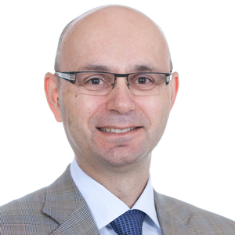
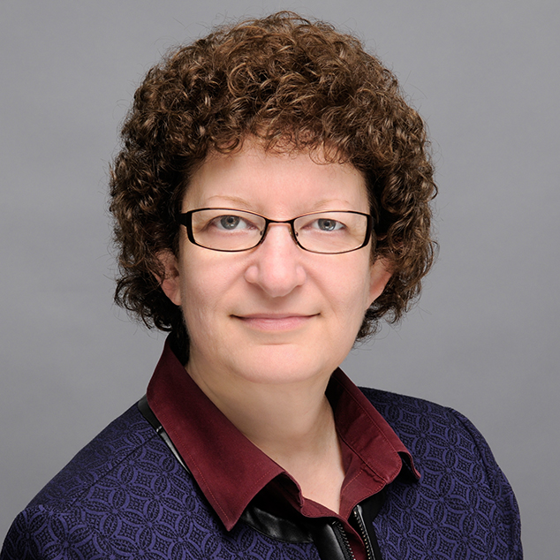
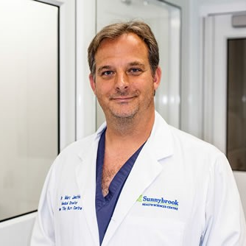
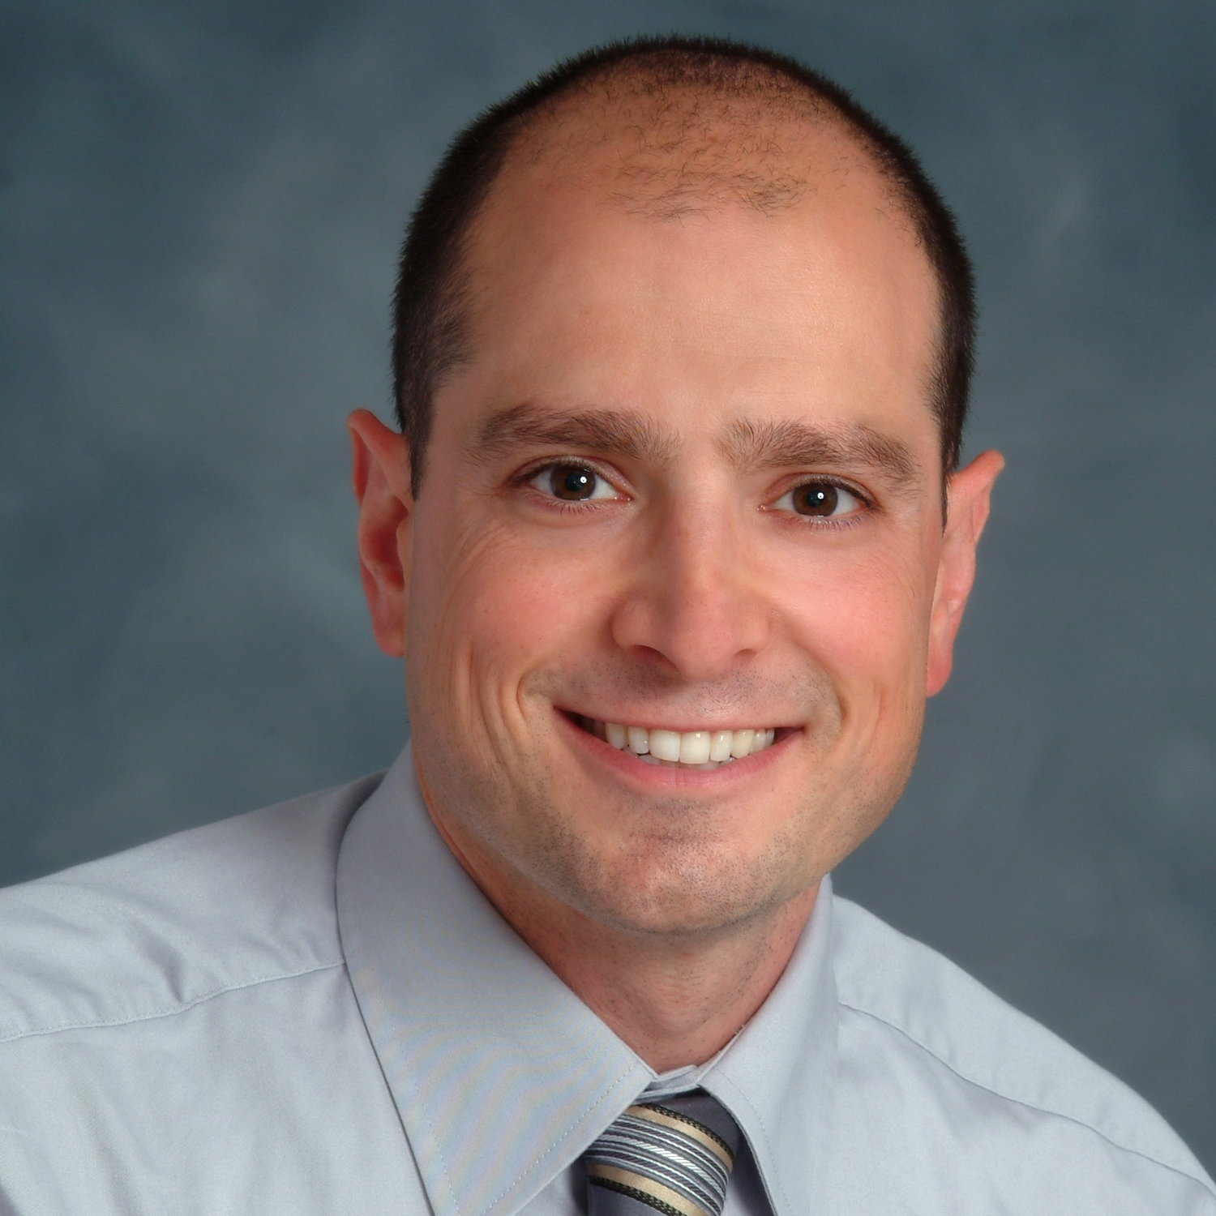
University of Toronto Department of Surgery
Annual Address 2018
Canadian Academy of Health Science
NewLY ELECTED MEMBERS
Michael Cusimano
Karen Davis
Marc Jeschke
David Urbach

Slide 4
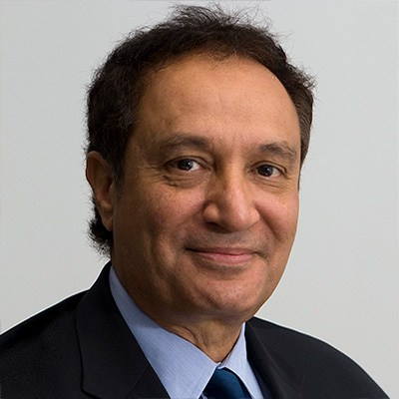
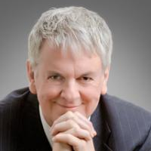
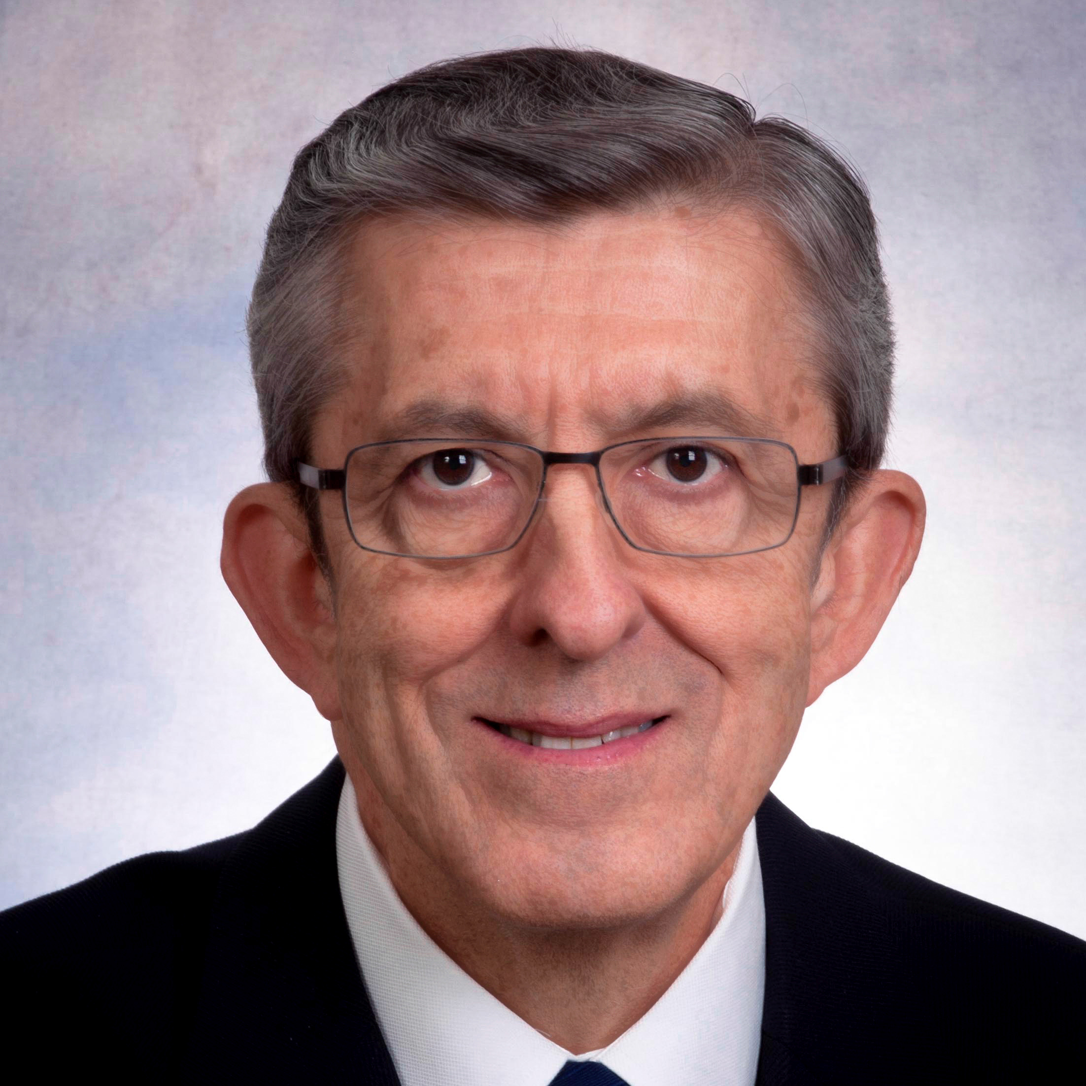
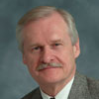
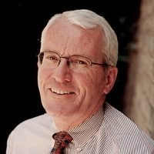
University of Toronto Department of Surgery
Annual Address 2018
Order of canada
Abdallah Daar
Officer of the Order of Canada
Geoff Fernie
Member of the Order of Canada
Wayne Johnston
Member of the Order of Canada
Bryce Taylor
Member of the Order of Canada
James Waddell
Member of the Order of Canada

Slide 5
Department of Surgery in the news
University of Toronto Department of Surgery
Annual Address 2018
Why we need robots in the OR Neil Fleshner
Harquail Family Fund for Neuromodation Nir Lipsman
Globe & Mail
City TV
NeuroBlate James Drake
YOUTUBE
Surgical Ethics for Medical Students Karen Devon
Stop the Bleed Avery Nathens
Patient-Student Relationship Jory Simpson
CBC News
Governor General’s Office
Organs by Design Shaf Keshavjee

Slide 6
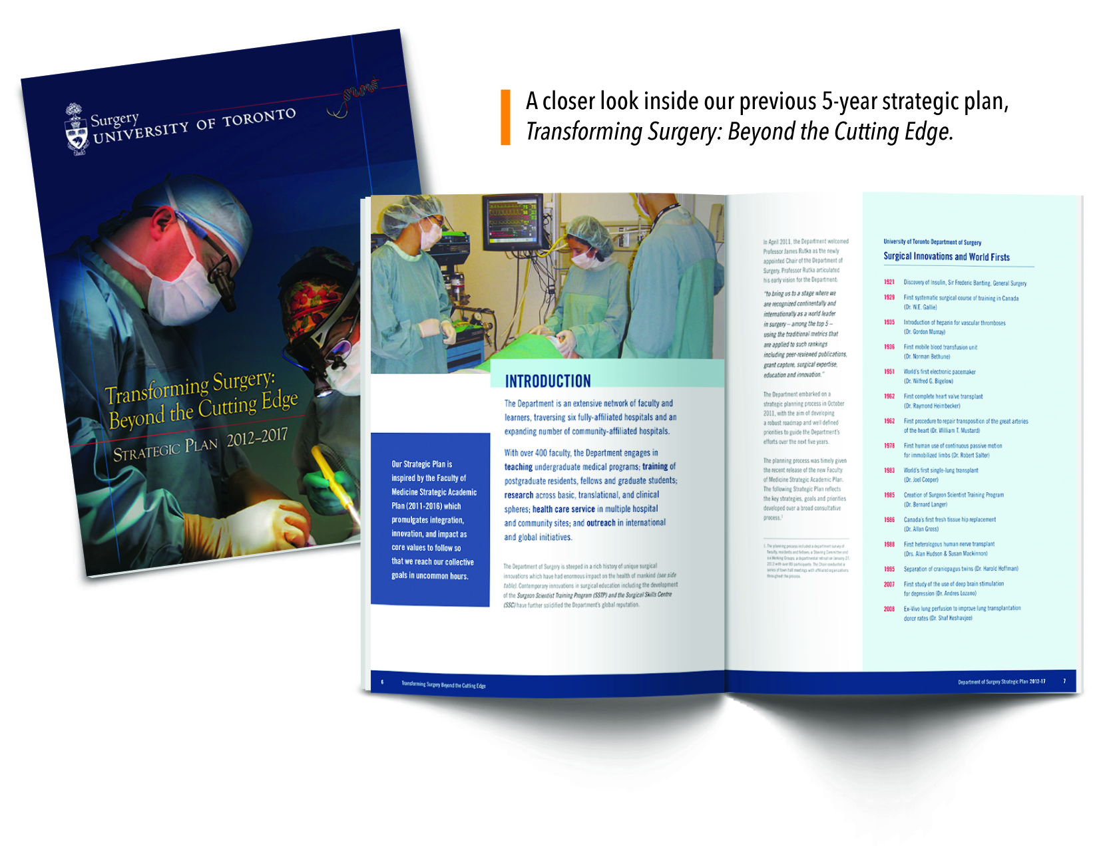
Transforming surgery:
BEYOND THE CUTTING EDGE 2012-2017
A 5-Year Review of Surgery & Strategy
In 2012, the Department of Surgery embarked on an ambitious 5-year strategic plan, Transforming Surgery: Beyond the Cutting Edge. The plan reflected on the collective priorities of its trainees, faculty, and community partners in an ambitious framework, as well as the changing landscape of Canadian surgical care. The following slides show just some of our notable accomplishments.

Slide 7
Aspire - Advance - Achieve 2018-2023
A 5-Year Blueprint of Surgery, Strategy, and Change
Widespread consultation
Myriad of stakeholders
Determined core values
Leads of pillars emboldened
Creation of new pathway

Slide 8
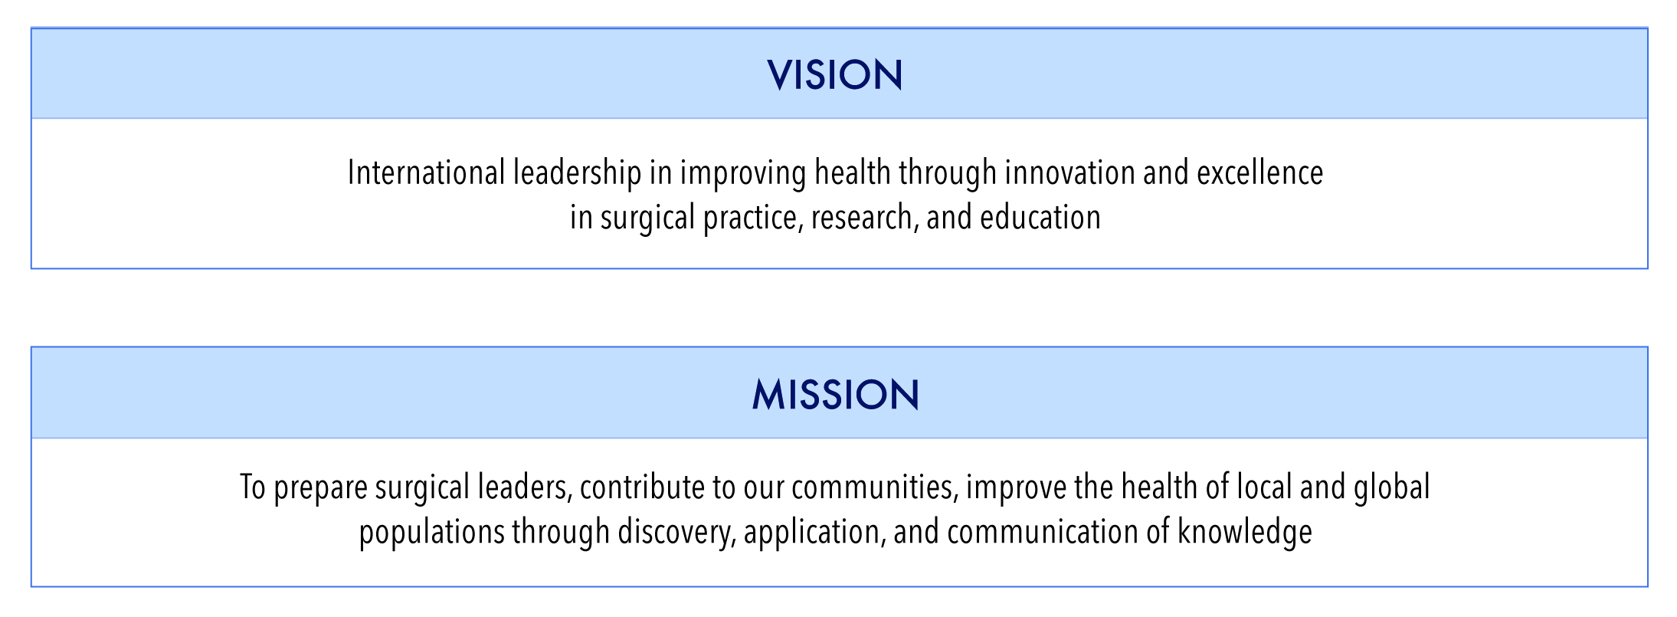
University of Toronto Department of Surgery
Annual Address 2018
Aspire - Advance - Achieve 2018-2023
A 5-Year Blueprint of Surgery, Strategy, and Change

Slide 9
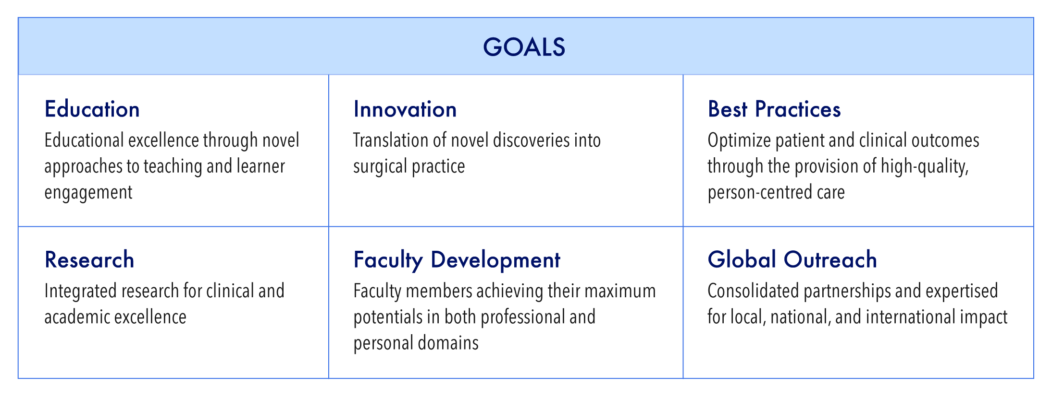
University of Toronto Department of Surgery
Annual Address 2018
Aspire - Advance - Achieve 2018-2023
A 5-Year Blueprint of Surgery, Strategy, and Change

Slide 10
University of Toronto Department of Surgery
Annual Address 2018
Aspire - Advance - Achieve 2018-2023
A 5-Year Blueprint of Surgery, Strategy, and Change

Slide 11
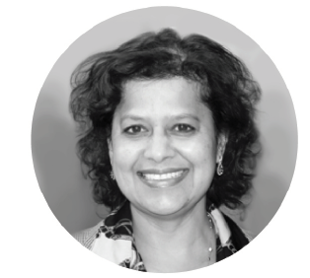
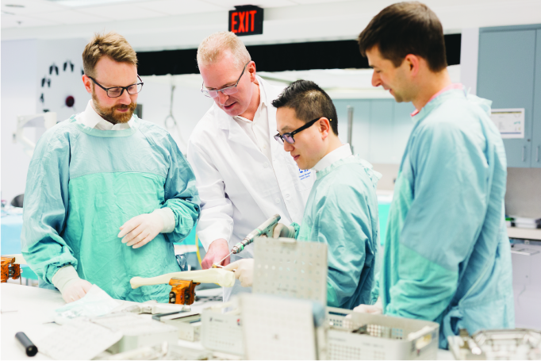
University of Toronto Department of Surgery
Annual Address 2018

Slide 12
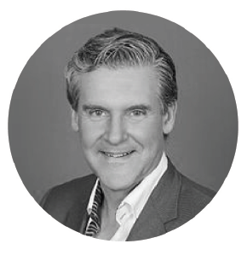
University of Toronto Department of Surgery
Annual Address 2018

Slide 13
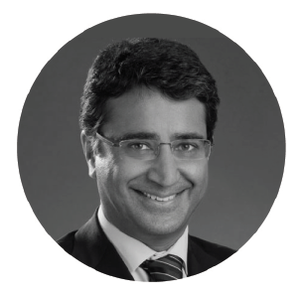
University of Toronto Department of Surgery
Annual Address 2018

Slide 14
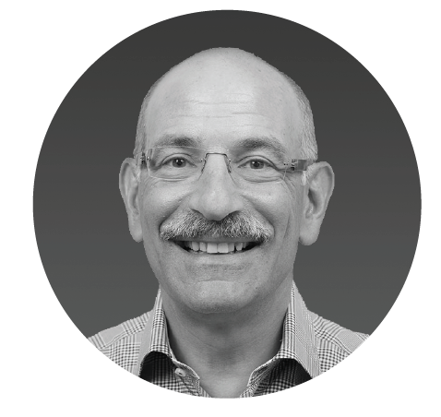
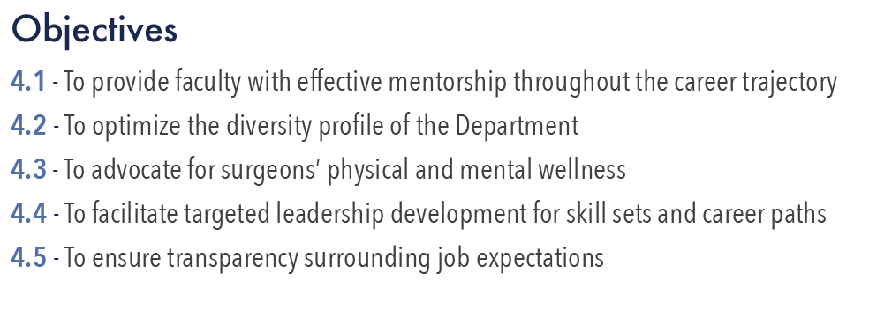
University of Toronto Department of Surgery
Annual Address 2018

Slide 15
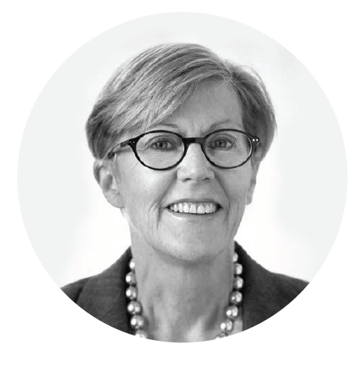
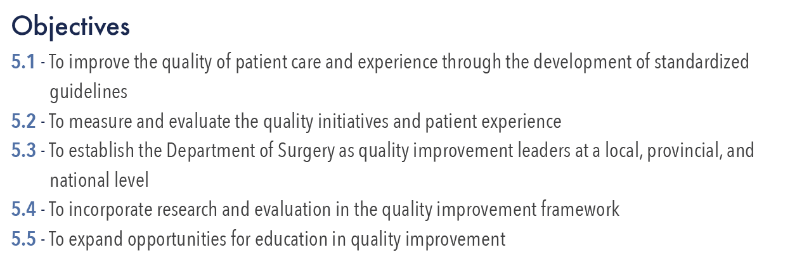
University of Toronto Department of Surgery
Annual Address 2018

Slide 16
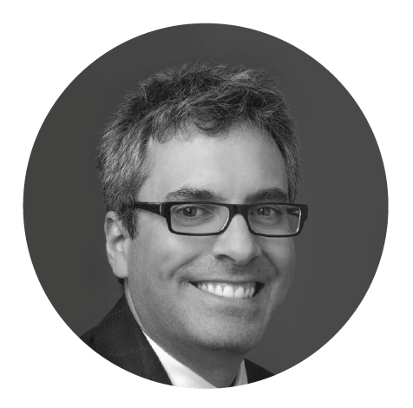
University of Toronto Department of Surgery
Annual Address 2018

Slide 17
University of Toronto Department of Surgery
Annual Address 2018
Supporting strategies
COMMUNICATIONS
New logo
Updated departmental website
Rapid e-communications
Increased social media presence
Medical illustrator
Monthly newsletter Excelsior
Semi-annual magazine The Surgical Spotlight
Holding Rounds, book clubs, and special interest groups
ADVANCEMENT
$9M in philanthropic funding in 2016-2017, surpassing our own record
Continued creative and aggressive fundraising through the Advancement Office
Explore alternative sustainable funding sources
Develop new relationships with key stakeholders
HONOURS, AWARDS AND EVALUATIONS
Active committee chaired by Robin Richards
Seek worthy nominees at university, regional, national and international levels
Tracking faculty progress annually in education, research, and creative professional activity

Slide 18
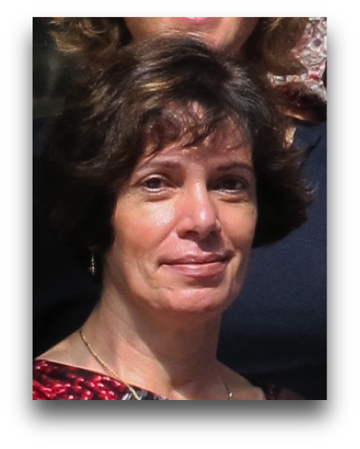
research update:
Val Cabral
Research Administrator
Events held
SSTP Career Night - March 20 2017
Approval of 16 new SSTP trainees - September 11, 2017
PGY1 & PGY2 Research Orientation Synopsis - September 18, 2017
SSTP Meet & Greet - October 2, 2017
Translational Research Retreat - March 26, 2018
SSTP Grant Writing Workshop - April 10, 2018

Slide 19
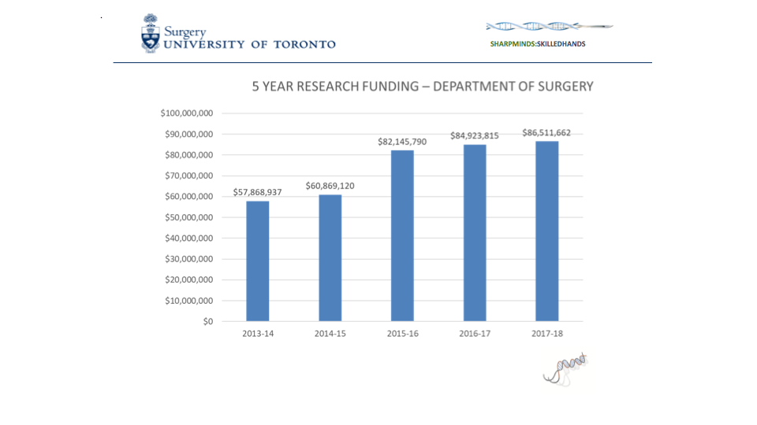
research update:

Slide 20
Surgeon Scientist training program:

Slide 21
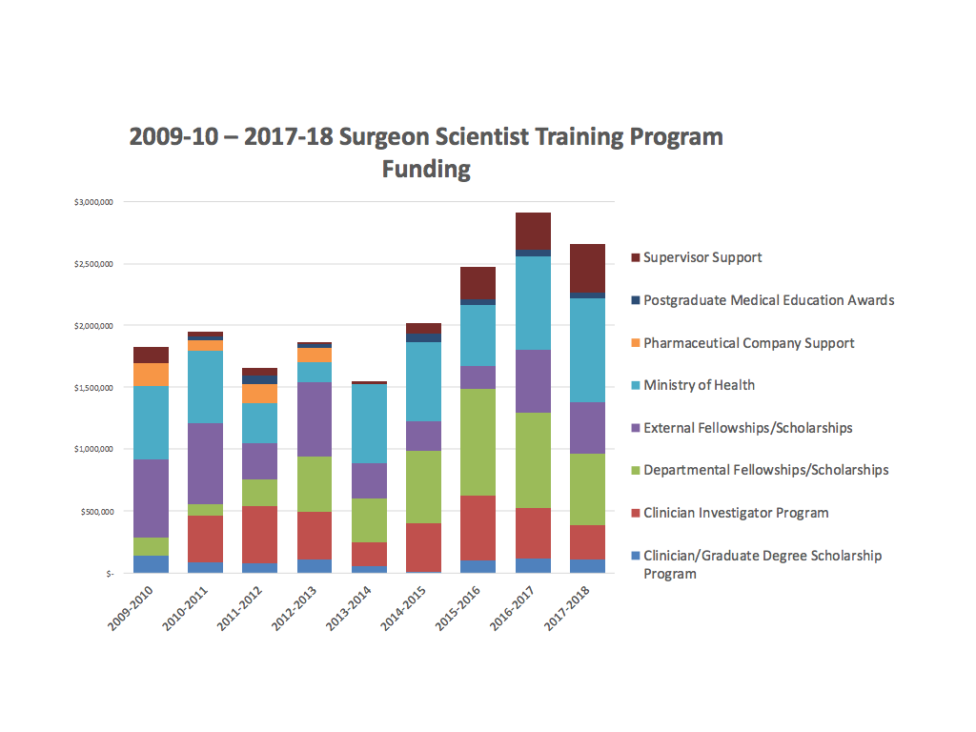
Surgeon Scientist training program:

Slide 22
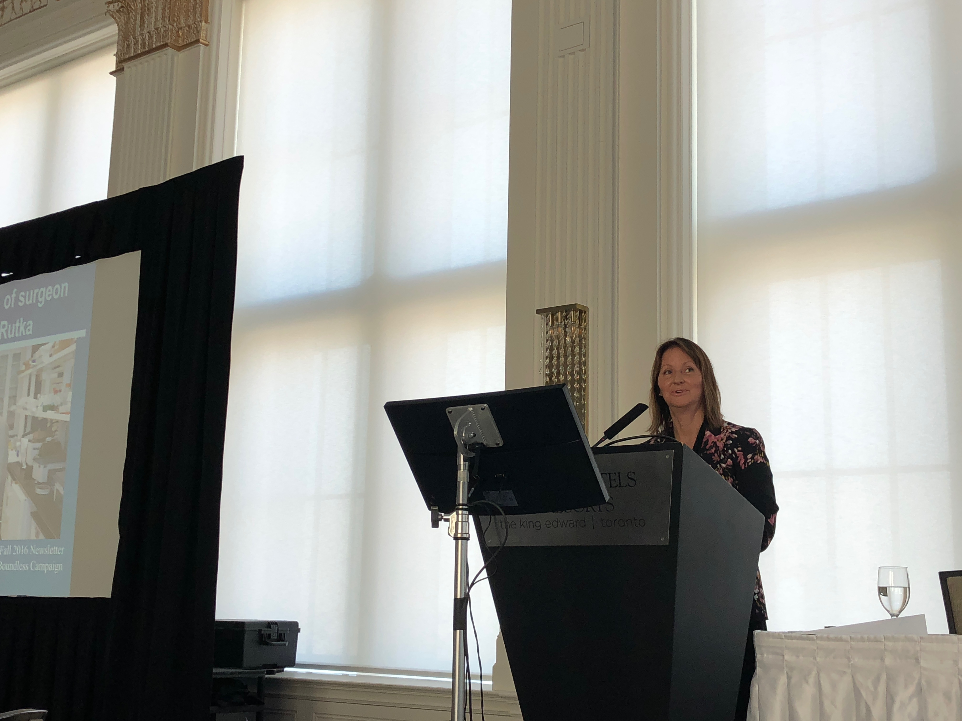
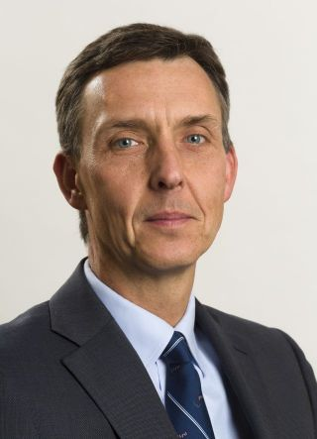
Surgeon Scientist training program:
The tipping point
Carol Swallow - Annual Assembly
May 2018
Dr Tom Forbes
Chair,
Vascular Surgery

Slide 23
Surgeon Scientist training program:
The tipping point
Typical number of entry SSTPs/year = 12 - 15
In 2017/18 there were 22 SSTPs who entered the program
The gap between available funding and cost of SSTP = $500K
Tom Forbes and leaders of Dept Surgery provided input
Shortfall averted by fund transfers from Divisions and Supervisors
One time only solution
Requirement for a more longterm solution

Slide 24
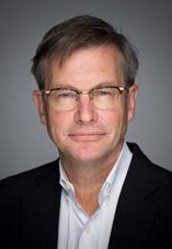
Surgeon Scientist training program:
Task force solution - the wright report
Task force committee formed
Interviews with broad stakeholder groups
Examined reduction of expenses, and increasing revenues
Delivered a series of recommendations for longterm sustainability
These will be vetted by the Executive Committee, the Senior Advisory
Committee, and the University Divisions
Implementation for 2019-20
Jim Wright

Slide 25
Surgeon Scientist training program:
Task force solution - the wright report
Jim Wright

Slide 26
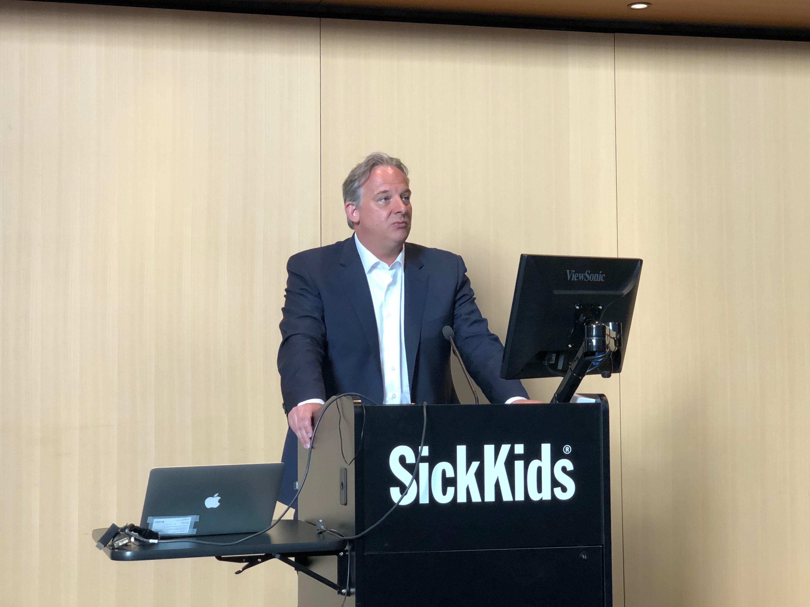
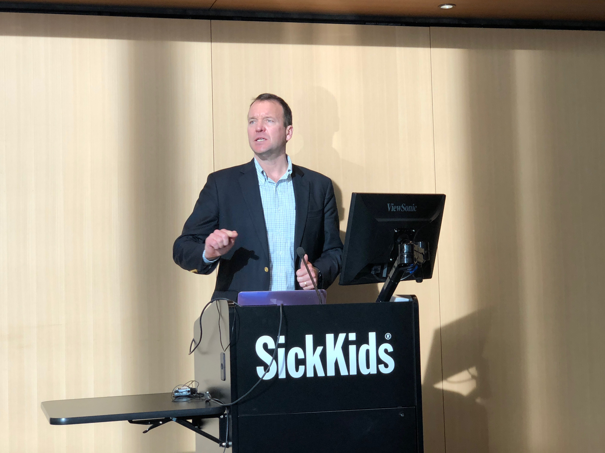
Translational research Retreat in Surgery
March 26, 2018
Randall Morris - Keynote speaker

Slide 27
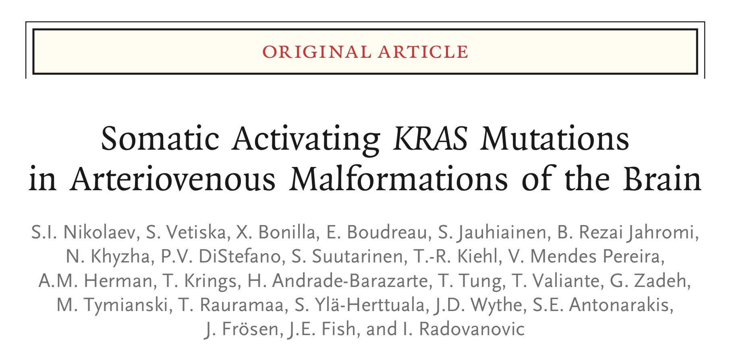
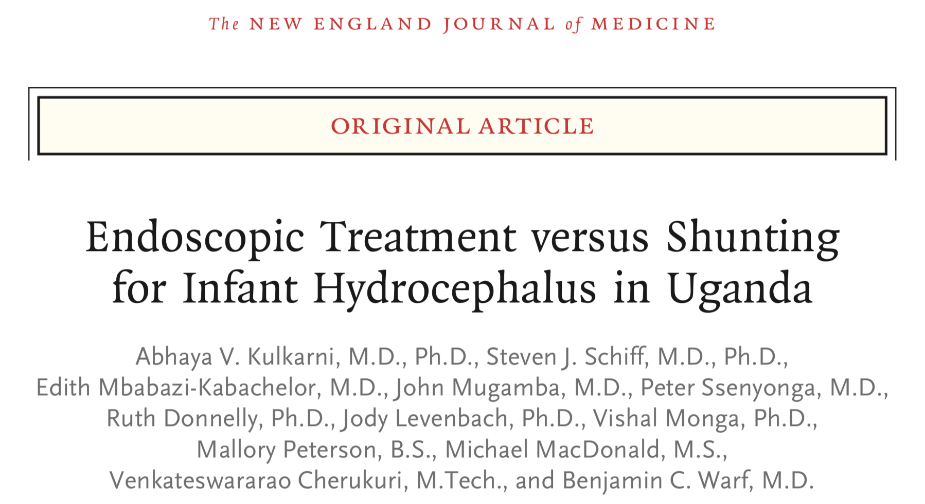
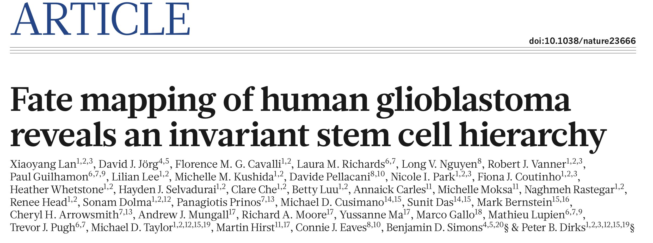
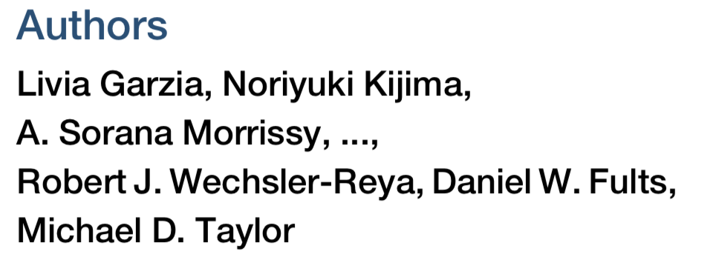
HIGH IMPACT PUBLICATIONS

Slide 28
HIGH IMPACT PUBLICATIONS

