Slide 1




DEPARTMENT OF SURGERY
DEPARTMENT OF SURGERY
James T. Rutka
James T. Rutka
OC, O Ont, MD, PhD, FRCSC, FACS, FAANS
RS McLaughlin Professor and Chair
Department of Surgery
University of Toronto
OC, O Ont, MD, PhD, FRCSC, FACS, FAANS
RS McLaughlin Professor and Chair
Department of Surgery
University of Toronto

Slide 2
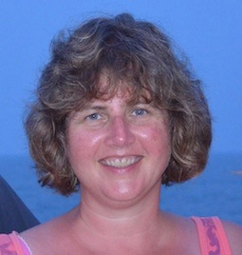
Stacey
Krumholtz
Sylvia
Perry
ASPIRE. ADVANCE. ACHIEVE. Strategic Plan 2018-2023
2nd Annual Joint Medicine - Surgery Lecture - Dr. David Rothenberger
Education Scholar’s Symposium
Bethune Roundtable
Faculty Promotions - 2nd consecutive year with 100% success rate
First Female Gordon Murray Lecturer - Dr. Susan Mackinnon

Slide 3

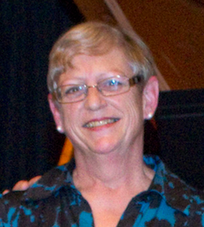
ANNUAL REPORT NOW ONLINE!
Stephanie
Neilson

Slide 4

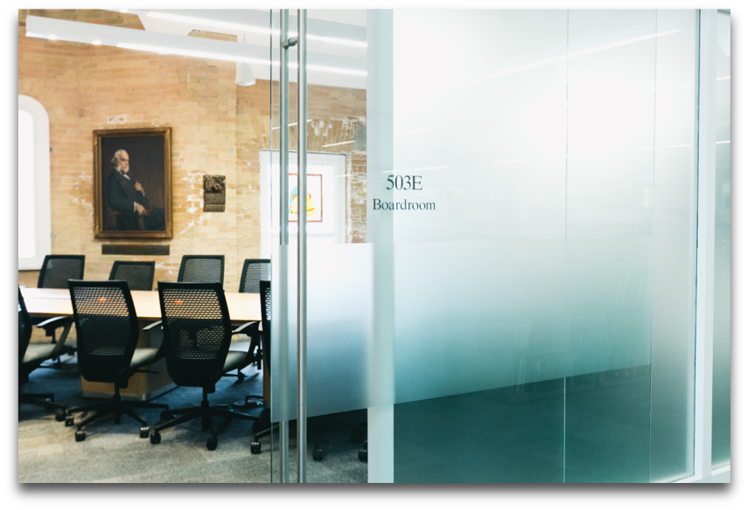
Harjit Bains - Finance Administrator
Val Cabral - Research Administrator
Nancy Condo - Business Officer
Alina Gaspar - HR / Payroll Administrator
Joanna Giddens - Strategic Plan Coordinator
David Grieco - Senior Development Officer
OFFICE STAFF
With Thanks for All That You Do!
Stacey Krumholtz - Medical Illustrator
Linna Liu - UG Educator Coordinator
Stephanie Neilson - Web / Communications
Sylvia Perry - Executive Administrator
Nancy Somer - Secretary
Tess Weber - PG Education Coordinator

Slide 5
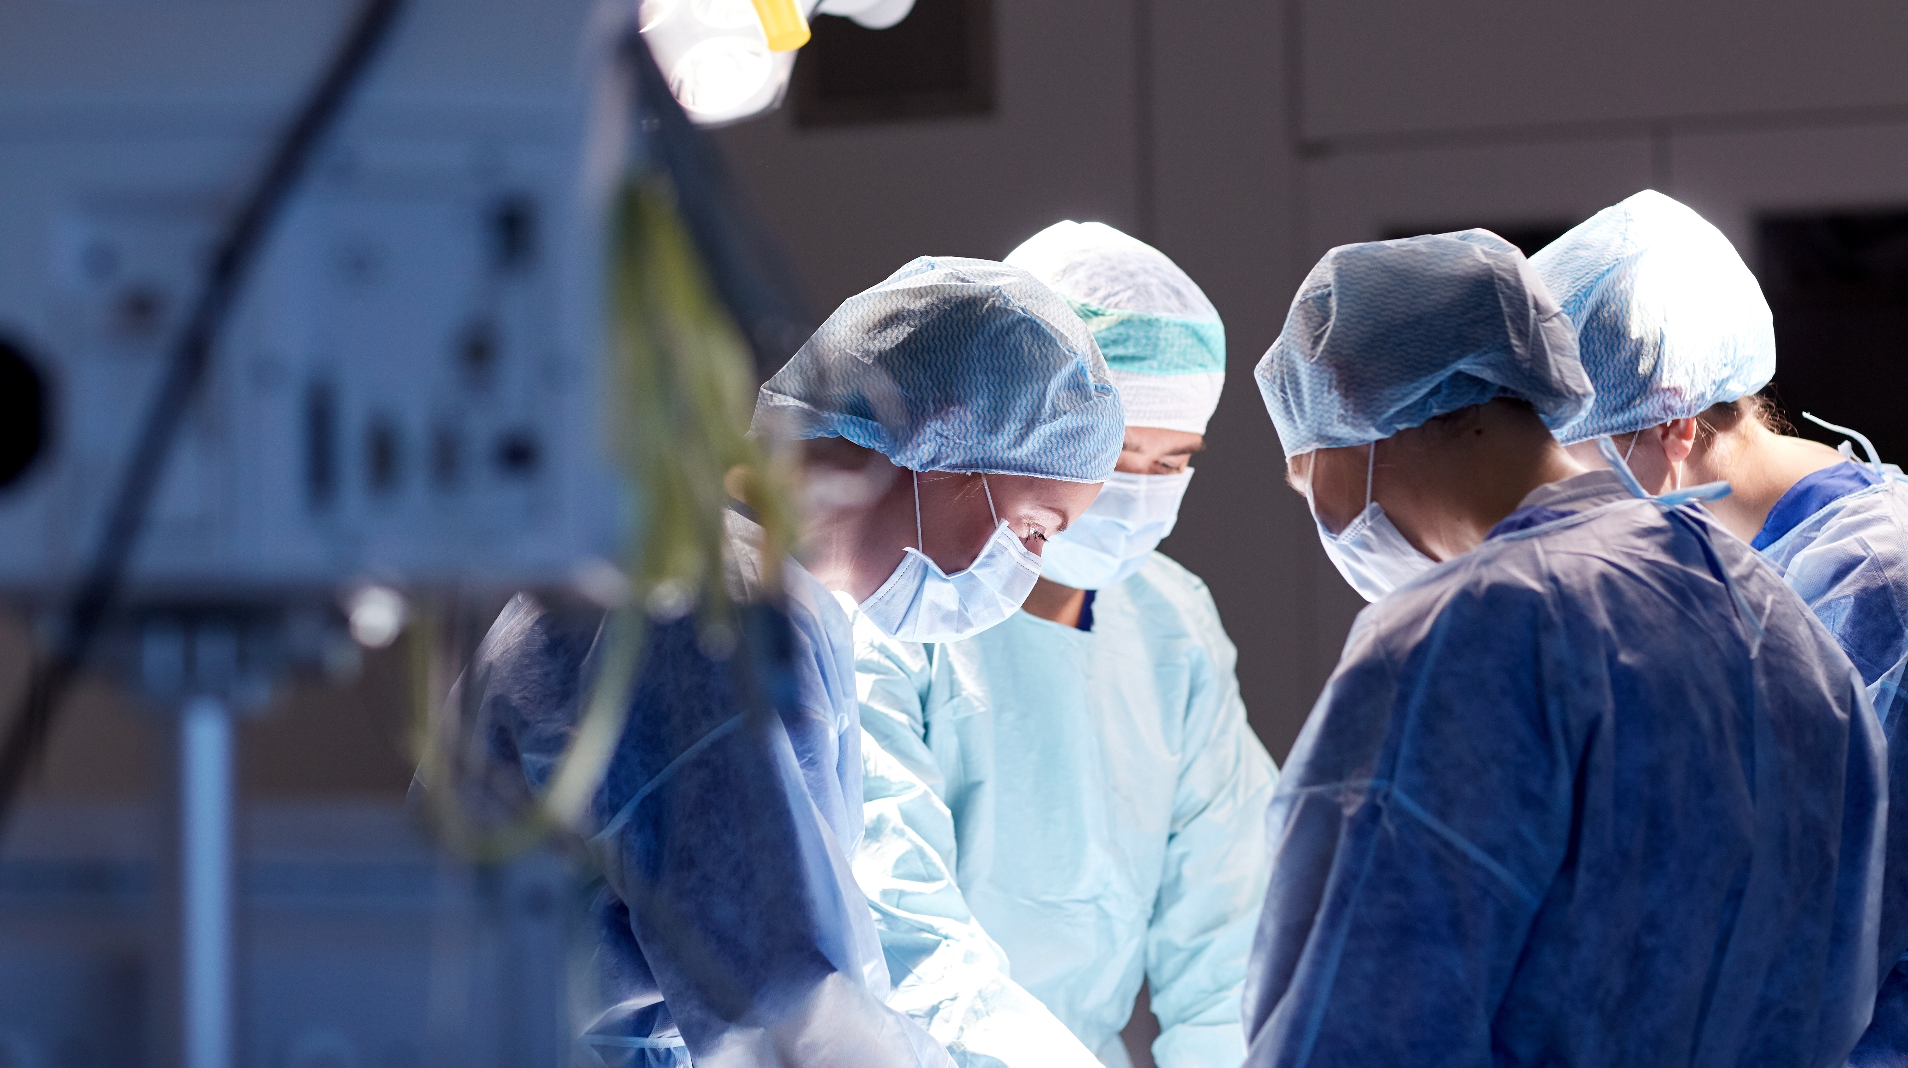
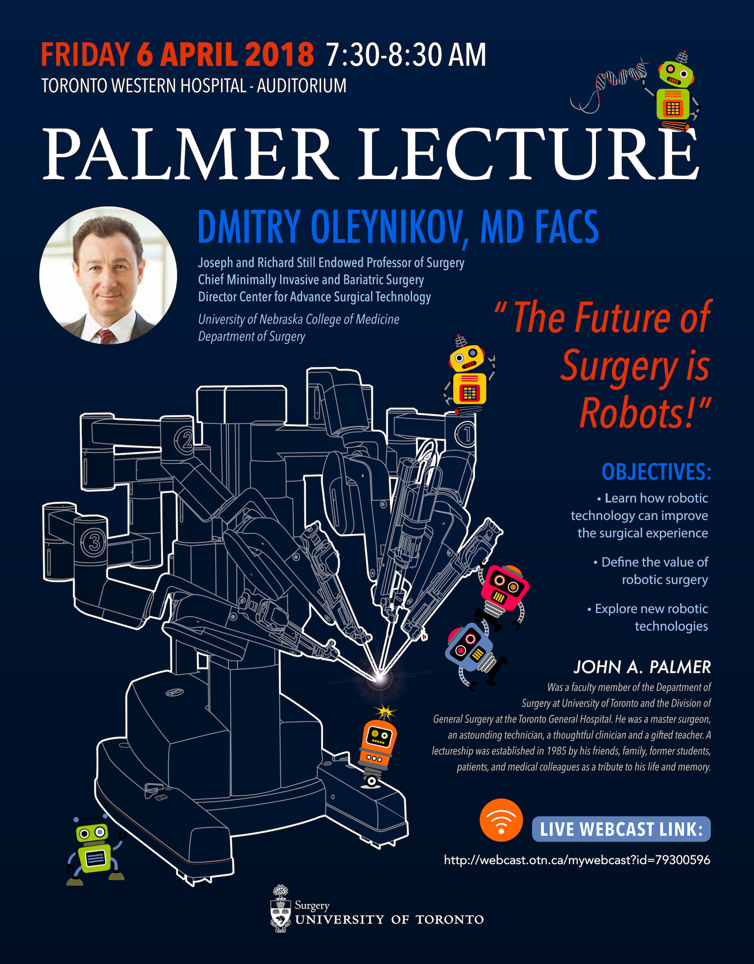
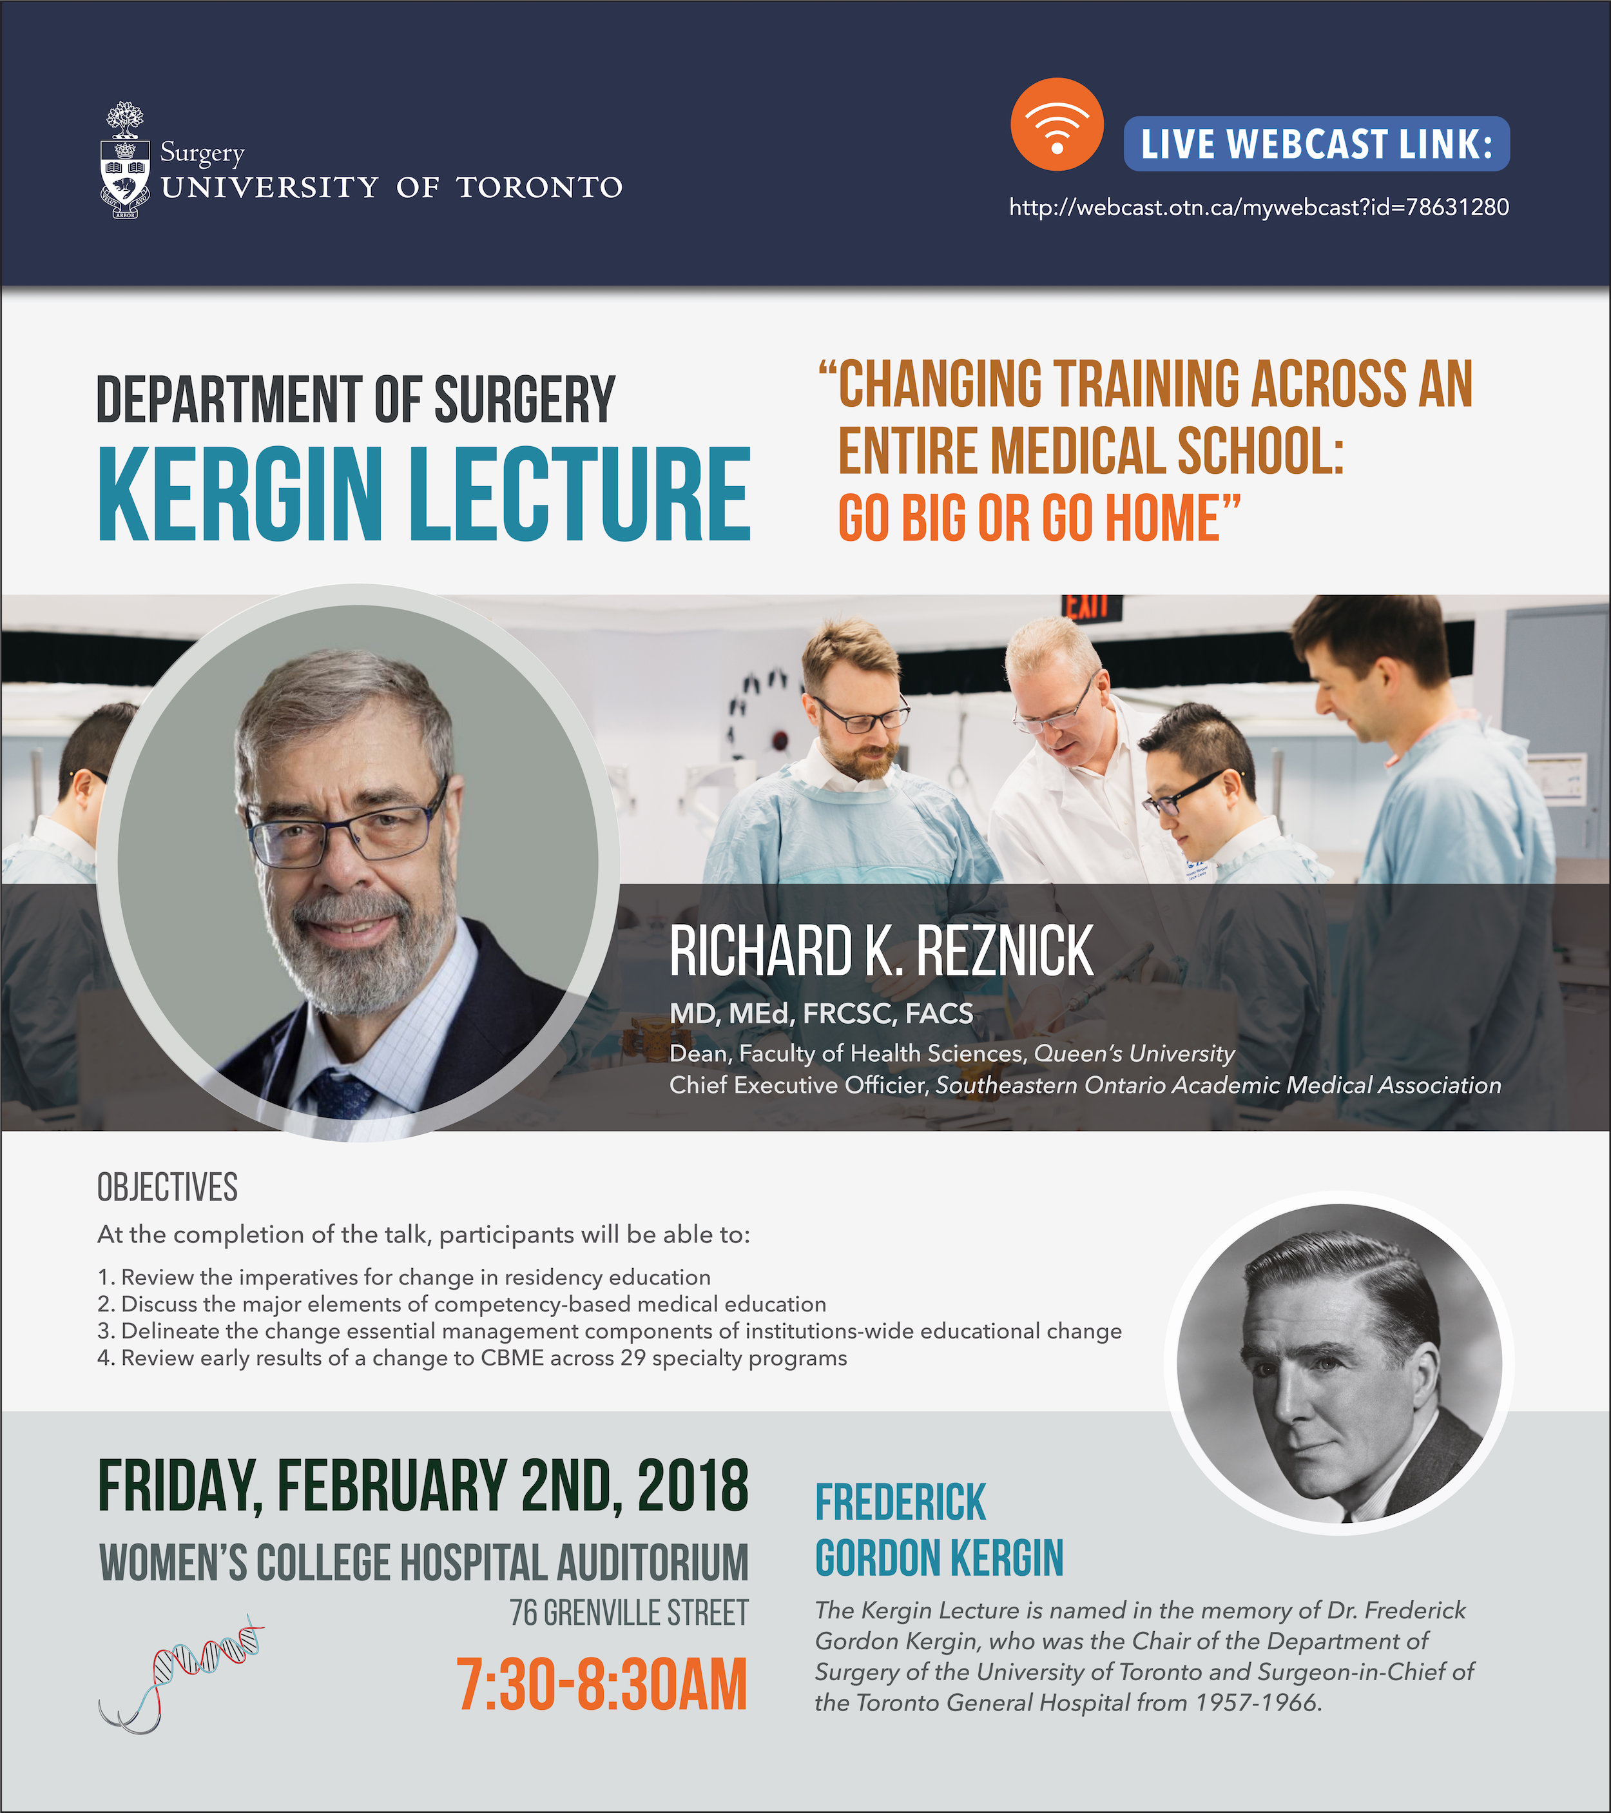
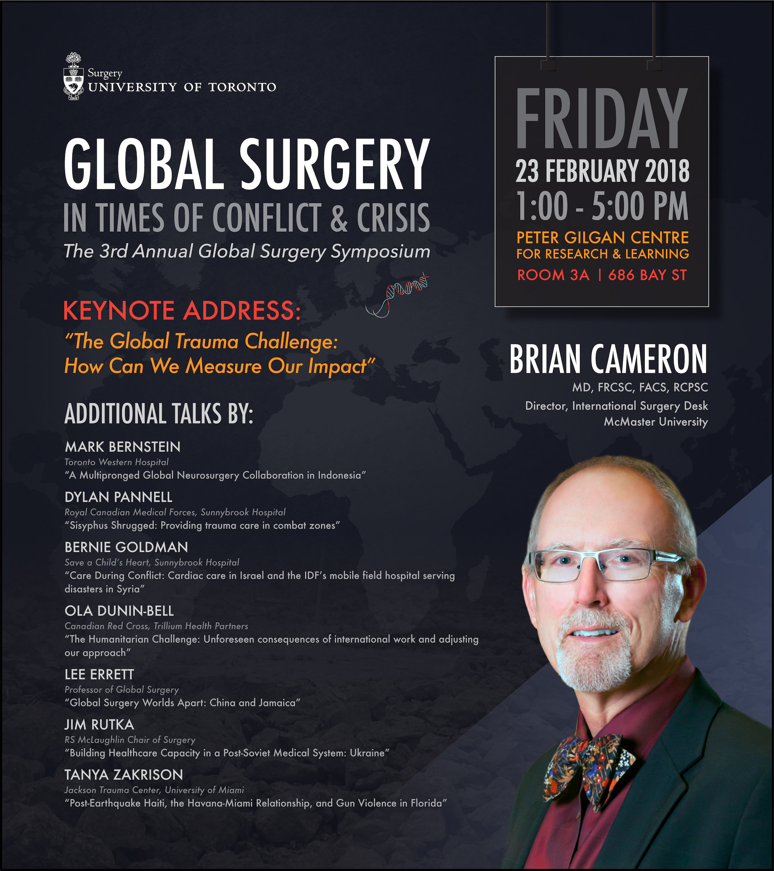
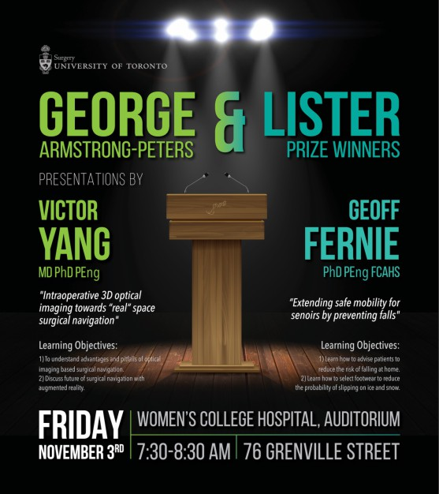
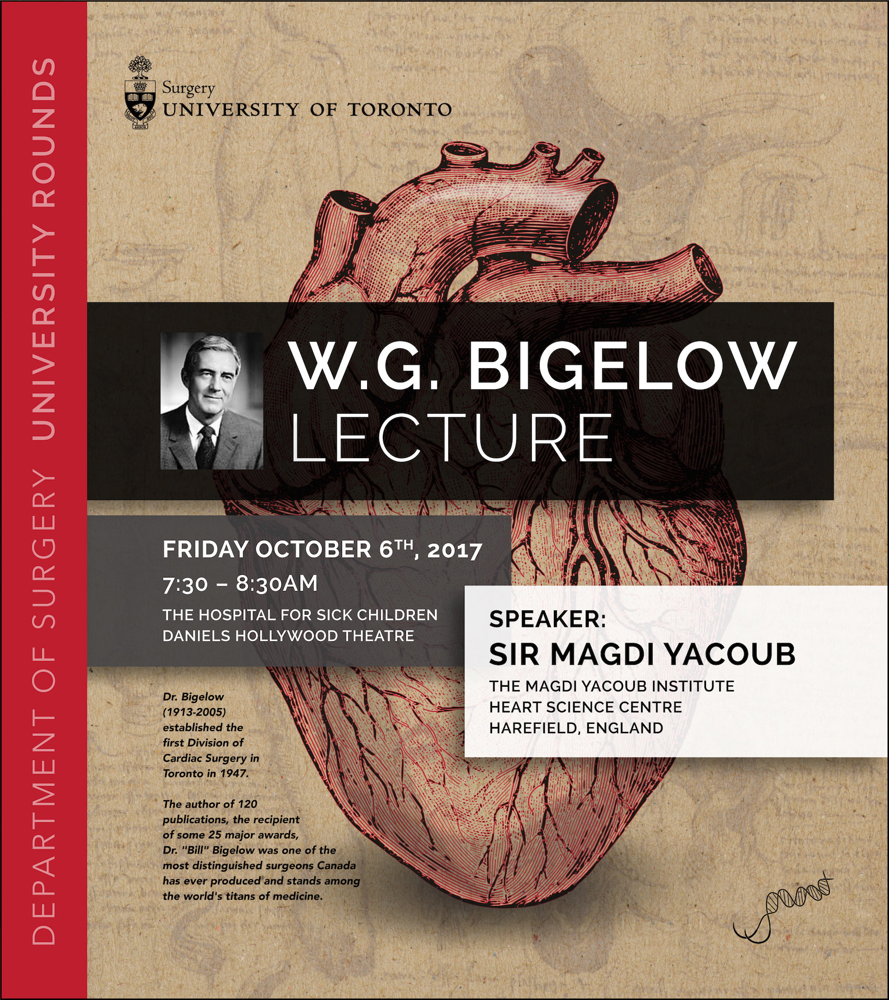

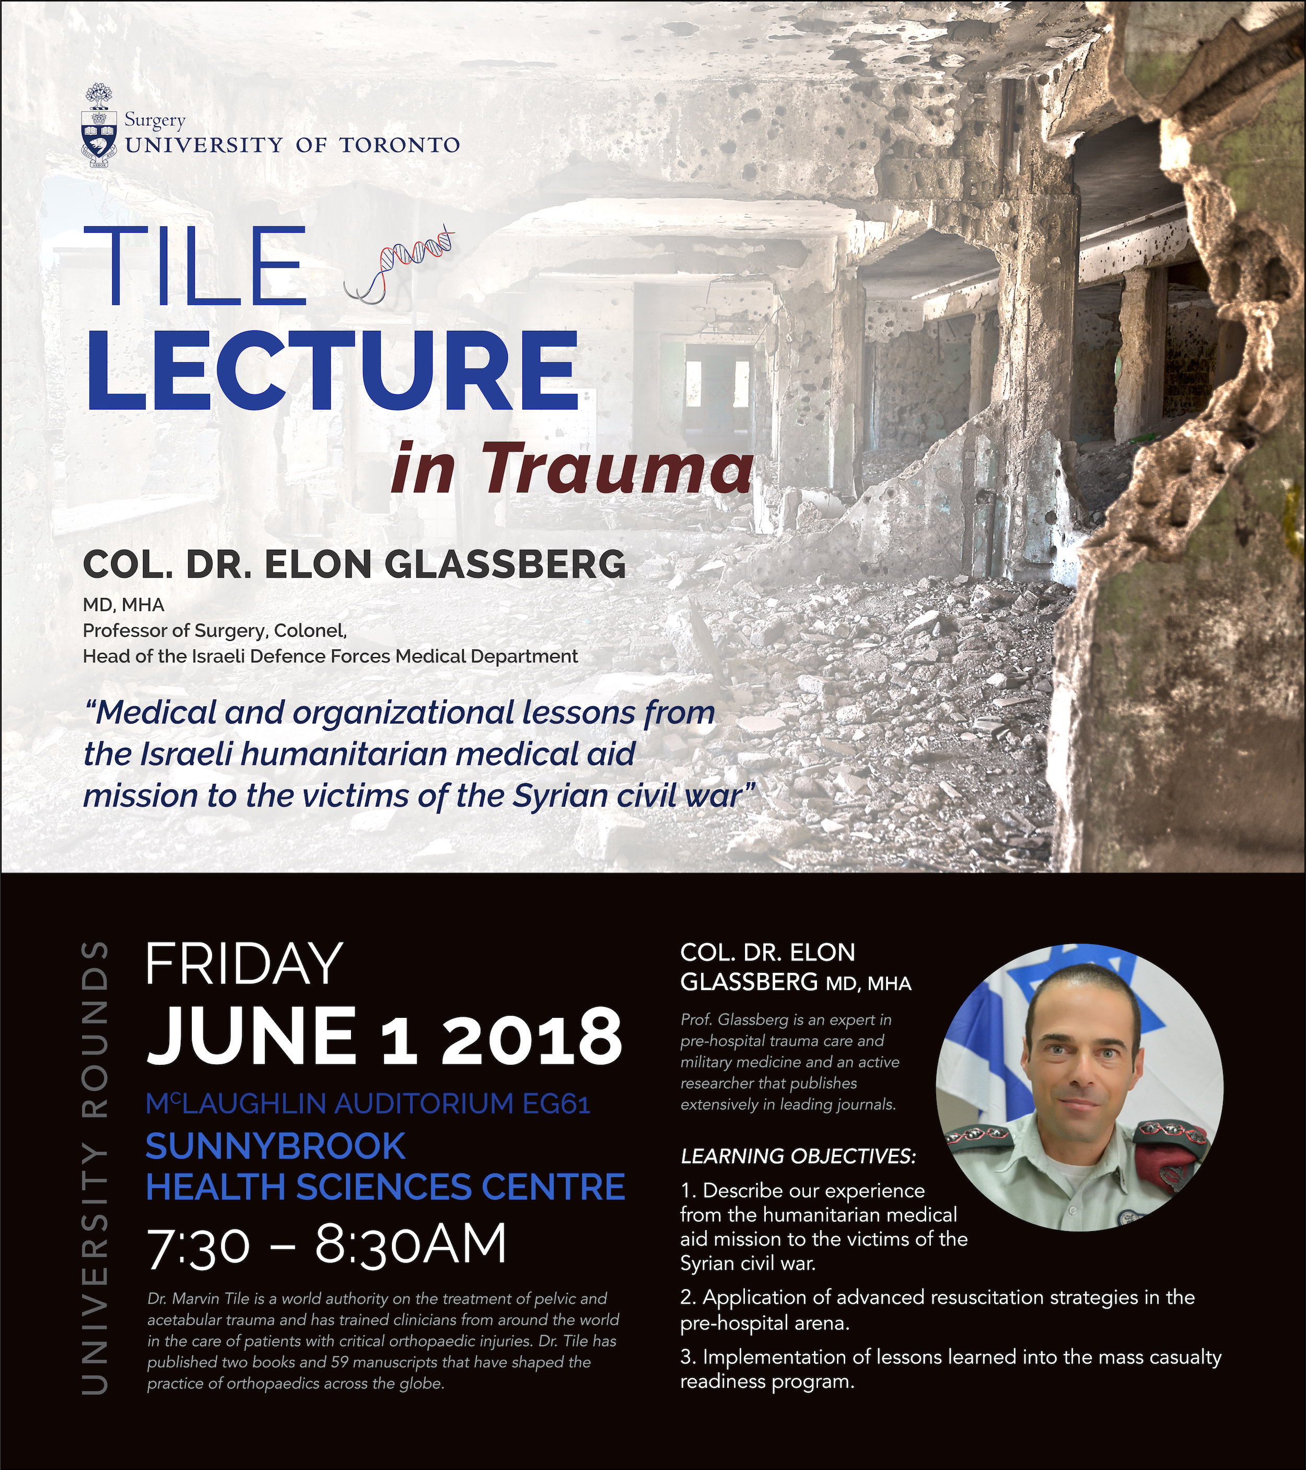
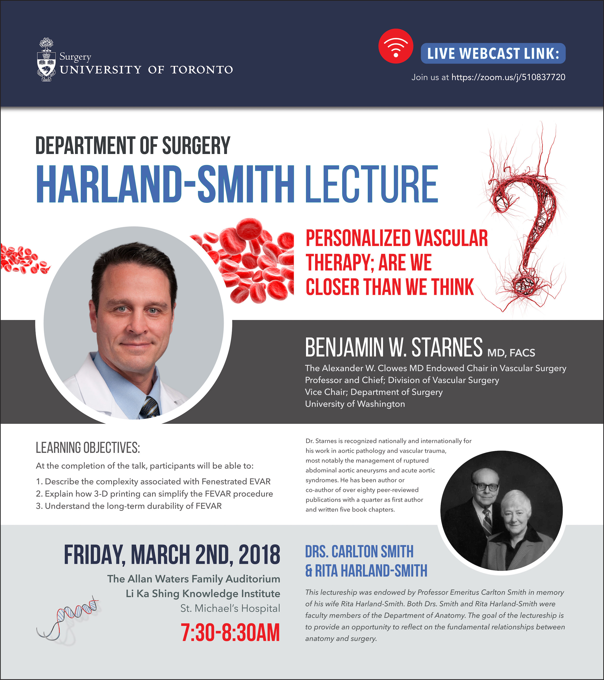
2017 - 2018 U of T Dept Surgery GRAND Rounds
University of Toronto Department of Surgery
Annual Address 2018

Slide 6

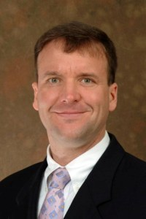
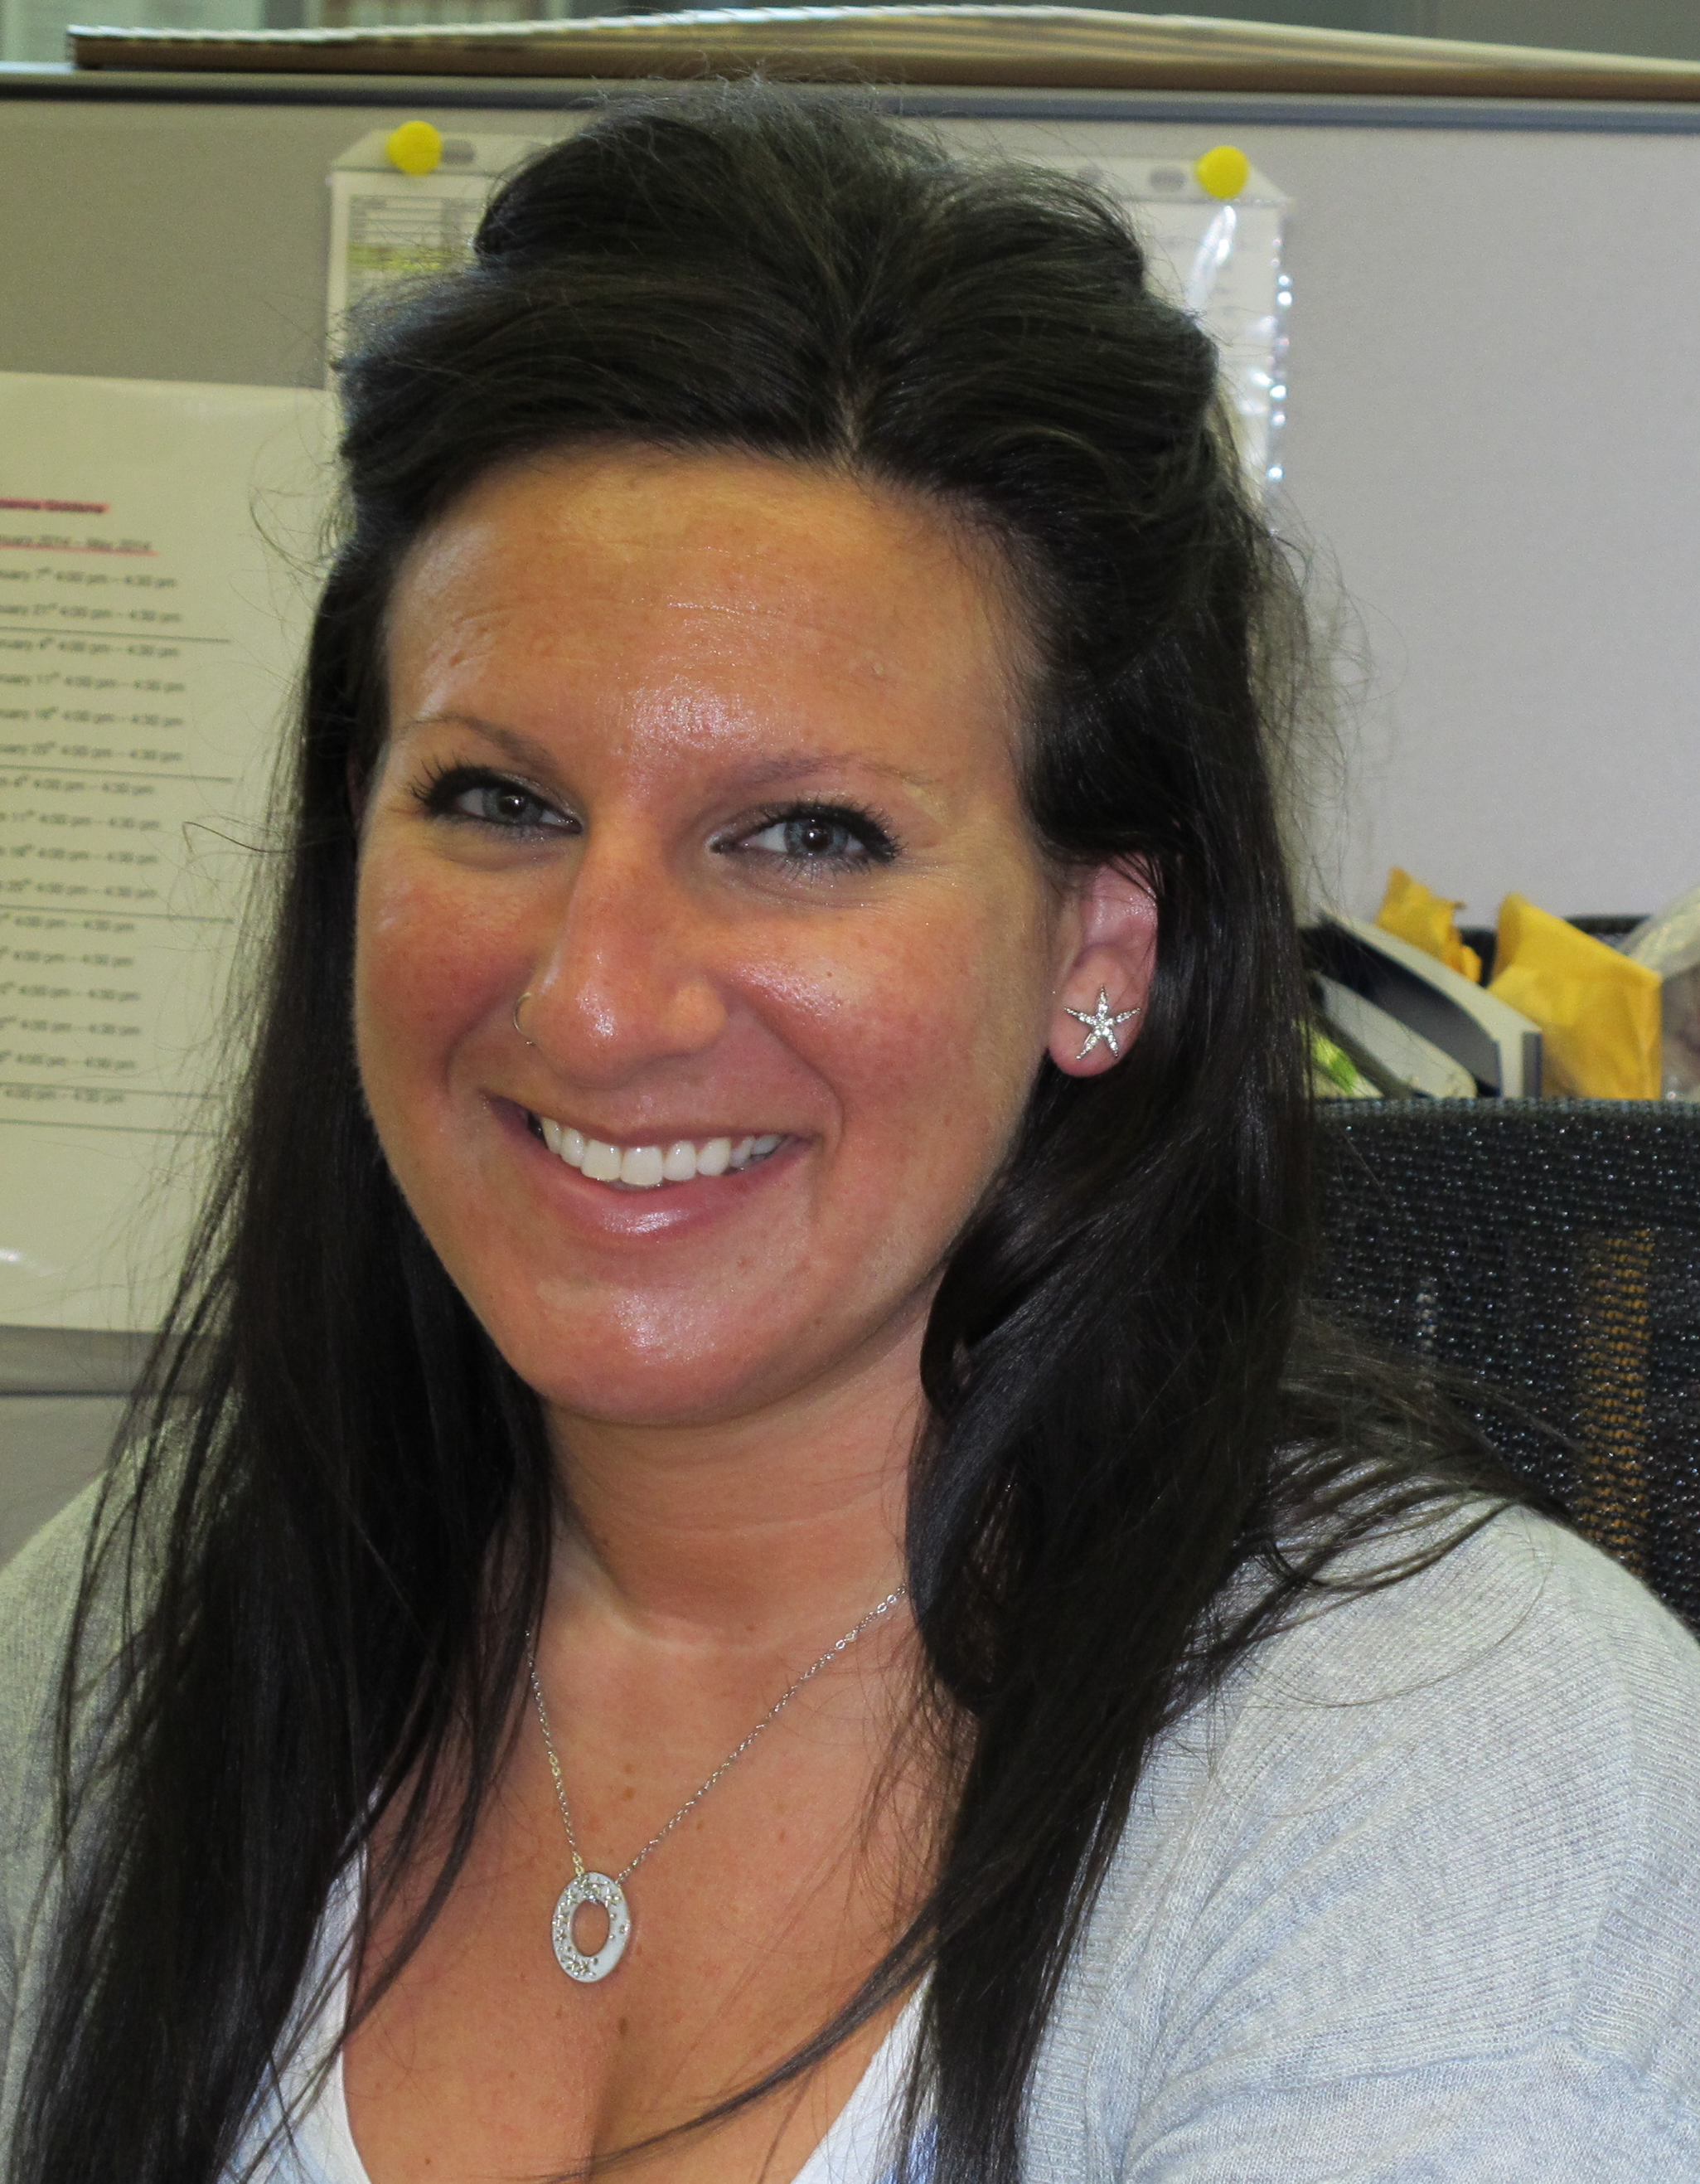
BETHUNE ROUNDTABLE
Andrew Howard
Joanna Giddens

Slide 7
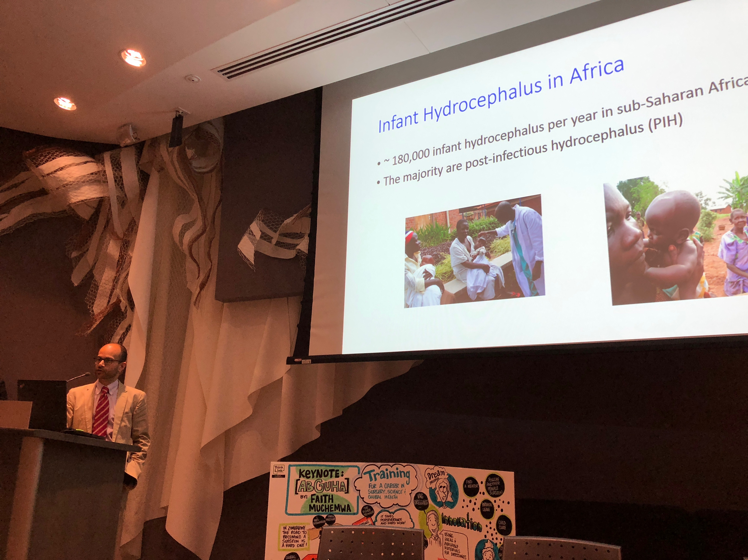
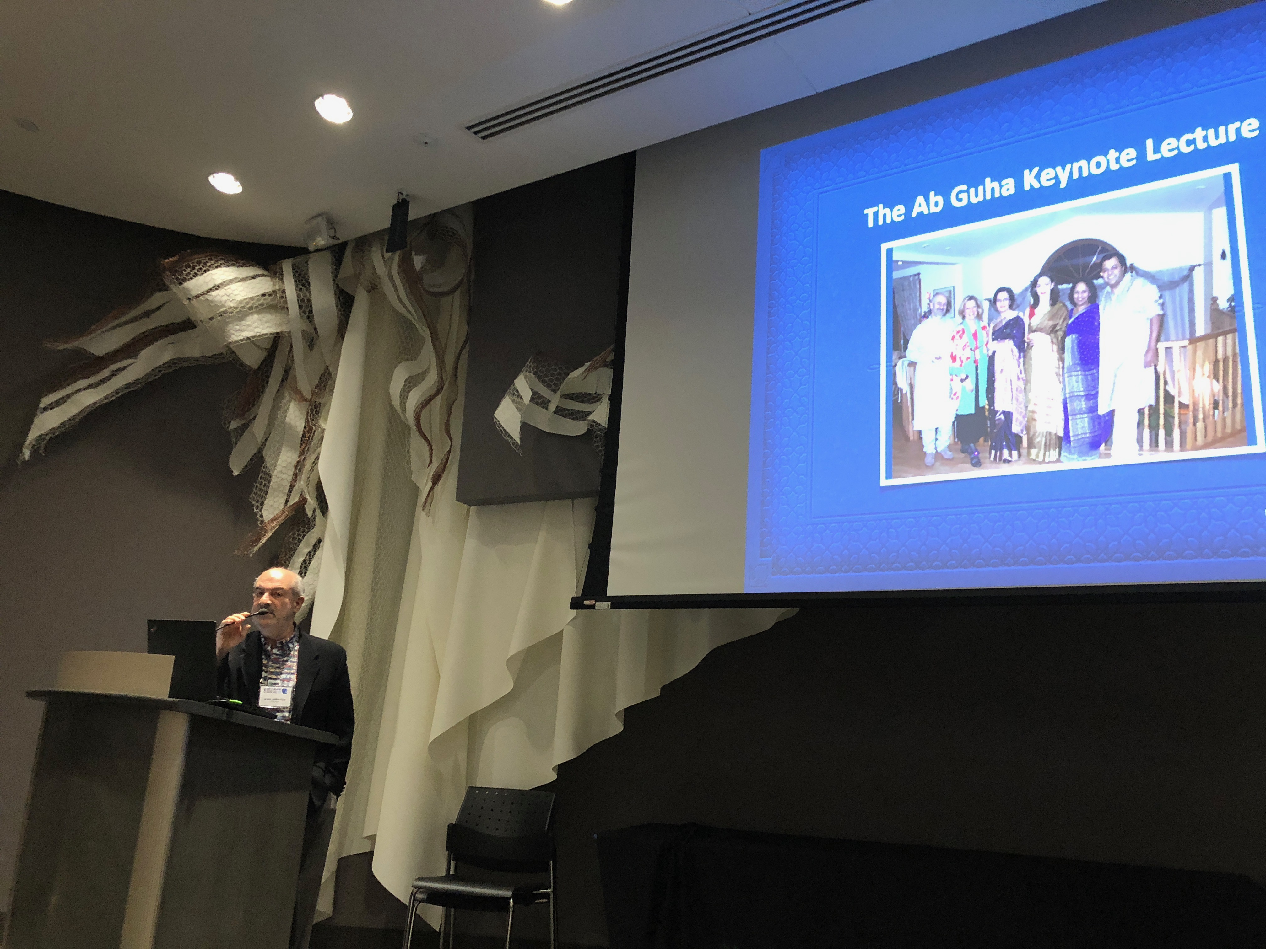
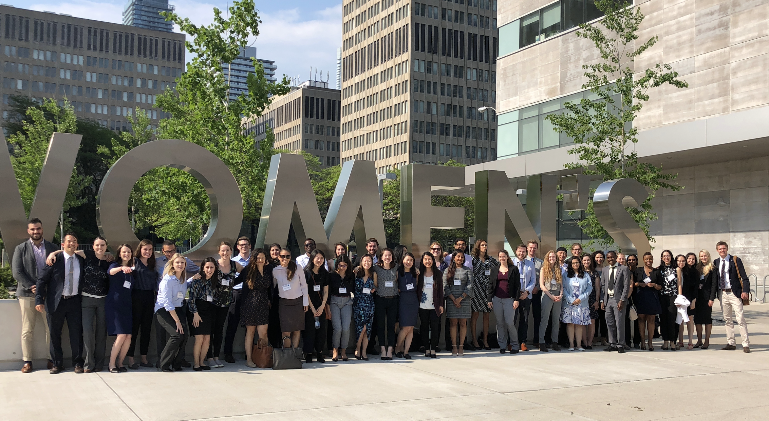
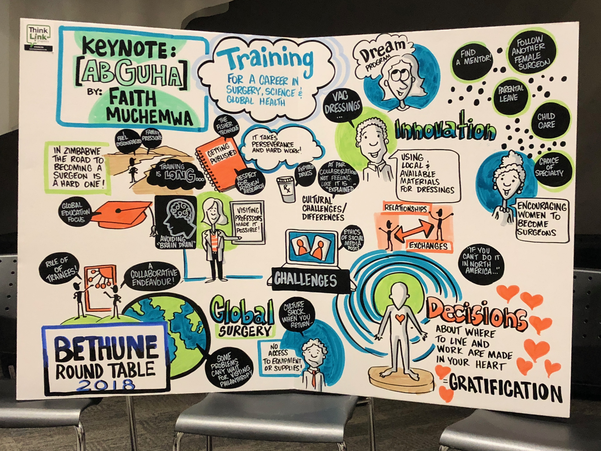
2018 BETHUNE ROUNDTABLE

Slide 8
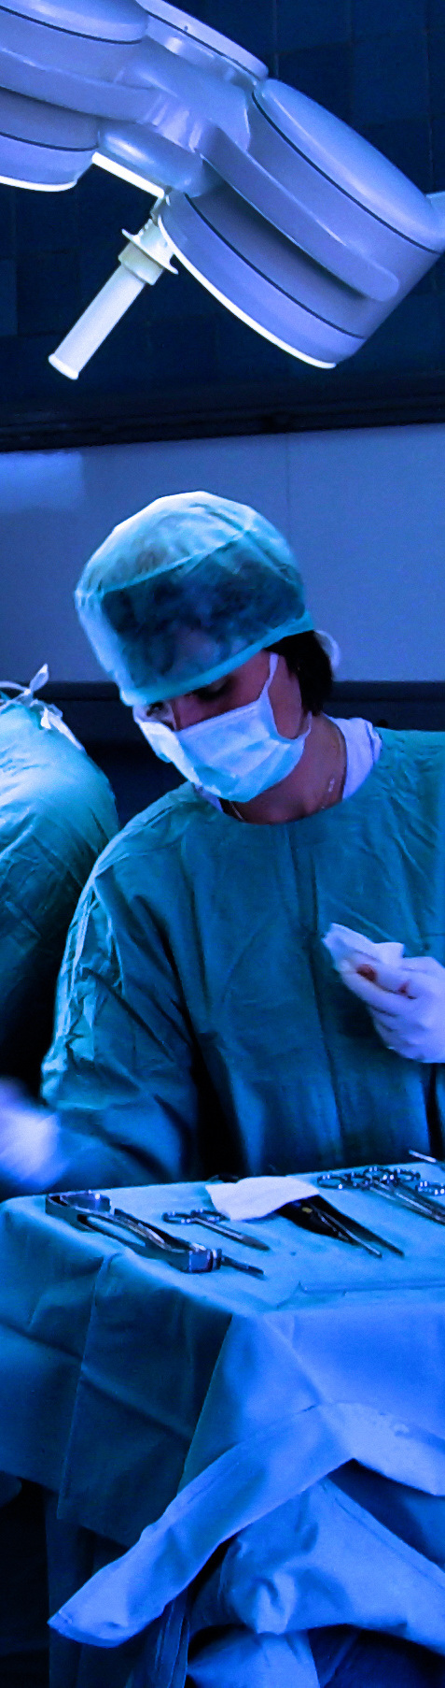



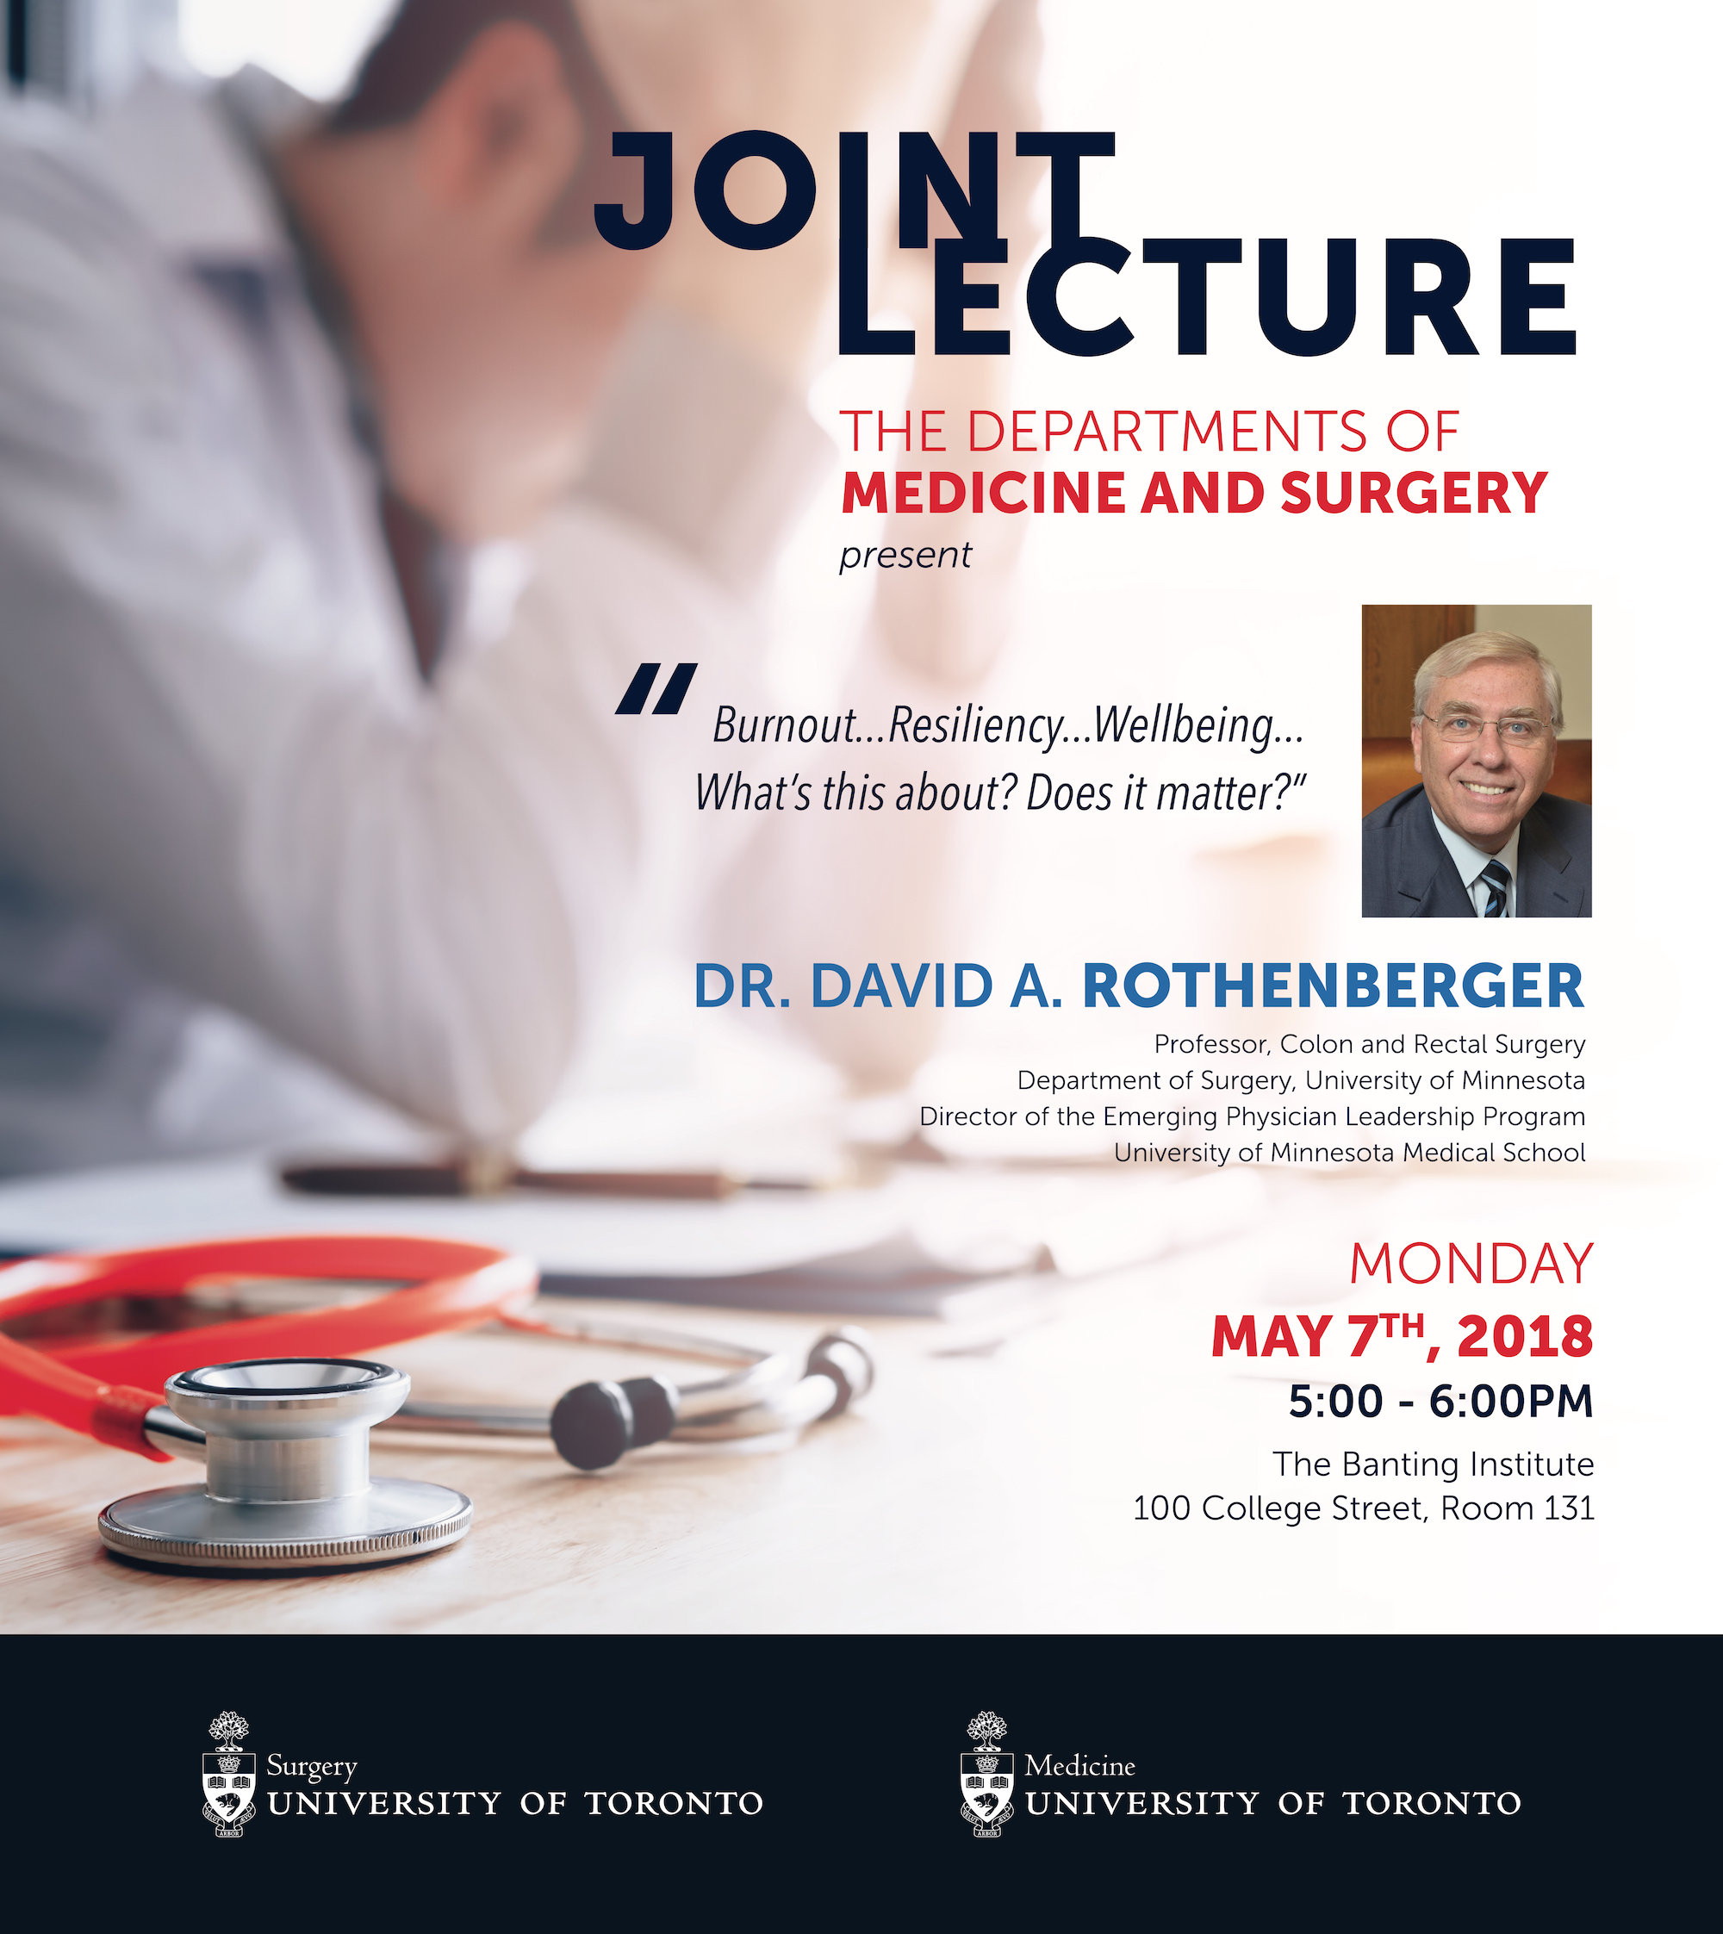

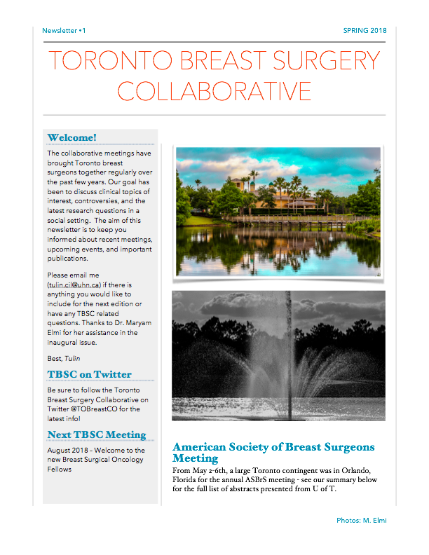
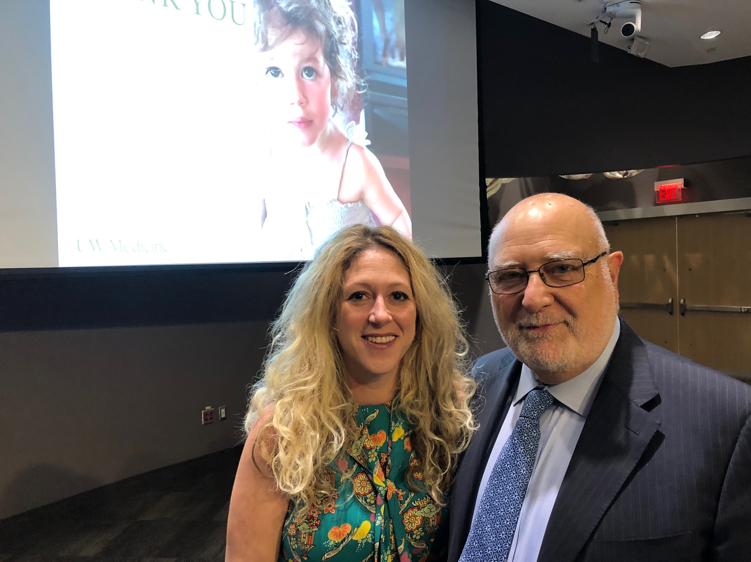
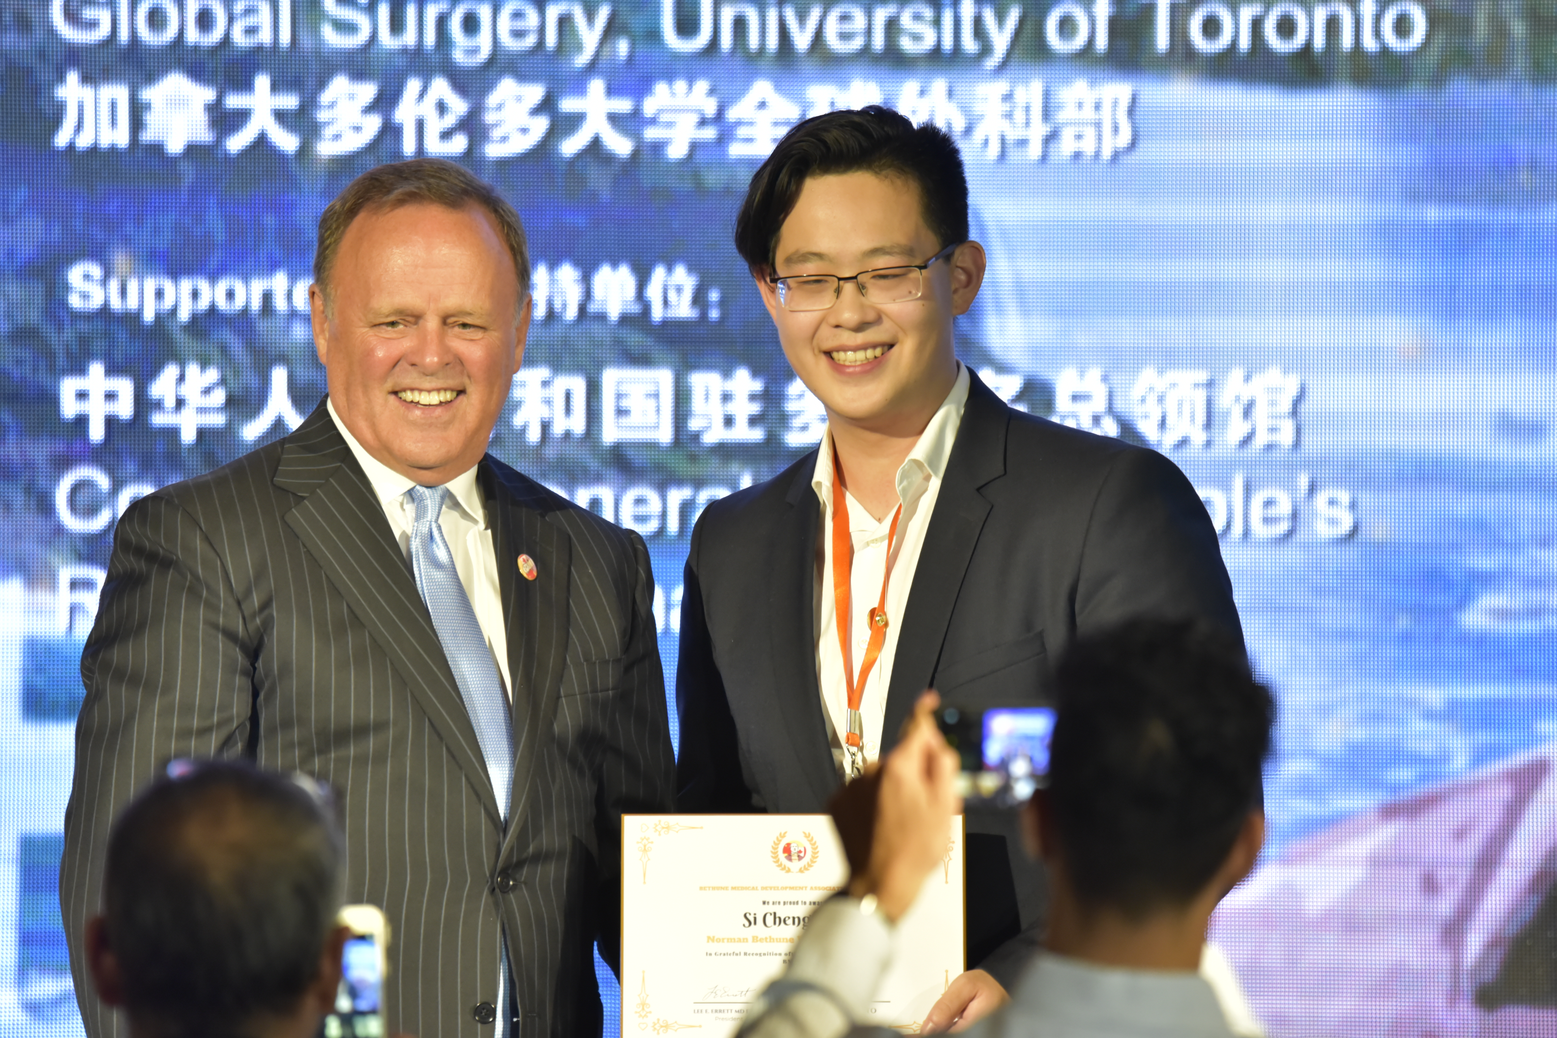
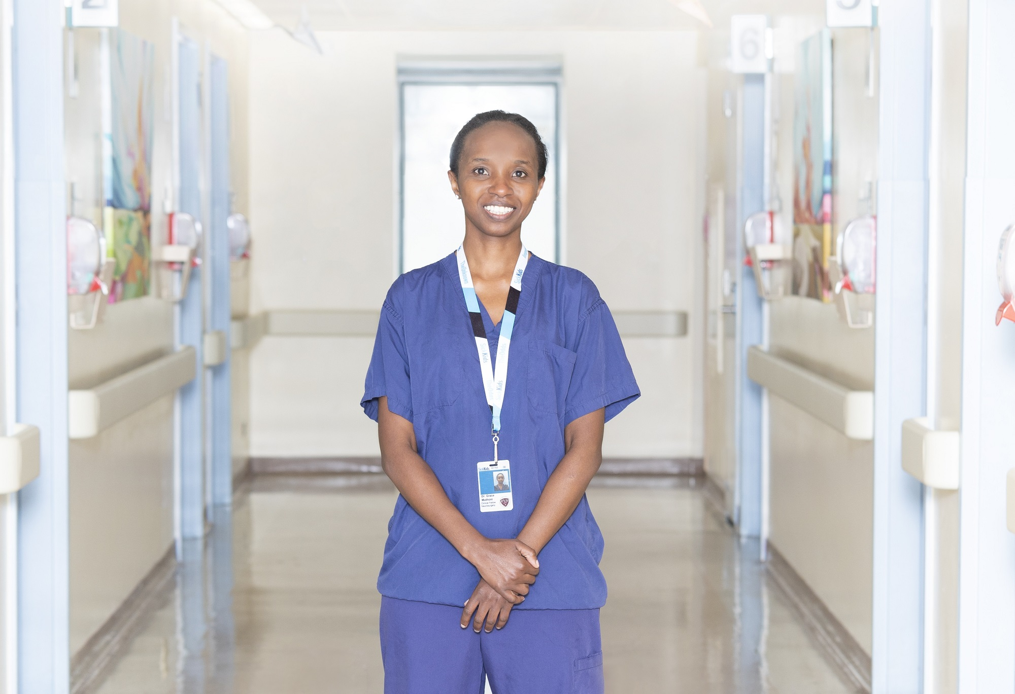
University of Toronto Department of Surgery
Annual Address 2018
Some other things we’ve been up to…
Toronto Breast Surgery Collaborative
First Newsletter
Bookclub
Annual Surgical Ethics Course
Prakash Fellowship
Grace Muthoni
Canada-China Medical Exchange Forum

Slide 9
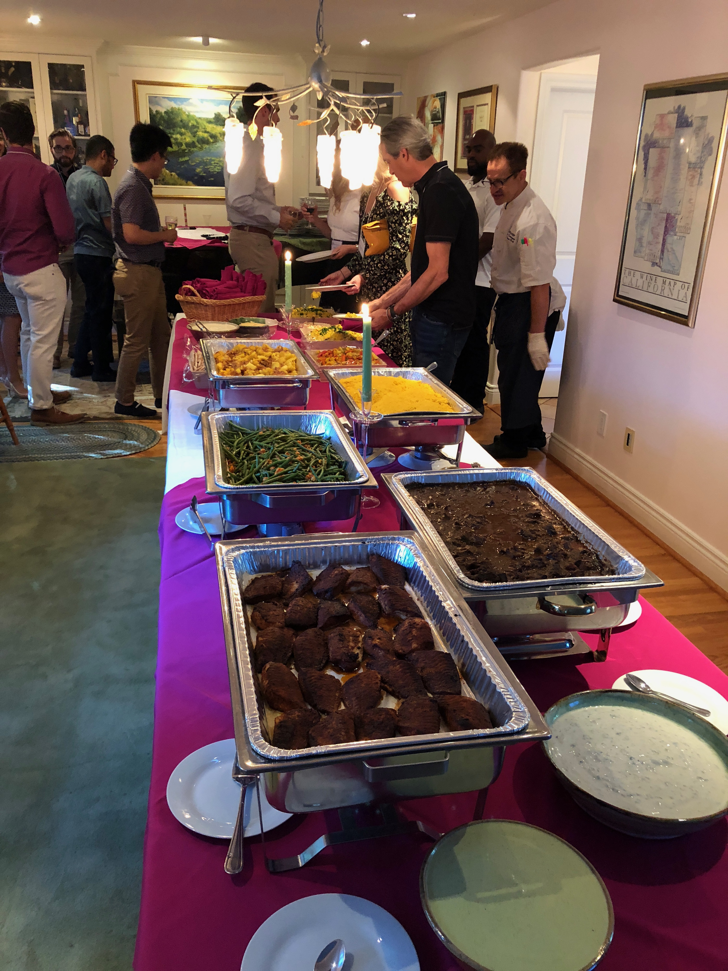
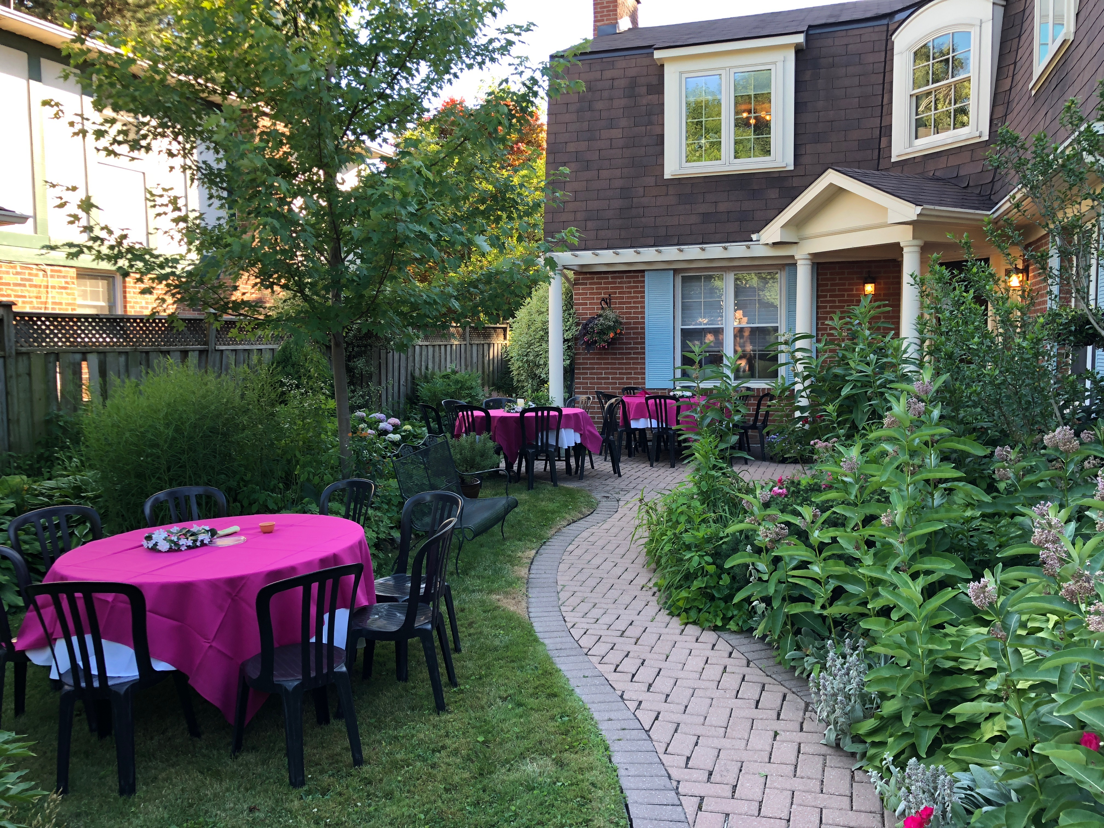
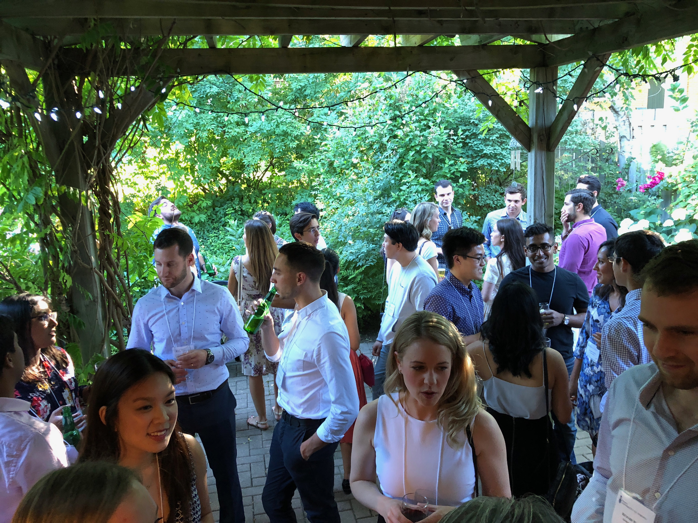
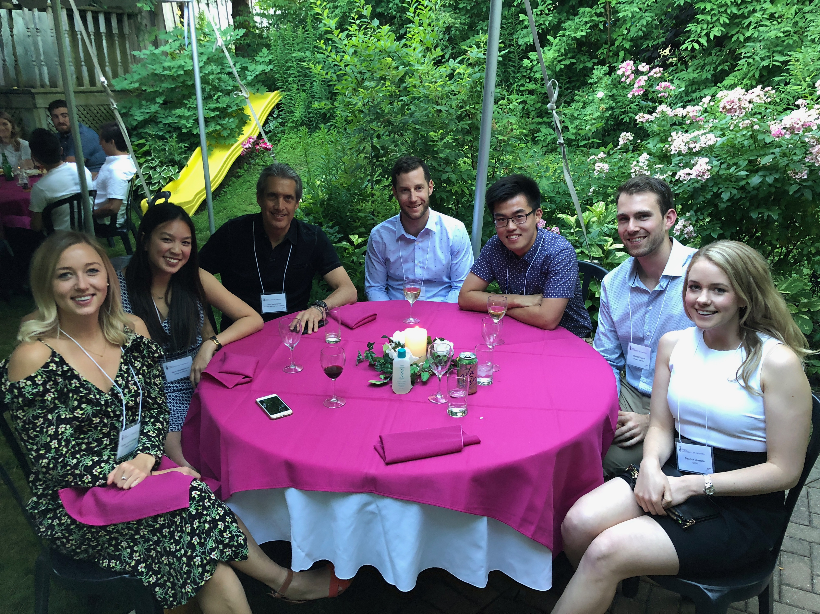
University of Toronto Department of Surgery
Annual Address 2018
PGY1’s Annual Welcome party

