Slide 1
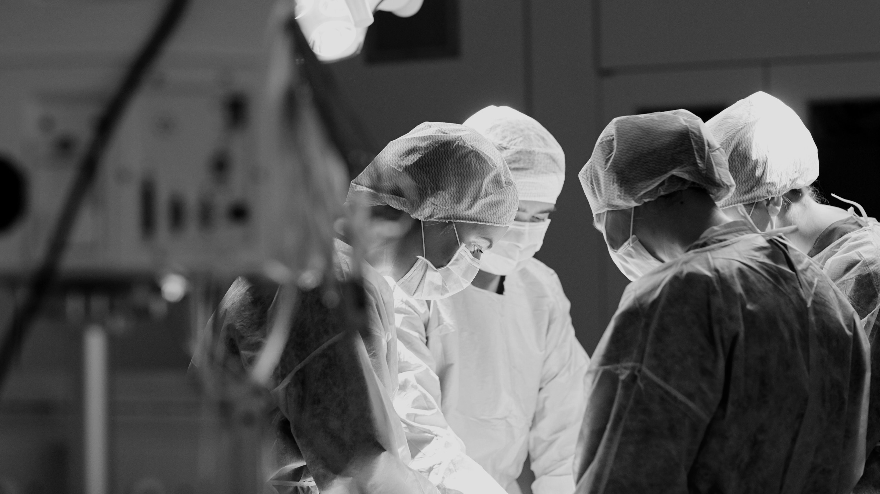


DEPARTMENT OF SURGERY
ANNUAL ADDRESS 2016
JAMES T. RUTKA
MD, PhD, FRCSC, FACS, FAAP, FAANS
RS McLaughlin Professor and Chair
Department of Surgery
University of Toronto

Slide 2

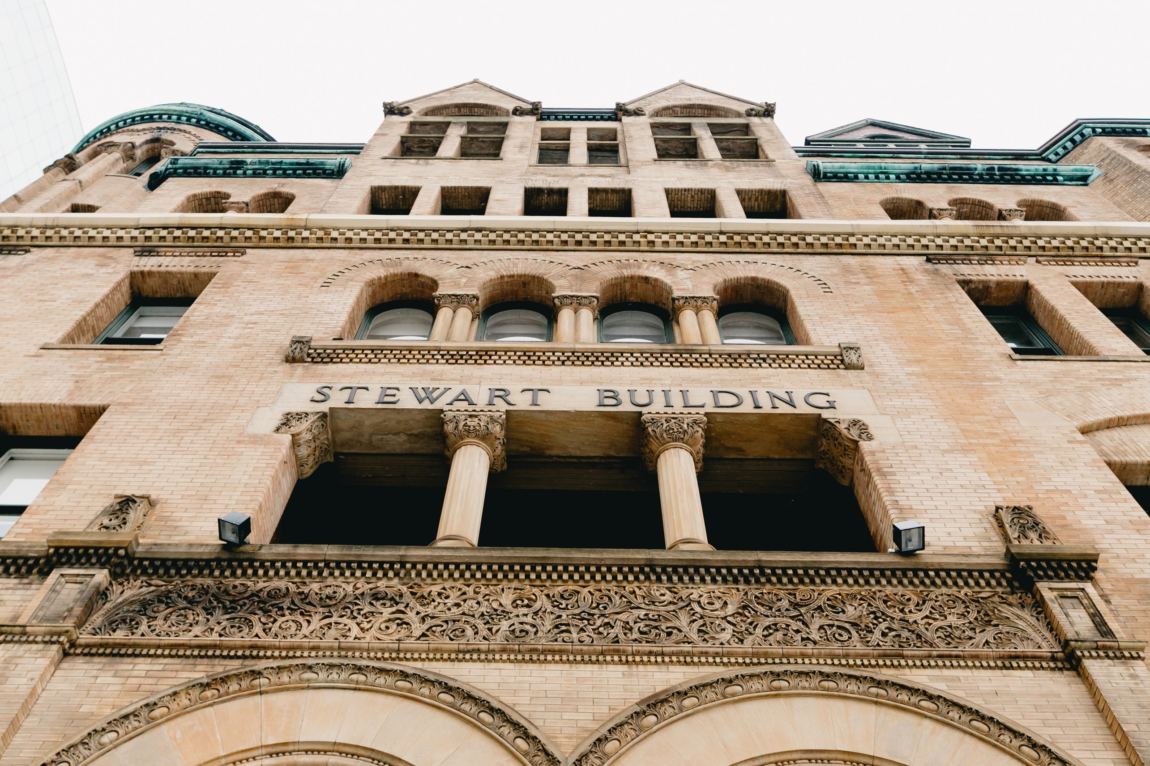
HIGHLIGHTS FROM 2015-16
1. SUCCESSFUL 5 YEAR REVIEW DEPARTMENT OF SURGERY
2. MORE THAN $55 M IN RESEARCH FUNDING - THE MOST EVER IN THE DEPT SURGERY!
3. INAUGURAL CONJOINT FACULTY DEVELOPMENT DAY WITH ANESTHESIOLOGY
4. PUBLICATION OF GLOBAL SURGERY AND SURGICAL INNOVATION PROSPECTUSES
5. HOSTING THE UK TRAVELLING SURGICAL SOCIETY ANNUAL MEETING
6. $6.1M IN ADVANCEMENT FUNDS - LARGEST AMOUNT IN HISTORY OF DEPARTMENT OF SURGERY

Slide 3
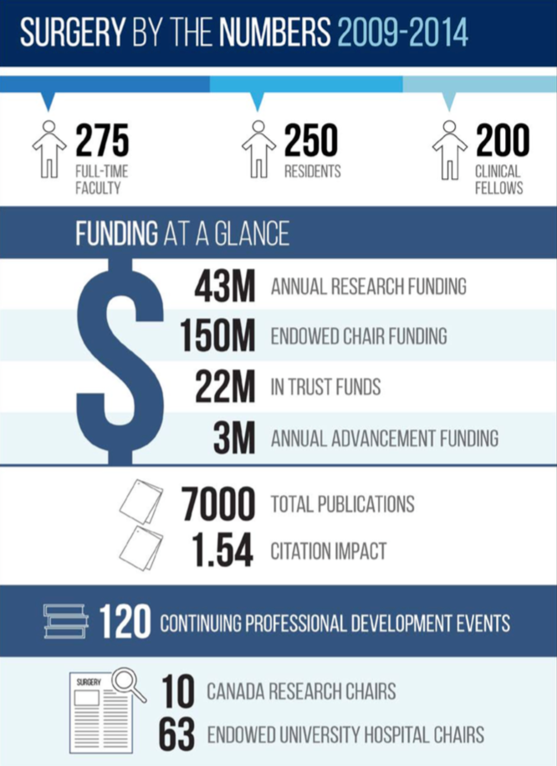
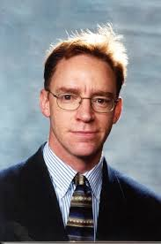
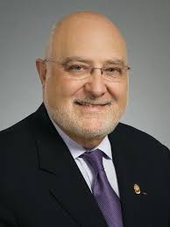
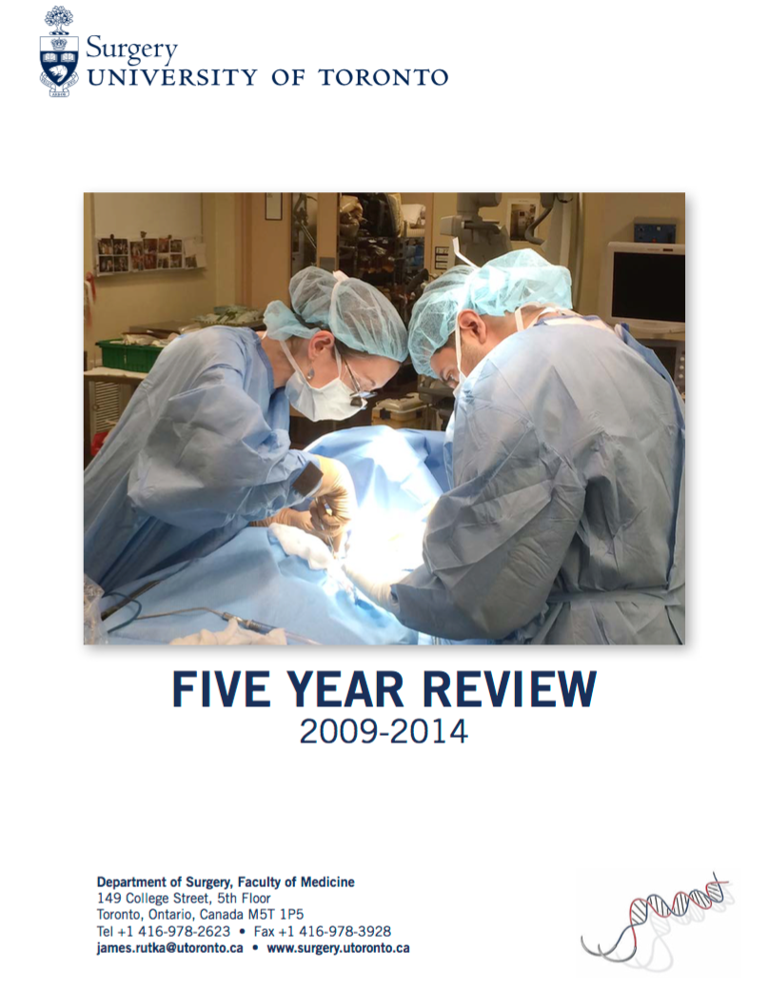

EXTERNAL REVIEW DEPT SURGERY
Carlos Pellegrini
John Kortbeek
Professor and Chair
Department of Surgery
University of Washington
Seattle
Professor and Chair
Department of Surgery
University of Calgary
Alberta
“There is no question that the Department of Surgery at the University of Toronto is the top department of its kind in Canada and one of the top 10 in the world. Its educational programs, in particular residency and fellowship are world-famous and its clinical programs are cutting edge, state of the art that compare favorably with any such program in the world.”
ANNUAL ADDRESS 2016

Slide 4


DEPARTMENT OF SURGERY - IN THE OFFICE
SPINE PROGRAM COORDINATOR - Nadia Jaber
PLASTICS PROGRAM ADMIN - Kathy Pavlovic
ORTHOPAEDICS PROGRAM ADMIN - Dan Stjimirovic
UROLOGY PROGRAM ADMIN - Kim MOFFAT
VASCULAR SURGERY PROGRAM ADMIN - Michelle Paiva
GENERAL SURGERY PROGRAM ADMIN - Faryal Esmail
QUALITY/BEST PRACTICES PROGRAM MANAGER - Emily Pearsall
CBC PROGRAM ADMIN - Polina Mironova
VICE CHAIRS AND DIRECTORS - David Latter, Michael Fehlings, Ron Levine, George Christakis, Melinda Musgrave, Lee Errett
SURGICAL SPOTLIGHT - Martin McKneally
CHAIR, DEPT SURGERY
BUSINESS OFFICER - Nancy Condo
ADMIN ASSISTANTS - Sylvia Perry, Nancy Somer
POST-GRAD COORDINATORS - Tess Weber, Robert Gardin
UNDERGRAD EDUCATION COORDINATOR - Shibu Thomas
FINANCE ADMINISTRATOR - Harjit Bains
STRATEGIC PLANNING - Joanna Giddens
RESEARCH PROGRAM MANAGER - Val Cabral
MEDICAL ILLUSTRATOR - Stacey Krumholtz
WEB/COMMUNICATIONS COORDINATOR - Stephanie Neilson
HR/PAYROLL ADMINISTRATOR - Alina Gaspar

Slide 5
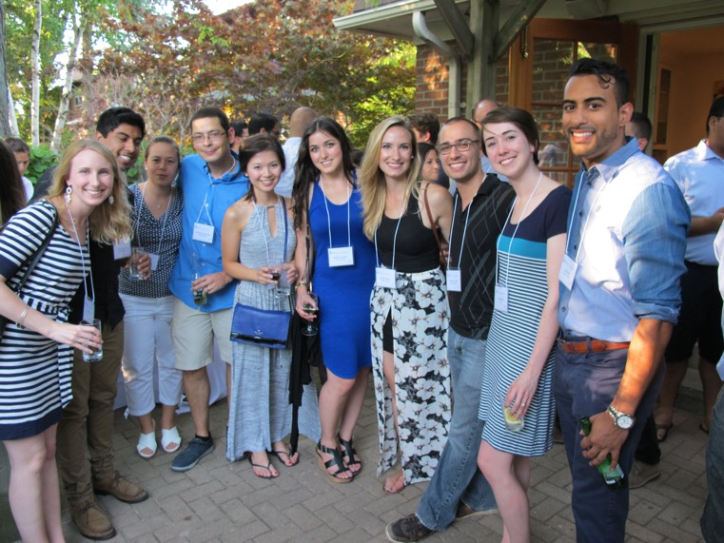
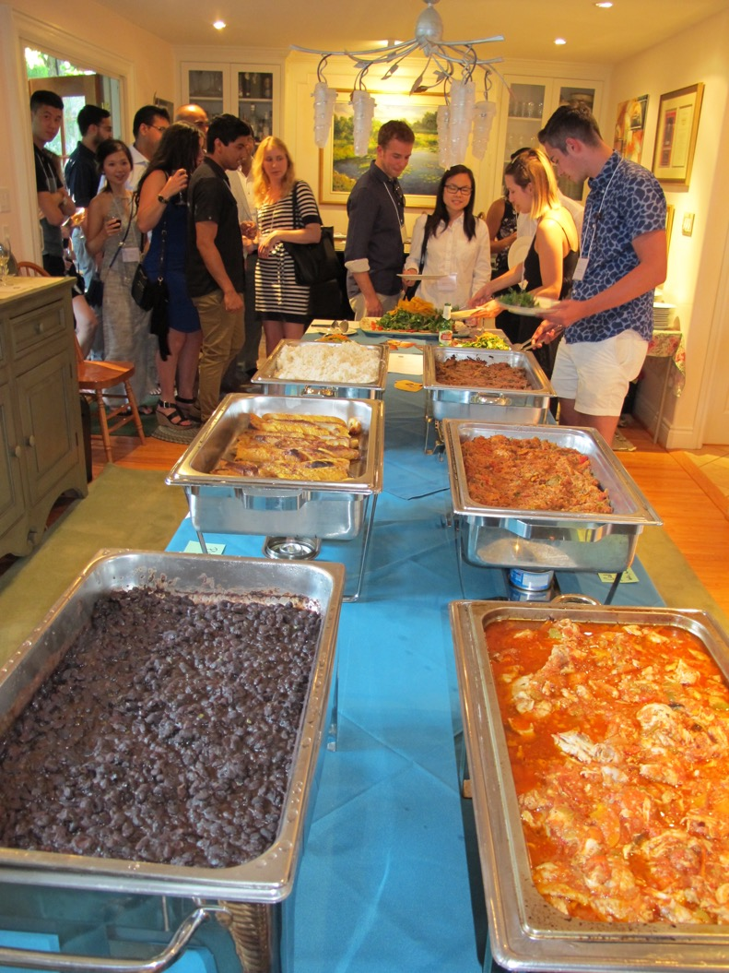
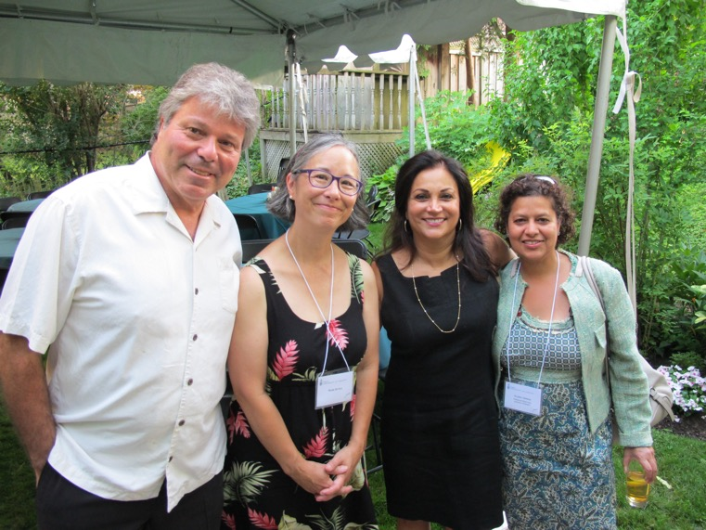
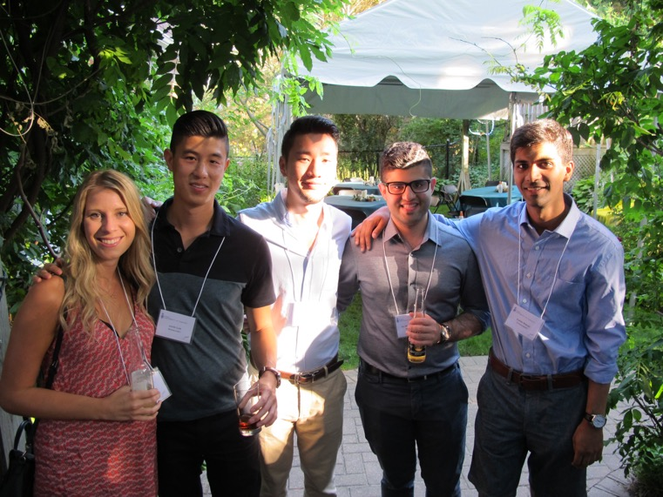
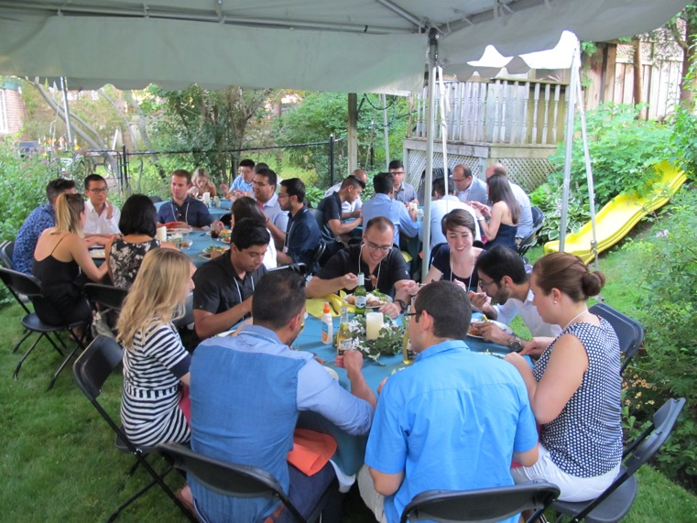
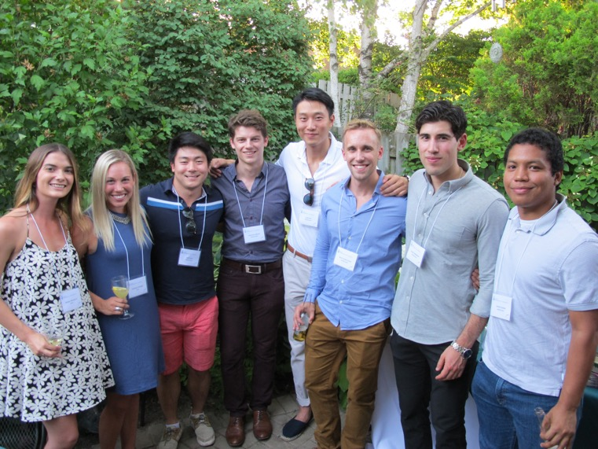
STELLAR CLASS OF NEW PGY1 RESIDENTS
STARTING JULY 1, 2016
ANNUAL ADDRESS 2016

Slide 6
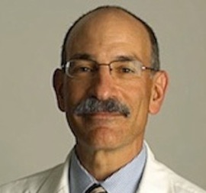
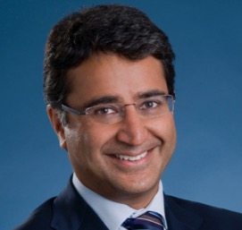
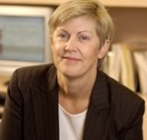
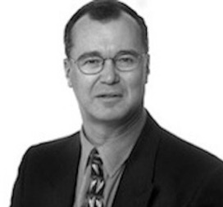
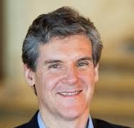
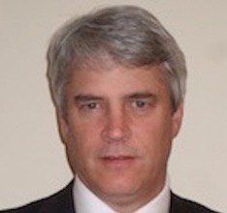
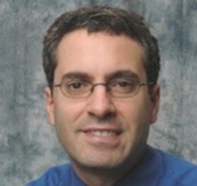
YOUR EXECUTIVE COMMITTEE/2015-2016
Ori Rotstein
Shaf Keshavjee
Robin McLeod
Robin Richards
Associate Chair
Vice Chair, Innovation
Vice Chair, Best Practices
Vice Chair, Clinical
Michael Fehlings
David Latter
Avery Nathens
Vice Chair, Research
Vice Chair, Education
Chair, Departmental Appointments Committee
ANNUAL ADDRESS 2016

Slide 7


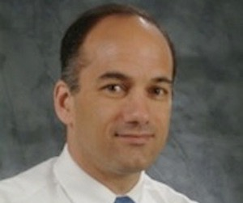
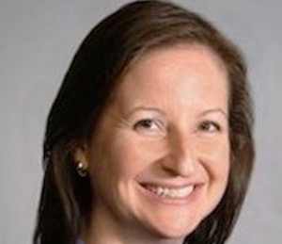
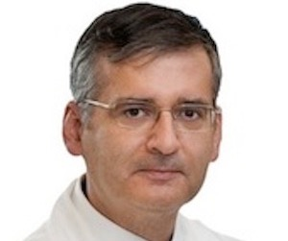
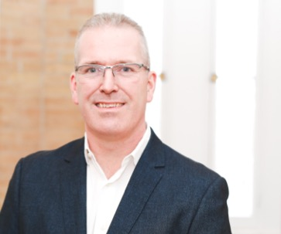
UNIVERSITY DIVISION CHAIRS/2015-2016
CINDI MORSHEAD
CHRIS CALDARONE
CAROL SWALLOW
ANATOMY
CARDIAC SURGERY
GENERAL SURGERY
ANDRES LOZANO
PETER FERGUSON
NEUROSURGERY
ORTHOPAEDICS
ANNUAL ADDRESS 2016

Slide 8
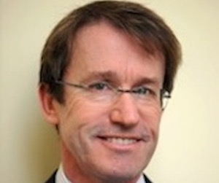
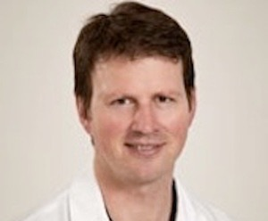
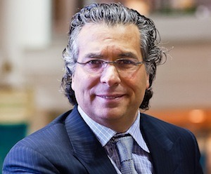
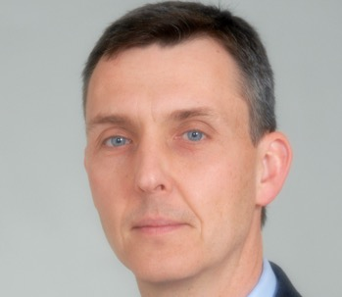
UNIVERSITY DIVISION CHAIRS CON’T/2015-2016
CHRIS FORREST
TOM WADDELL
PLASTIC & RECONSTRUCTIVE SURGERY
THORACIC SURGERY
NEIL FLESHNER
TOM FORBES
UROLOGY
VASCULAR SURGERY
ANNUAL ADDRESS 2016

Slide 9
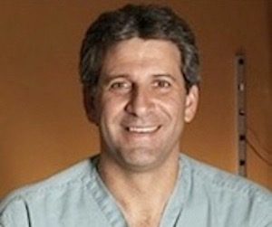
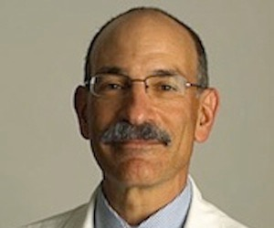
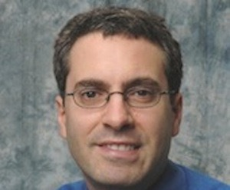
SURGEON-IN-CHIEFS/2015-2016
CHRIS CALDARONE
HOSPITAL FOR SICK CHILDREN
JAY WUNDER
MOUNT SINAI HOSPITAL SURGERY
ORI ROTSTEIN
ST. MICHAEL’S HOSPITAL
AVERY NATHENS
SUNNYBROOK HEALTH SCIENCES CENTRE
ANNUAL ADDRESS 2016

Slide 10
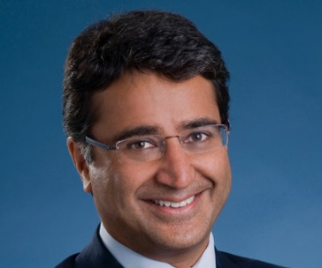

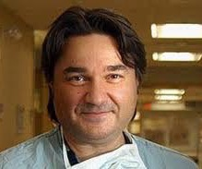
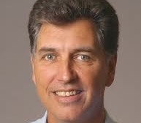
SURGEON-IN-CHIEFS CONT’D/2015-2016
SHAF KESHAVJEE
UNIVERSITY HEALTH NETWORK
CHRIS COMPEAU
ST. JOSEPH’S HEALTH CENTRE
CARMINE SIMONE
MICHAEL GARRON HOSPITAL
(FORMERLY TORONTO EAST GENERAL HOSPITAL)
LLOYD SMITH
NORTH YORK GENERAL HOSPITAL
ANNUAL ADDRESS 2016

Slide 11

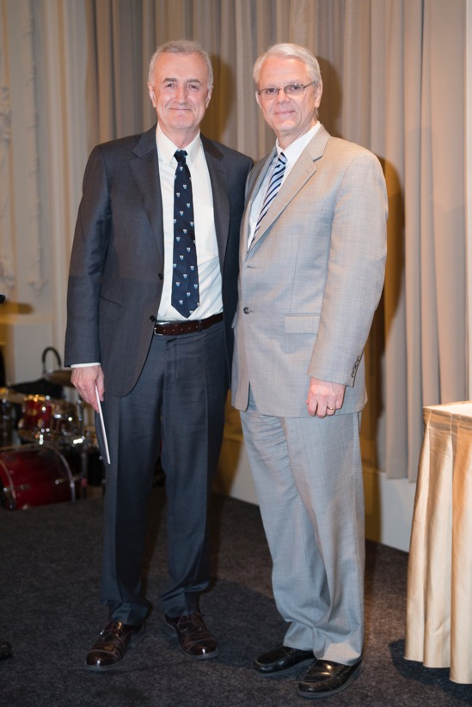


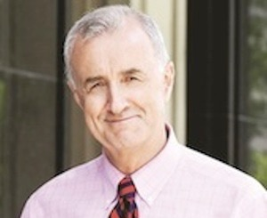
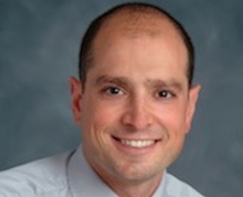
SURGEON-IN-CHIEFS CON’T/2015-2016
JOHN SEMPLE
DAVID URBACH
WOMEN’S COLLEGE HOSPITAL
2016 - PRESENT
WOMEN’S COLLEGE HOSPITAL
2006-2016
ANNUAL ADDRESS 2016

Slide 12

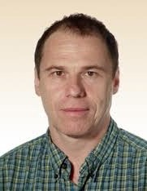
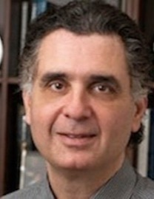
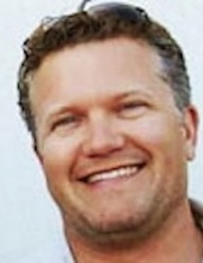
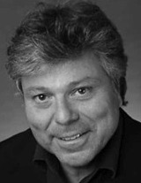
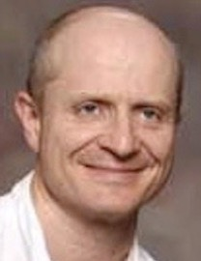
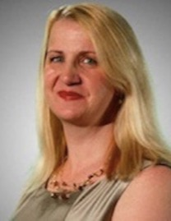
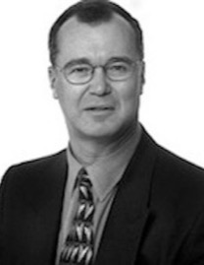
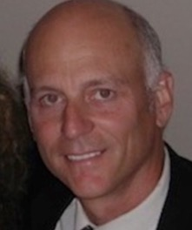
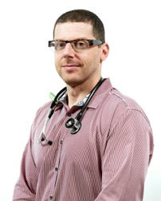

EDUCATION AND RESEARCH TEAM
Robin Richards
George Christakis
Melinda Musgrave
Ron Levine
Terry Axelrod
Andras Kapus
Jeremy Hall
Oleg Safir
Chair, Internal Evaluation Committee
Director, Postgraduate Education
Director, Undergraduate Education
Director, Education Evaluation
Director, CPD
Associate Chair, Research
Deputy Director, Education Evaluation
Director, Surgical Skills Centre
Maurice Blitz
Director, Surgical Foundations
ANNUAL ADDRESS 2016

Slide 13
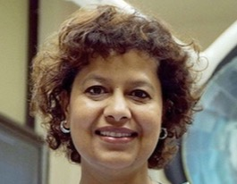
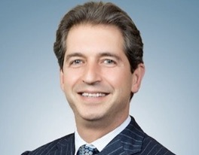
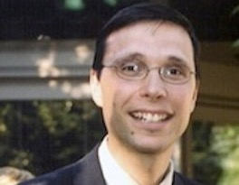
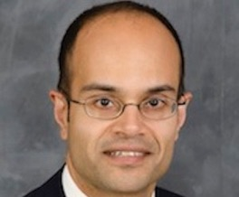
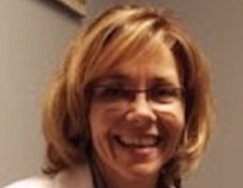

PROGRAM DIRECTORS
2015-2016
NAJMA AHMED
MITCH BROWN
R J CUSIMANO
GENERAL SURGERY
PLASTIC & RECONSTRUCTIVE SURGERY
CARDIAC SURGERY
AB KULKARNI
HELEN MACRAE
MARKKU NOUSIANNEN
NEUROSURGERY
COLORECTAL SURGERY
ORTHOPAEDICS

Slide 14





PROGRAM DIRECTORS CONT’D
2015-2016
GEORGE OREOPOULOS
ANDREW PIERRE
VASCULAR SURGERY
THORACIC SURGERY
AGOSTINO PIERRO
ROB STEWART
FRANCES WRIGHT
PAEDIATRIC GENERAL SURGERY
UROLOGY
SURGICAL ONCOLOGY

Slide 15

SPECIAL LEADERSHIP POSITIONS
International/National/University
Howard Clarke - Chair, International Confederation of Plastic Surgery Societies Board of Directors
Teodor Grantcharov - Board of Governors of the American College of Surgeons
Avery Nathens - Director, ACS Trauma Quality Improvement Program
Bryce Taylor - Chair, Board of Directors, Canadian Medical Hall of Fame
Sender Herschorn - Director, University of Toronto Research Program in Functional Urology
David Latter - Director, MD Admissions and Student Finances
ANNUAL ADDRESS 2016

Slide 16
SPECIAL LEADERSHIP POSITIONS
Hospital
Albert Yee - Chief, Holland Musculoskeletal Program; Hospital Head Orthopaedics, Sunnybrook
Shady Ashamalla - Hospital Head, General Surgery, Sunnybrook Health Sciences Centre
Tony Finelli - Hospital Head, Urology, University Health Network
Todd Mainprize - Hospital Head, Neurosurgery, Sunnybrook Health Sciences Centre
ANNUAL ADDRESS 2016

Slide 17




LATE CAREER TRANSITIONS
THANK YOU!
JOHN CAMERON
Orthopaedics,
Sunnybrook Health Sciences Centre
RICHARD HOLTBY
Orthopaedics,
Sunnybrook Health Sciences Centre
ANNUAL ADDRESS 2016

Slide 18

ACADEMIC PROMOTIONS
JULY 1, 2015 - JUNE 30, 2016
ANNUAL ADDRESS 2016

Slide 19



LECTURER TO ASSISTANT PROFESSOR
JOSEPH NOORA
Trillium Health Partners
Cardiac Surgery
JASON PENNINGTON
Scarborough Hospital
General Surgery
NAJIB SAFIEDDINE
Michael Garron (Toronto East General) Hospital
Thoracic Surgery
ANNUAL ADDRESS 2016

Slide 20



ASSISTANT TO ASSOCIATE PROFESSOR
MARCELO CYPEL
University Health Network
Thoracic Surgery
OSAMI HONJO
Hospital for Sick Children
Cardiac Surgery
PAUL KARANICOLAS
Sunnybrook Health Sciences Centre
General Surgery
ANNUAL ADDRESS 2016

Slide 21


ASSISTANT TO ASSOCIATE PROFESSOR
GRAHAM ROCHE-NAGLE
  University Health Network
Vascular Surgery
DANIEL WHELAN
  St. Michael’s Hospital
Orthopaedics
ANNUAL ADDRESS 2016

Slide 22


ASSOCIATE TO FULL PROFESSOR
MOJGAN HODAIE
  University Health Network
Neurosurgery
DARRYL OGILVIE-HARRIS
  University Health Network
Orthopaedics
ANNUAL ADDRESS 2016

Slide 23

PROFESSOR EMERITA
LAVINA LICKLEY
Women’s College Hospital
General Surgery
ANNUAL ADDRESS 2016

Slide 24
CONTINUING APPOINTMENT REVIEWS
JULY 1, 2015 - JUNE 30, 2016
ANNUAL ADDRESS 2016

Slide 25






CONTINUING APPOINTMENT REVIEWS
ORI ROTSTEIN
SHADY ASHAMALLA
JASKARNDIP CHAHAL
KAREN DEVON
GREGORY FAIRN
ROBERT HAMILTON
CAR Chair
SHSC
General Surgery
WCH
Orthopaedics
WCH/UHN
General Surgery
SMH
General Surgery
UHN
Urology
ANNUAL ADDRESS 2016

Slide 26






CONTINUING APPOINTMENT REVIEWS CONT’D
EDWARD HICKEY
PAUL KARANICOLAS
PAUL KUZYK
  STEVEN McCABE
BARTOLOMEU NASCIMENTO
ANNE O’NEILL
HSC
Cardiac Surgery
SHSC
General Surgery
MSH
Orthopaedics
UHN
Plastic & Reconstructive Surgery
SHSC
General Surgery
UHN
Plastic & Reconstructive
Surgery
ANNUAL ADDRESS 2016

Slide 27





CONTINUING APPOINTMENT REVIEWS CONT’D
FAYEZ QUERESHY
IVAN RADOVANOVIC
JOAO DE REZENDE-NETO
MOHAMMED SHAMJI
LAURA SNELL
UHN
General Surgery
UHN
Neurosurgery
SMH
General Surgery
UHN
Neurosurgery
SHSC
Plastic & Reconstructive
Surgery
ANNUAL ADDRESS 2016

Slide 28
NEW FACULTY RECRUITMENTS
JULY 1, 2015 - JUNE 30, 2016
ANNUAL ADDRESS 2016

Slide 29

NEW FACULTY RECRUITS
Fathi Abuzagaya - Rouge Valley (OS)
Olubimpe Ayeni - Southlake (PRS)
Robert Bendavid - Office based (GS)
Kristen Foell - Royal Victoria (US)
Alexander Iskander - Humber River (GS)
Mehdi Shahideh - Trillium (NS)
Bharat Sharma - Royal Victoria (GS)
Jason Smith - Rouge Valley (OS)
Ron Somogyi - North York General (PRS)
Dana Wilson - Trillium (OS)
ADJUNCT
Adam Mohammed - Trillium (TS)
Frank Papanikolaou - Trillium (US)
Tara Lynn Teshima - Markham Stouffville (PRS)
Roberto Tutino - Trillium (PRS)
William Williams - Hospital for Sick Children (CS)
PART TIME
ANNUAL ADDRESS 2016

Slide 30












NEW FACULTY RECRUITS FULL TIME
HEATHER BALTZER
SAVTAJ BRAR
Plastic & Reconstructive Surgery (UHN)
General Surgery (MSH)
KAREN CROSS
KRISTEN DAVIDGE
Plastic & Reconstructive Surgery (SMH)
Plastic & Reconstructive Surgery (HSC)
ALAN ROGERS
Plastic & Reconstructive Surgery (SHSC)
GONZALO SAPISOCHIN
General Surgery (UHN)
SARAH WARD
BOBBY YANAGAWA
Orthopaedics (SMH)
Cardiac Surgery (SMH)
AUGUSTO ZANI
MENTORS: Greg Borschel; John Cameron; Chris Hayes,
Paul Karanicolas; Avery Nathens; Subodh Verma
and Cari Whyne
General Surgery (HSC)

Slide 31









In Memoriam
Michael Goldberg
(Vascular Surgery, SMH)
1941 - 2016
Ernie Spratt
(Thoracic Surgery, SJHC)
1939 - 2014
Griff Pearson
(Thoracic Surgery, UHN)
1926 - 2016
ANNUAL ADDRESS 2016

Slide 32
ADVANCEMENT
JULY 1, 2015 - JUNE 30, 2016
ANNUAL ADDRESS 2016

Slide 33


DEPARTMENT OF SURGERY
ADVANCEMENT SUMMARY 2015-2016
DAVID GRIECO
Senior Development Officer, Surgery
$6.1M raised; highest total in Department’s history
Over $1.6M secured for Surgeon Scientist Training Program
Continued support of Surgical Skills Centre & Global Surgery initiatives
Established new innovation funds in Urology and Vascular Surgery supporting faculty research
New lecture and graduate award created in Orthopaedics
The BOUNDLESS Campaign to date has raised over $30M in support for the Department of Surgery
ANNUAL ADDRESS 2016

Slide 34
NEW CHAIR APPOINTMENTS
JULY 1, 2015 - JUNE 30, 2016
ANNUAL ADDRESS 2016

Slide 35



CHAIR ANNOUNCEMENTS 2015/2016
MARTIN GARGAN
FRED GENTILI
AARON NAUTH
INAUGURAL
INAUGURAL
Chair in Fracture Care Research
Harold and Bernice Groves Chair
in Orthopaedics
Crean Hotson Chair in
Skull Base Surgery
ANNUAL ADDRESS 2016

Slide 36




CHAIR ANNOUNCEMENTS CONT’D 2015/2016
JOHN SEMPLE
STEPHEN FREMES
ANDRES LOZANO
MIKE TYMIANSKI
RE-APPOINTED
RE-APPOINTED
RE-APPOINTED
APPOINTED
Harold and Esther Halpern Chair
in Neurosurgical Stroke Research
Canadian Breast Cancer Foundation
Research Chair
Goldman Chair
Dan Family Chair in Neurosurgery
ANNUAL ADDRESS 2016

Slide 37

UPDATE - STRATEGIC PLANNING
JULY 1, 2015 - JUNE 30, 2016
JOANNA GIDDENS - Strategic planning implementation coordinator
ANNUAL ADDRESS 2016

Slide 38

STRATEGIC PLAN
David Latter
Vice Chair, Education
WHAT’S NEW?
EDUCATION UPDATE
UGME - The new curriculum - 2016!
PGME - Royal College implementing CBC across all Divisions
Formation of Education Scholars Committee
Inaugural Education Scholars Retreat in February 2017
ANNUAL ADDRESS 2016

Slide 39

STRATEGIC PLAN
EDUCATION COURSE
For Senior Surgical Residents
Barry RUBIN
Negotiating your first contract and staff position
Incorporation
Finances and tax planning
Office expenses
Insurance needs including disability insurance
Hiring personnel for your office
Group contracts
ANNUAL ADDRESS 2016

Slide 40






STRATEGIC PLAN
Michael Fehlings
Vice Chair Research
Shaf Keshavjee
WHAT’S NEW?
Vice Chair, Innovation
RESEARCH UPDATE
Successful second annual research retreat
Increased advancement efforts - with a focus on the SSTP
Creation of guidelines for applications for new technology patents
Publication of Innovation Prospectus
ANNUAL ADDRESS 2016

Slide 41


STRATEGIC PLAN
Ori Rotstein
Paul Grieg
WHAT’S NEW?
FACULTY DEVELOPMENT
Mentoring program formally implemented for new recruits
Development of mentoring metrics
Acceptance of late-career transition guidelines
Implementation of surgical leadership training program
Joint Surgery:Anesthesiology Faculty Development Day
ANNUAL ADDRESS 2016

Slide 42







STRATEGIC PLAN
Avery Nathens
Lee Errett
WHAT’S NEW?
GLOBAL SURGERY
Creation of Surgeon:Global Surgery Academic Role
Inaugural Global Surgery Symposium - Mr Henry Marsh
Publication of Global Surgery Prospectus
Andrew Howard
ANNUAL ADDRESS 2016

Slide 43




GLOBAL SURGERY SYMPOSIUM / 2016
ANNUAL ADDRESS 2016

Slide 44

STRATEGIC PLAN
WHAT’S NEW?
QUALITY/BEST PRACTICES
Robin McLeod
Vice Chair
QUALITY/BEST PRACTICES
ANNUAL ADDRESS 2016

Slide 45



RESEARCH
UPDATE
Val Cabral
Research Administrator
Michael Fehlings
Vice Chair Research
ANNUAL ADDRESS 2016

Slide 46

RESEARCH FUNDING (2009-2015)
$55.2M
ANNUAL ADDRESS 2016

Slide 47

SURGEON SCIENTIST TRAINING PROGRAM
ANNUAL ADDRESS 2016

Slide 48

SURGEON SCIENTIST TRAINING PROGRAM
ANNUAL ADDRESS 2016

Slide 49

SURGEON SCIENTIST TRAINING PROGRAM
ANNUAL ADDRESS 2016

Slide 50




42ND ANNUAL GALLIE DAY CELEBRATION
KING EDWARD HOTEL MAY 13, 2016
Dr. Rosalind Bradford
Gordon Murray’s Daughter
Dr. Mohit Bhandari
Gordon Murray Lecturer 2016
ANNUAL ADDRESS 2016

Slide 51





GALLIE DINNER AWARD PRESENTATIONS
KING EDWARD HOTEL MAY 13, 2016
Dr. Dennis Di Pasquale
Tovee Undergraduate Prize
Dr. Kathryn Isaac
D R Wilson Award
Dr. Georges Azzie
Tovee Postgraduate Prize
& Dr. Joshua Greenberg
D R Wilson Award
ANNUAL ADDRESS 2016

Slide 52





GALLIE DINNER AWARD PRESENTATIONS
KING EDWARD HOTEL MAY 13, 2016 Cont’d
Dr. Nir Lipsman
Shafie Fazel Award
Dr. Sandra de Montbrun
Surgical Skills Centre Award
Dr. Michael Taylor
Lister Prize
Dr. Teodor Grantcharov
Charles Tator Award
ANNUAL ADDRESS 2016

Slide 53





GALLIE DINNER AWARD PRESENTATIONS
KING EDWARD HOTEL MAY 13, 2016 Cont’d
Dr. Anand Govindarajan
B Langer Surgeon Scientist Award
Dr. Toni Zhong
George Armstrong-Peters Prize
Dr. Christoph Haller
Zane Cohen Clinical Fellowship Achievement Award
ANNUAL ADDRESS 2016

Slide 54












UK TRAVELING SURGICAL SOCIETY
June 4- 11, 2016
ANNUAL ADDRESS 2016

Slide 55



IN THE NEWS
HEADLINE EXEMPLARS
NATIONAL POST/CTV - This girl’s leg was 95% severed…(Greg Borschel and colleagues)
GLOBE & MAIL/NATIONAL POST/CBC/THE STAR - Canada’s first hand transplant…(Steve McCabe & Team)
GLOBE & MAIL - Sunnybrook doctor first to perform blood-brain barrier procedure…(Todd Mainprize & Team)
2016 HONDA INDY TORONTO - Race car drivers stay safe thanks to efforts of medical team (Hugh Scully & colleagues)
ANNUAL ADDRESS 2016

Slide 56

HONOURS AND
AWARDS
2015/2016
ANNUAL ADDRESS 2016

Slide 57




HONOURS AND AWARDS 2015-2016
JAMIL AHMAD
William K Lindsay Faculty Research Mentor Award
NAJMA AHMED
2016 Royal College / AMS Donald Richards Wilson Award
OLEH ANTONYSHYN
Department of Surgery UG Teaching Award (SHSC)
Ukraine - Order of Merit
ABDOLLAH BEHZADI
2016 Dr. Norman Hill Award for Leadership in Education
GREGORY BORSCHEL
Plastic Surgery Foundation Visiting Professor
ANNUAL ADDRESS 2016

Slide 58





HONOURS AND AWARDS 2015-2016 CONT’D
MITCH BROWN
Canadian Society of Plastic Surgeons President’s Medal
Arnis Freiberg Faculty Teaching Award
GEORGE CHRISTAKIS
John Provan Outstanding Undergraduate Surgical Educator Award
SEAN CLEARY
Nicolas Colapinto Teaching Award
ROBERT CUSIMANO
Lynda L. Mickleborough Award for Excellence in Cardiac Surgery Teaching
TIM DANIELS
Roger A. Mann Award
ANNUAL ADDRESS 2016

Slide 59






HONOURS AND AWARDS 2015-2016 CONT’D
TIRONE DAVID
American Association for Thoracic Surgery Scientific Achievement Award
JOAO de REZENDE-NETO
William J Horsey Award for Excellence in PG Education
ANDREW DUECK
Best Faculty Teacher in VS as voted by residents/fellows
STEPHEN FREMES
Bernard Goldman Award for Excellence in Cardiac Surgery Teaching
RICHARD HOLTBY
Marvin Tile Award
JOEL FISH
Inaugural Ronald M Zuker Award
ANNUAL ADDRESS 2016

Slide 60





HONOURS AND AWARDS 2015-2016 CONT’D
OSAMI HONJO
NANCY MCKEE
William G Williams Award for Excellence in Cardiac Surgery
PRS Chair’s Lifetime Achievement Award
SIMON KELLEY
2015 Founder’s Medal from Canadian Orthopaedic Research Society
LAURENCE KLOTZ
Fellowship Canadian Academy of Health Sciences inductee
ANDRES LOZANO
Order of Canada
ANNUAL ADDRESS 2016

Slide 61






HONOURS AND AWARDS 2015-2016 CONT’D
DAVID LATTER
CINDI MORSHEAD
James Yao Award for Excellence in Cardiac Surgery Teaching
2016 Excellence in Undergraduate Teaching in Life Sciences Award
GEORGE OREOPOULOS
Ross Fleming Award for Excellence in Surgical Education
MARTIN MCKNEALLY
2016 Distinguished Service to Joint Center for Bioethics
GIUSEPPE PAPIA
2015-2016 Peters-Boyd Academy,
Clerkship Faculty Teaching Award for Clinical Teaching
ROBERT NAM
PARO 2016 Excellence in Clinical Teaching Award
ANNUAL ADDRESS 2016

Slide 62







HONOURS AND AWARDS 2015-2016 CONT’D
GRAHAM ROCHE-NAGLE
SUBODH VERMA
Canadian Society for VS John L Provan Education Award
Royal Society of Canada’s College of New Scholars
Appointed to Journal of American College of Cardiology Editorial Board
Established CARDIOLINK - first national platform for clinical trials in CS
RICHARD WEISEL
ORI ROTSTEIN
Fellowship Canadian Academy of Health Sciences inductee
2016 Scientific Forum of ACS will be dedicated in his honour
LEONARD TSE
KAZUHIRO YASUFUKU
Canadian Society for VS Cook Research Award
Gustav Killian Centenary Medal
Ivan Silver Innovation Award from CPD
ROBERT ZELDIN
Lifetime Membership Achievement Award from OMA
ANNUAL ADDRESS 2016

Slide 63
GRANTS
2015/2016
ANNUAL ADDRESS 2016

Slide 64






GRANT RECIPIENTS 2015-2016
NANCY BAXTER
CIHR Knowledge Synthesis Grant
SEAN CLEARY & ANAND GHANEKAR
Canadian Liver Foundation
ROB CARTOTTO
US Department of Defense Grant
MICHAEL CUSIMANO
CIHR Grant
SUNIT DAS
CIHR Transitional Open Operating Grant ($500K)
ANNUAL ADDRESS 2016

Slide 65





GRANT RECIPIENTS 2015-2016 CONT’D
PETER DIRKS
Canadian Cancer Society Innovation & Innovation to Impact ($200K)
CIHR Transitional Open Operating Grant ($900K)
JOAO de REZENDE-NETO
CIHR Proof of Principles Program Phase I ($100K)
JAMES DRAKE
GREGORY FAIRN
NSERC Discovery Grant 2016
NSERC Research Tools and Instruments
JOEL FISH
MARK ERWIN
PSI grant ($170K)
Weston Brain Institute - Rapid Response 2015
ANNUAL ADDRESS 2016

Slide 66






GRANT RECIPIENTS 2015-2016 CONT’D
TOM FORBES
KEITH JARVI
PSI Foundation Spring 2016 ($160K)
CIHR Proof of Principle Program Phase I ($160K)
REBECCA GLADDY
ANDRAS KAPUS
McLaughlin Centre, UofT Accelerator Grant 2016
Kidney Foundation of Canada ($100K)
PAUL KARANICOLAS
CIHR New Investigator Award
ROBERT HAMILTON
Prostate Cancer Canada: Movember Discovery Grant
ANNUAL ADDRESS 2016

Slide 67






GRANT RECIPIENTS 2015-2016 CONT’D
SIMON KITTO
AB KULKARNI
CIHR KTA operating grant
NIH R01 grant
HONG-SHUO SUN
CINDI MORSHEAD
NSERC Discovery Grant 2016 ($140K)
NSERC Discovery Grant 2016 ($180K)
CAROL-ANNE MOULTON
PSI Foundation Spring 2016
EMIL SCHEMITSCH & AARON NAUTH
CIHR Transitional Open Operating Grant ($600K)
ANNUAL ADDRESS 2016

Slide 68







GRANT RECIPIENTS 2015-2016 CONT’D
KATALIN SZASZI
CIHR Transitional Open Operating Grant
CARI WHYNE
NSERC Discovery Grant 2016 ($170K)
MICHAEL TAYLOR
TAUFIK VALIANTE
McLaughlin Center, UofT 2016 Accelerator Grant
NSERC Discovery Grant ($170K)
SUBODH VERMA
CIHR Transitional Open Operating Grant ($650K)
CARIN WHYNE & JEFF FIALKOV
CIHR Proof of Principle Program - Phase I ($160K)
ANNUAL ADDRESS 2016

Slide 69



GRANT RECIPIENTS 2015-2016 CONT’D
KAREN WONG
GELAREH ZADEH
CIHR Project Grant ($400K)
OCI Team grant
CIHR Grandtand Elekta LTD ($260K + $225K)
TONI ZHONG
CIHR Operating Grant - Foundation Scheme ($860K)

Slide 70






MULTI-MILLION DOLLAR/GRANT AWARDEES
Shaf Keshavjee
Karen Davis
Peter Dirks
Marc Jeschke
Ren-Ke Li
Kazuhiro Yasufuku
$6 Million
$25 Million
$11.7 Million
$1 Million
$2.5 Million
$1.25 Million
Genome Canada:
Applications partnership
Program Round 3
CIHR SPOR Network
Human Pain Conditions
Stand up to Cancer
Stem Cell Dream Team
Focus on Brain Tumours
NIH Grant
Burn physiology and management
CIHR Foundation Scheme
Operating Grant
Canadian Cancer Society:
Impact Grant
ANNUAL ADDRESS 2016

Slide 71



2016 MULTI-MILLION DOLLAR/
CIHR FOUNDATION GRANTS AWARDEES
NANCY BAXTER
$2.3M
Reducing the Public Health Burden of Colorectal Cancer (CRC)
AGOSTINO PIERRO
$3.6M
Necrotizing Entercolitis Research program
GEOFFREY FERNIE
$1.9M
Increasing safe mobility of
older Canadian pedestrians and drivers
CATHERINE O’BRIEN
$1.2M
Colorectal cancer stem cell plasticity: A novel therapeutic target
ANNUAL ADDRESS 2016

Slide 72






2016 CIHR PROJECT GRANTS/
AWARDEES
JOHN MARSHALL
AGOSTINO PIERRO
$676K
Regulation of Neutrophil (PMN) Inflammatory Function
by Caspase-8 Phosphorylation
$344K
Development, validation and implementation
of a reporting guideline for clinical trials
MICHAEL TAYLOR
TOM SCHWEIZER
$994K x 2!
Molecular genetics of medulloblastoma
$355K
Brain imaging biomarkers of recovery from sport concussion
GELAREH ZADEH
$493K
Molecular characterization of radiation induced meningiomas
KAREN WONG
$378K
An International Study
for Conditions Associated with a Facial Difference; FACE-Q Kids
ANNUAL ADDRESS 2016

Slide 73







2016 CIHR GRANT RECIPIENTS/
ADDITIONAL AWARDEES!
PAUL KARANICOLAS
DIANE NAM
TAUFIK VALIANTE
SUBODH VERMA
SHAF KESHAVJEE
KATALIN SZASZI
THOMAS WADDELL
AVERY NATHENS
ANNUAL ADDRESS 2016

Slide 74





2016 ULTRA HIGH IMPACT PAPERS/PUBLISHED
KATALIN SZASZI & ANDRAS KAPUS
ANAND GOVINDARAJAN & NANCY BAXTER
NATURE COMMUNICATIONS Publication on context-dependent
switch in chemo/mechanotransduction via multilevel crosstalk
among cytoskeleton-regulated MRTF and TAZ and TFGβ-regulated Smad3
NEJM Publication on outcomes of daytime procedures performed
by attending surgeons after night work
AVERY NATHENS
PETER DIRKS
Publication in LANCET on not delaying
surgical treatment for acute cholecystitis!
Publication in CANCER CELL for ongoing work on
cancer stem cells and epigenetic regulation
ANAND GHANEKAR
MICHAEL TAYLOR
Publication in NATURE BIOTECH on differentiation
of cholangiocytes from pluripotent stem cells
NATURE publication on divergent clonal selection
dominating medulloblastoma at recurrence
ANNUAL ADDRESS 2016

Slide 75


2016 ULTRA HIGH IMPACT PAPERS/PUBLISHED
SANDRA DE MONTBRUN
MICHAEL FEHLINGS
Publication in ANNALS OF SURGERY
on implementing a national certification
skills examination
Publication in SCIENCE TRANSLATIONAL MEDICINE
on the use of riluzole on protection against spinal cord
injury in cervical spinal myelopathy
GELAREH ZADEH
MARC JESCHKE
Publication in CANCER CELL on the role of
IDH1 in glioblastoma multiforme and cancer
ANNALS OF SURGERY publication on impaired immune
response in elderly burn patients
ANNUAL ADDRESS 2016

Slide 76

COMING YOUR WAY IN
2016-2017

Slide 77




FACULTY DEVELOPMENT DAY
FRIDAY NOVEMBER 11th, 2016
Chestnut Residence
Keynote Speaker = Dr Barry McLellan, President and CEO Sunnybrook Health Sciences Centre
Competency based education and assessments
Competency by design
New technologies - apps and medical devices
Physician well being and mindfulness
Academic promotion - understanding the process
Awards presentations in Dept Surgery
OR’s Are Closed
November 11th!
ANNUAL ADDRESS 2016

Slide 78



HOLIDAY SEASON PARTY
CASA LOMA, TORONTO
Thursday, December 8th, 2016
ANNUAL ADDRESS 2016

Slide 79


2017 KERGIN LECTURE
Dr. David Naylor
Former Dean Faculty of Medicine
Former President University of Toronto
Friday February 3rd, 2017
ANNUAL ADDRESS 2016

Slide 80




GLOBAL SURGERY SYMPOSIUM
Peter Gilgan Centre for Research and Learning
Friday February 17th, 2017
Mr “Andy” Leather
Director, King's Centre for Global Health
Senior Lecturer in Global Health and Surgery, King's College London
ANNUAL ADDRESS 2016

Slide 81


EDUCATION SCHOLARS RETREAT
Peter Gilgan Research Centre
Friday February 24th, 2017
ANNUAL ADDRESS 2016

Slide 82





‘REFRESH’ STRATEGIC PLAN
University Club
March 7th, 2017
Steve Spaz Williams
Special effects artist
Animator
Oscar Nominee
Keynote Speaker
ANNUAL ADDRESS 2016

Slide 83










2017 Annual Gallie Day
Gordon Murray Lecturer
Dr Allan Kirk
Chair Dept Surgery
Duke University
Friday April 28th, 2017
ANNUAL ADDRESS 2016

Slide 84





Sylvia
Perry
THANK YOU
Questions? Comments?
Email James T. Rutka at james.rutka@utoronto.ca
Stacey Krumholtz
Medical Illustrator

